Slide 1
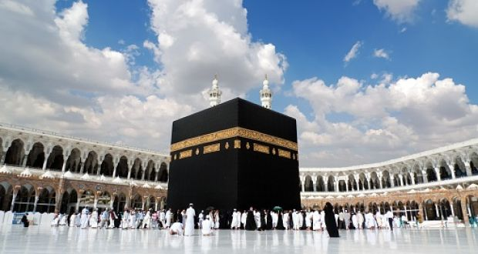
The First Muslims

Slide 2
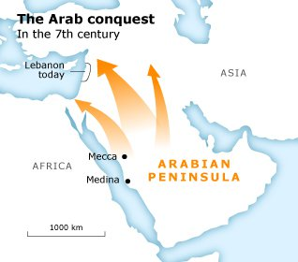
The Arab People of the Arabian Peninsula
Nomadic people known as Arabs arose in the Arabian Peninsula and began spread their influence in the 7th century AD
The harsh environment of the Arabian Peninsula was mostly desert with few rivers and lakes
Arabs lived in individual tribes ruled by a sheikh who was chosen from one of the leading families by a council of elders
Medina
Mecca
Arabs lived as farmers, sheepherders, and later traders as they used the camel to traverse the deserts to carry goods along the Silk Road from the Indian Ocean to the Mediterranean

Slide 3
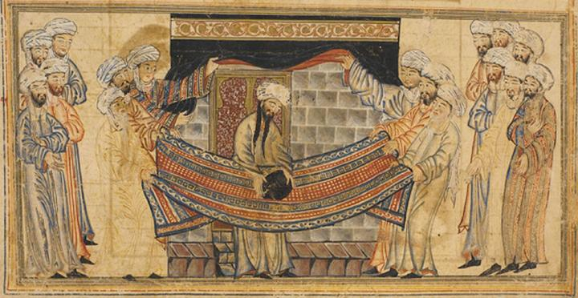
Early religion of the Arab Peoples
Arabs of the time were polytheistic with a supreme god known as Allah as well as tribal gods
All Arab tribes worshiped at a black meteorite known as the Black Stone which had been placed at a shrine called the Kaaba in the city of Mecca

Slide 4
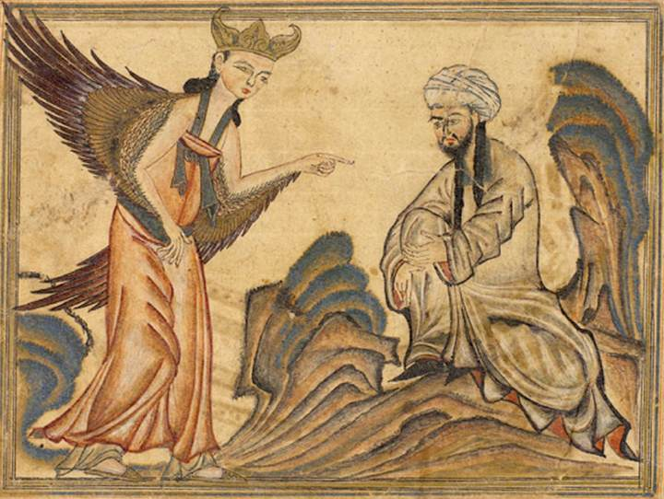
The Teachings of Muhammad
Muhammad was born into a merchant family in the year AD 570 and eventually became a caravan manager
He grew upset with the growing gap between the rich and poor as well as the greediness of Meccans
According to Islamic teachings, Muhammad received revelations from Allah through the angel Gabriel in the year AD 610
Muhammad had believed that Allah had revealed himself through Moses and Jesus and that Allah was providing his final revelations to him
He founded the religion of Islam which means “Submission to the will of Allah” with followers called Muslims

Slide 5
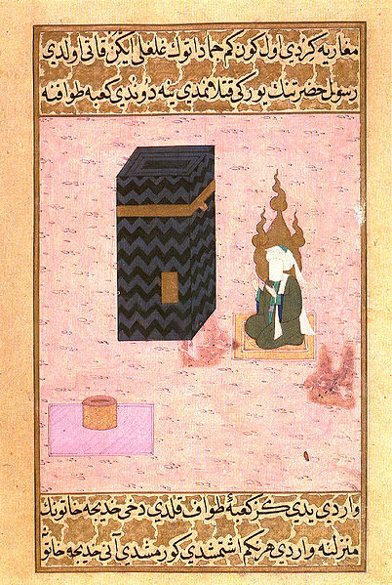

Slide 6
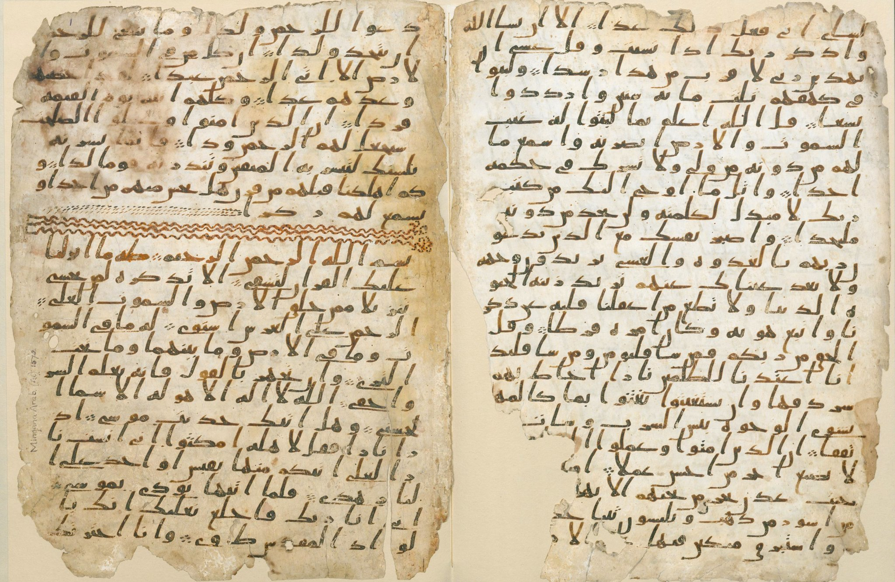
The Teachings of Muhammad
The revelations were written down in the holy book of Islam, the Quran
After facing persecution for his beliefs, Muhammad and his followers traveled to the city of Medina in what became known as the Hijrah
The timing of this move became the start date for the official calendar of Islam
Muhammad quickly gained more followers in Medina as well as Arabs from the desert known as Bedouin
In AD 630, Muhammad returned to Mecca with 10,00 followers and took over the city making the Kaaba a sacred shrine of Islam
This journey to Mecca became the basis for the requirement that Muslims participate in a hajj once in their lifetime

Slide 7
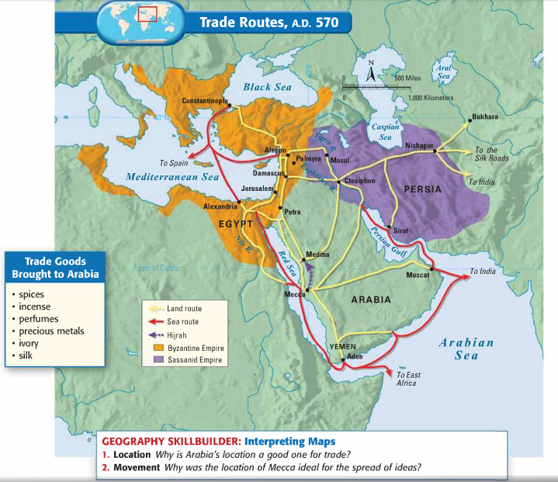

Slide 8
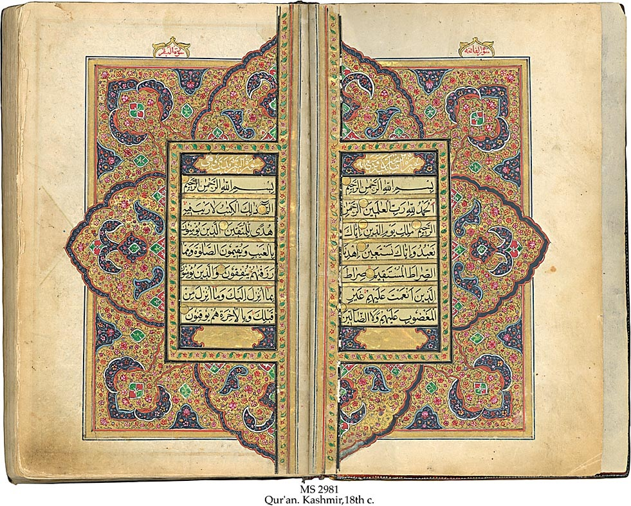

Slide 9
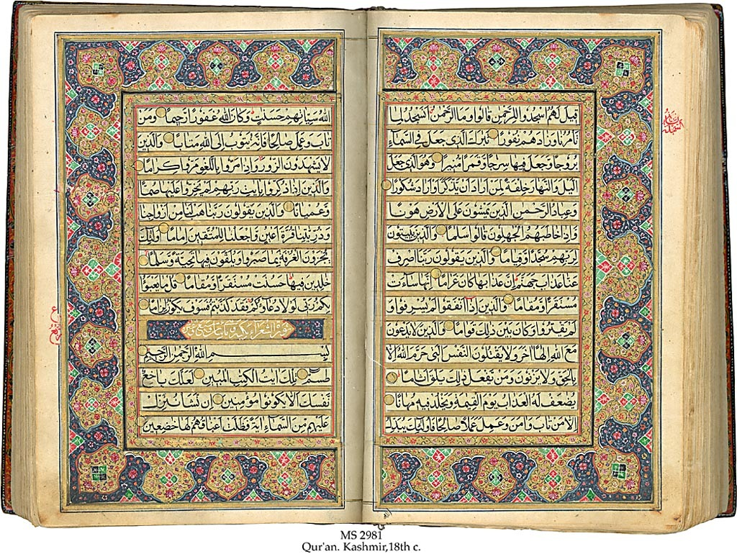

Slide 10
The Teachings of Muhammad
FIVE PILLARS
OF FAITH
Belief that there is no God but Allah, and Muhammad his Prophet
Muslims must pray, facing the holy city of Mecca, five times a day
Muslims must fast during the holy month of Ramadan
The zakat, or tax for charity, must be paid
Every Muslim (if able) must make a pilgrimage to Mecca once during their lifetime known as a hajj
Islam is a monotheistic religion
Allah is considered the all-powerful being who created the universe
Islam emphasizes salvation and offers hope in the afterlife
Muhammad is considered a prophet rather than a divine person
Muslims adhere to the Five Pillars of Faith

Slide 11
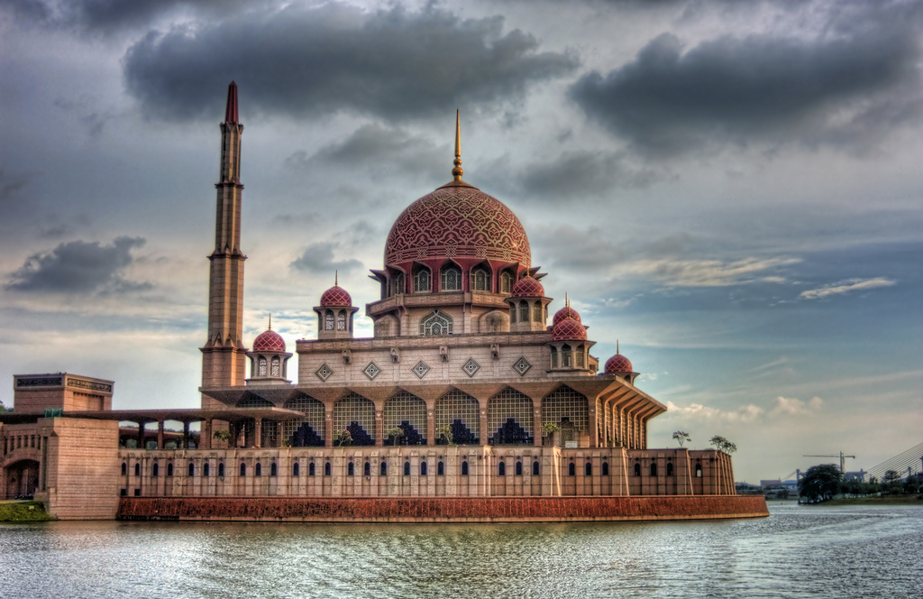
Minaret
Mosque

Slide 12
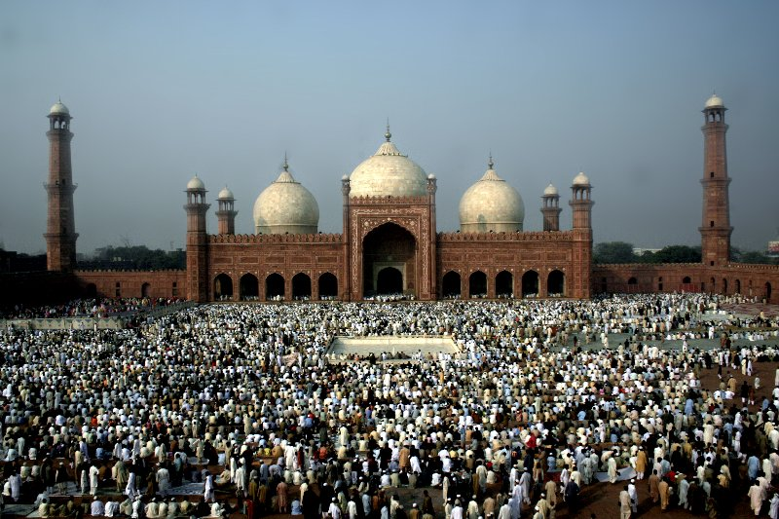
Minaret
Mosque

Slide 13
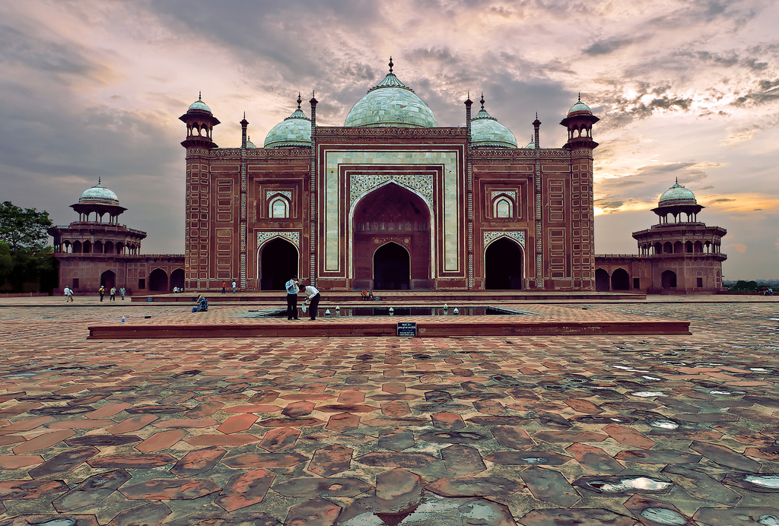

Slide 14
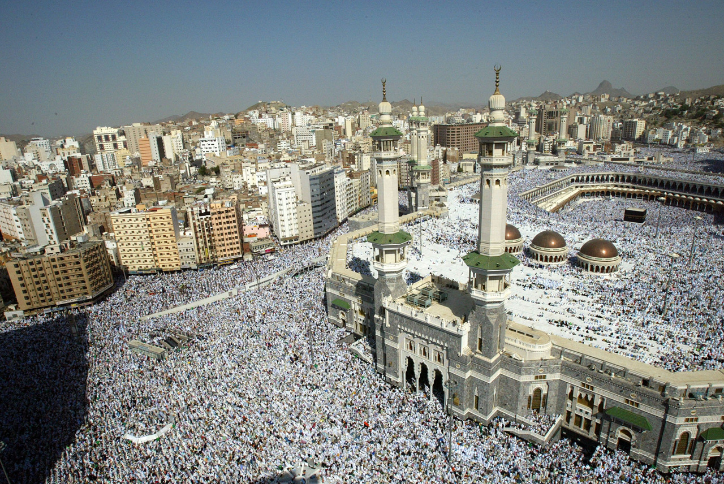

Slide 15
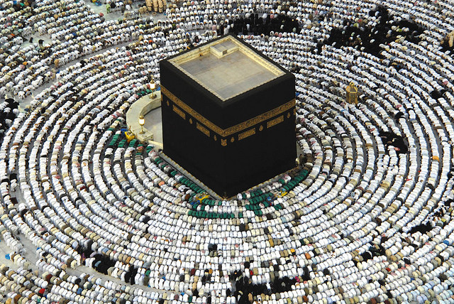

Slide 16
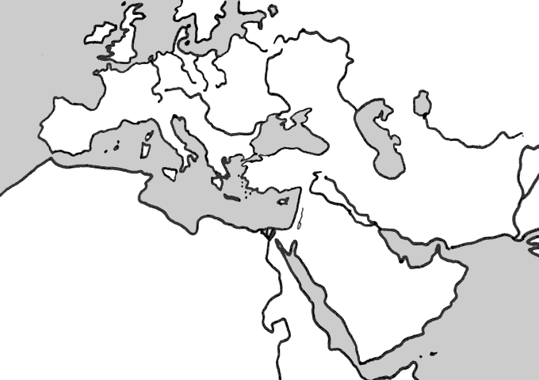
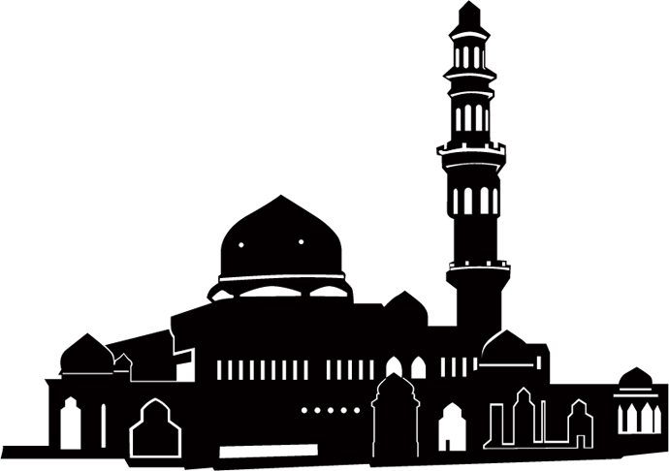
The Teachings of Muhammad
Islam is a _______________________ religion
____________ is considered the all-powerful being who _____________________________________
Islam emphasizes _____________________________ ________________________________________________
Muhammad is considered a __________________, similar to Moses, rather than a divine person
The _______________ consists of _______ chapters and is the ______________________________________
Describe shari’ah.
Map above: Label the Arabian Peninsula, Mecca, and Medina and draw Muhammad’s hajj in AD 610
Image below: Label the two parts of a Muslim place of worship
FIVE PILLARS OF FAITH
______________
___________________

Slide 18
The Arab People of the Arabian Peninsula
______________ people known as ____________ arose in the Arabian Peninsula and began spread their influence in the ____________________
Why was the environment of the Arabian Peninsula so harsh?
Describe Arabian societies.
Medina
Mecca
Arabs lived as ____________, _________________, and later as ____________ as they used the ____________ to traverse the deserts to carry goods along the _________________ from the Indian Ocean to the Mediterranean

Slide 19
Early religion of the Arab Peoples
What was the religion of the early Arabs like?
All Arab tribes worshiped at a black meteorite known as the ________________ which had been placed at a shrine called the ________ in the city of __________

Slide 20
The Teachings of Muhammad
Describe the life of Islam’s founder, ___________________
According to Islamic teachings, Muhammad received ___________________ _____________________________ _____________________________
Muhammad had believed that Allah had revealed himself through __________ and ____________ and that Allah was providing his final revelations to him
He founded the religion of __________ which means:

Slide 21
The Teachings of Muhammad
The revelations were written down in the holy book of Islam, the ______________
What happened after Muhammad and his followers faced persecution for their beliefs?
What is this date important in Islam?
Muhammad quickly gained more followers in Medina as well as ________________________ ________________________________
What happened in AD 630?
This ________________________ became the basis for the requirement that Muslims participate in a ________ at least once in their lifetime

Slide 22
The Teachings of Muhammad
FIVE PILLARS
OF FAITH
Belief that there is no God but Allah, and Muhammad his Prophet
Muslims must pray, facing the holy city of Mecca, five times a day
Muslims must fast during the holy month of Ramadan
The zakat, or tax for charity, must be paid
Every Muslim (if able) must make a pilgrimage to Mecca once during their lifetime known as a hajj
Islam is a monotheistic religion
Allah is considered the all-powerful being who created the universe
Islam emphasizes salvation and offers hope in the afterlife
Muhammad is considered a prophet rather than a divine person
Muslims adhere to the Five Pillars of Faith

Slide 23
