Slide 1
Philippine – American War
Political Cartoons

Slide 2
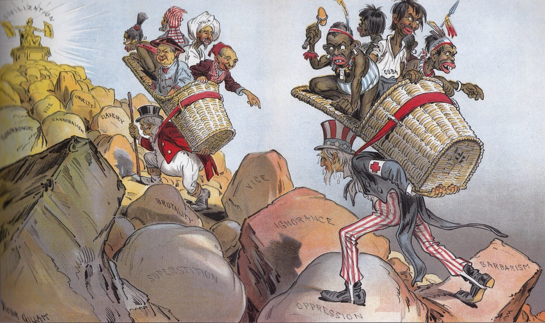
Example 1: Judge, 1899

Slide 3
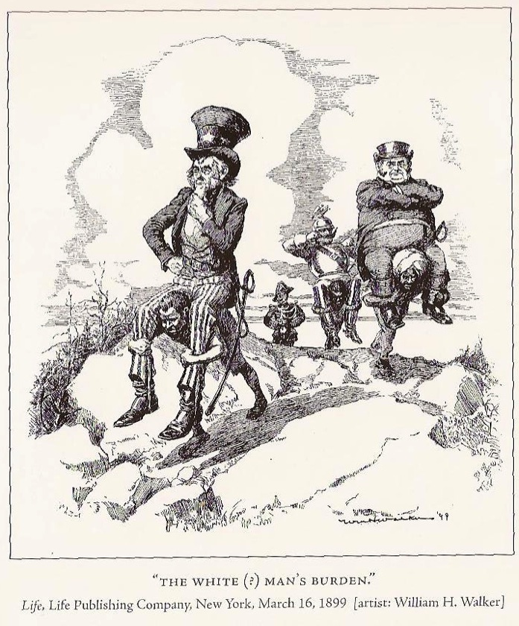
Example 2: Life, 1899

Slide 4
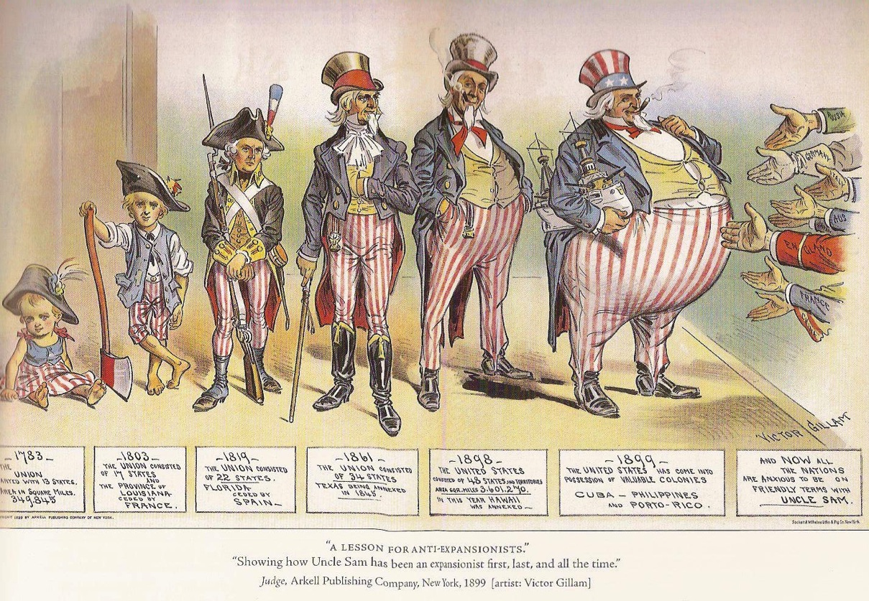
Set A: Cartoon 1 Judge, 1899

Slide 5
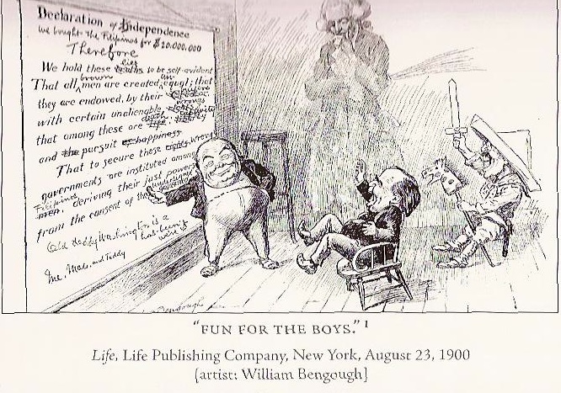
Set A: Cartoon 2 Life, 1900

Slide 6
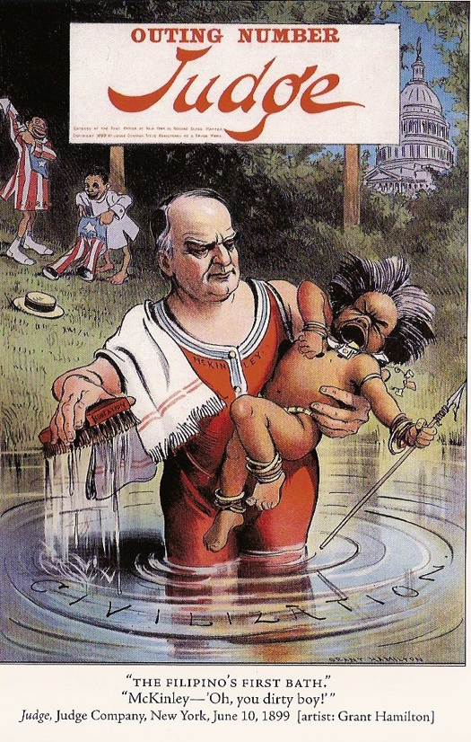
Set B: Cartoon 1 Judge, 1899

Slide 7
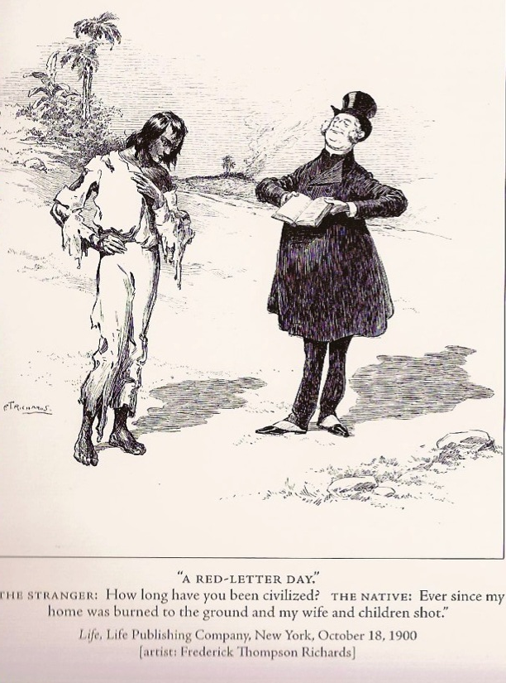
Set B: Cartoon 2 Life, 1900

Slide 8
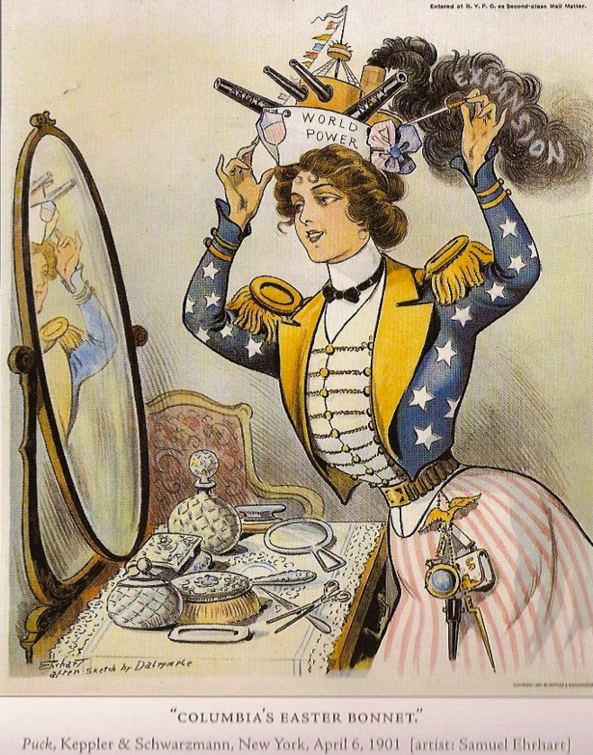
Set C: Cartoon 1 Puck, 1901

Slide 9
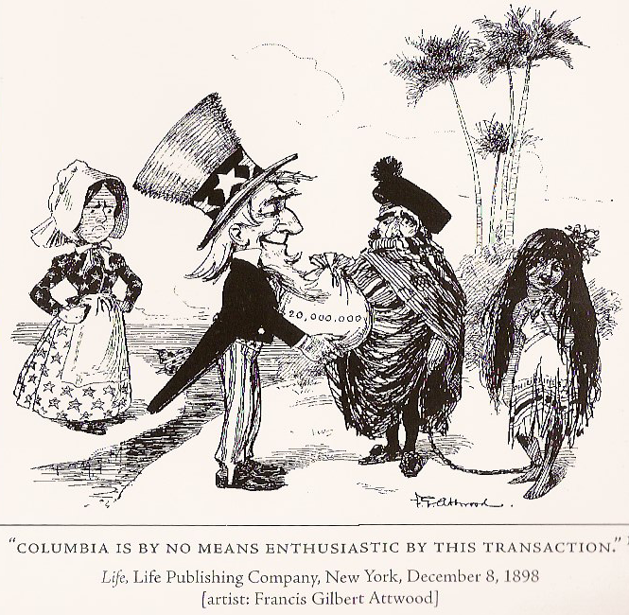
Set C: Cartoon 2 Life, 1898

Slide 10
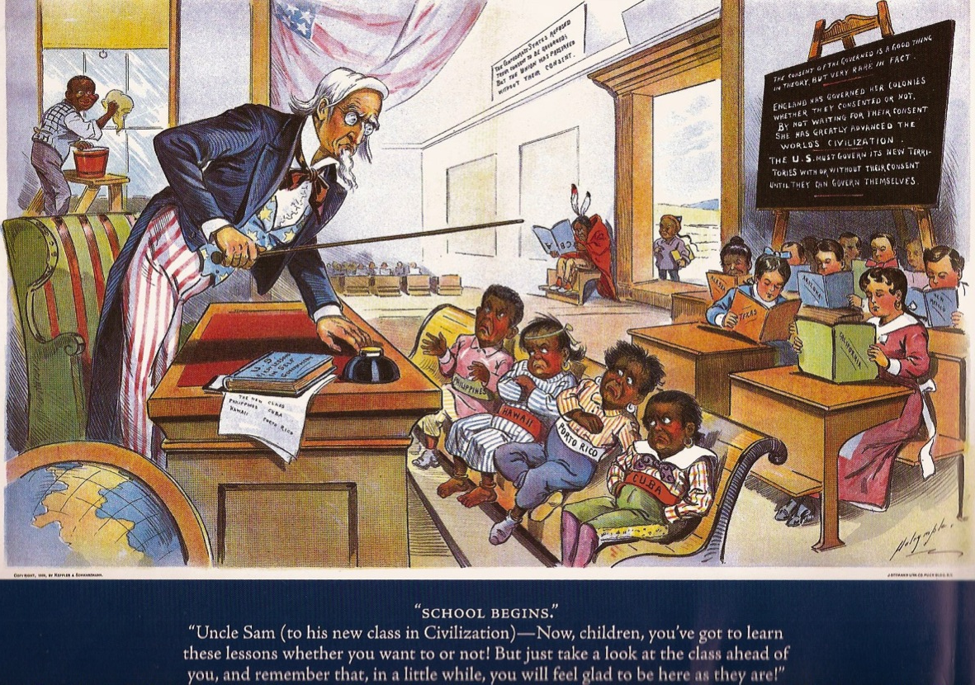
Set D: Cartoon 1 Puck, 1899

Slide 11
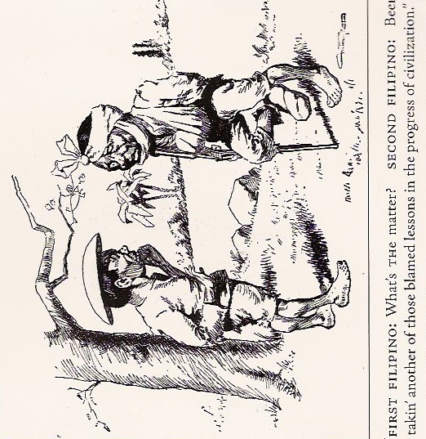
Set D: Cartoon 2 Life, 1899

Slide 12
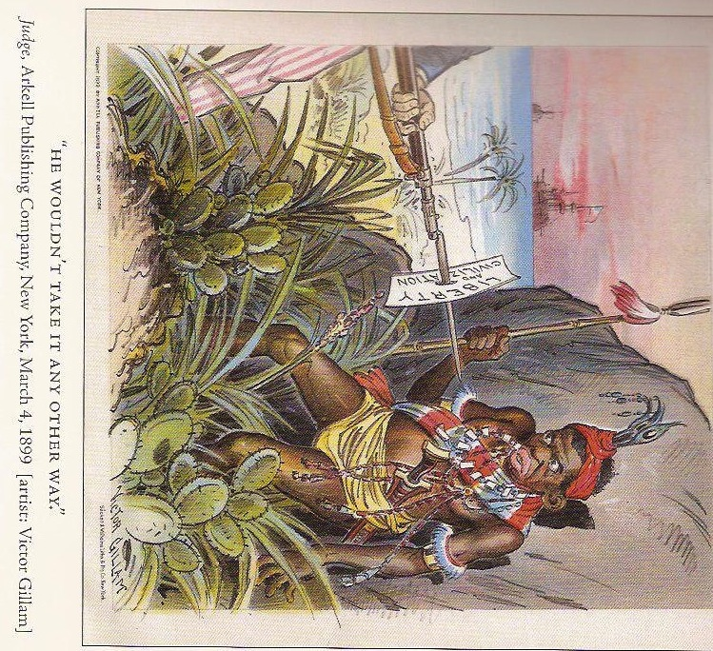
Set E: Cartoon 1 Judge, 1899

Slide 13
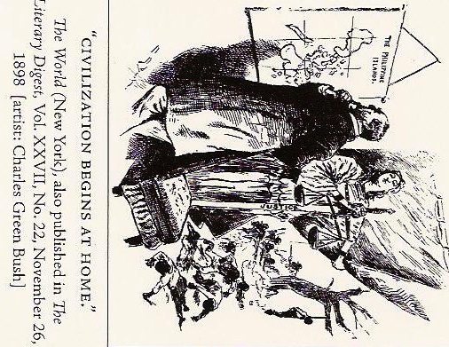
Set E: Cartoon 2 The World, 1898

Slide 14
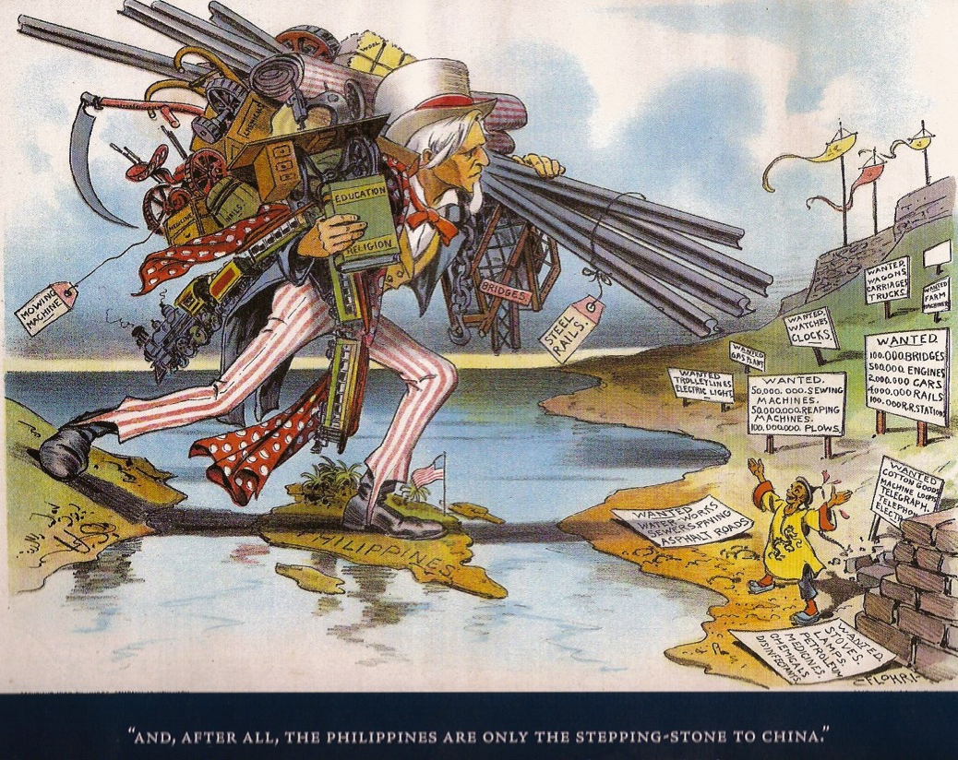
Set F: Cartoon 1 Judge, 1900

Slide 15
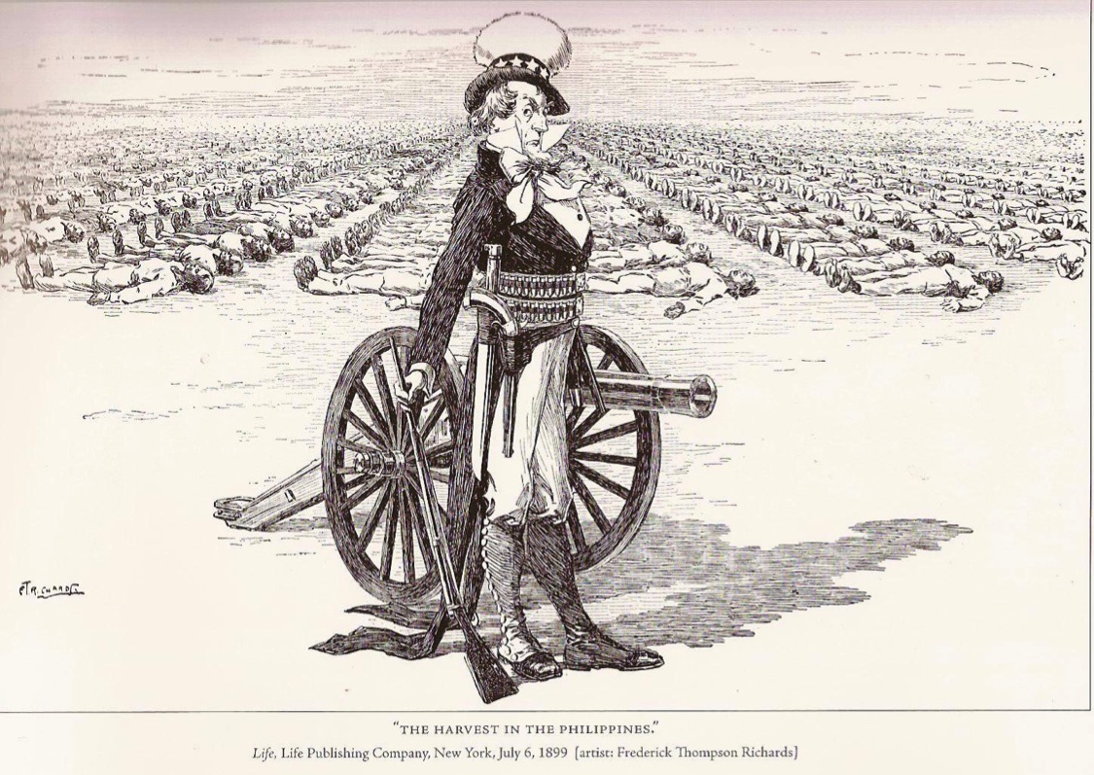
Set F: Cartoon 2 Life, 1899

