Slide 1
The Protestant Reformation

Slide 2
Bell Ringer
What root words do you see?
PROTESTANT REFORMATION

Slide 3
Bell Ringer
PROTESTANT
REFORMATION
http://www.youtube.com/watch?v=kDXwsuRxzo4

Slide 4
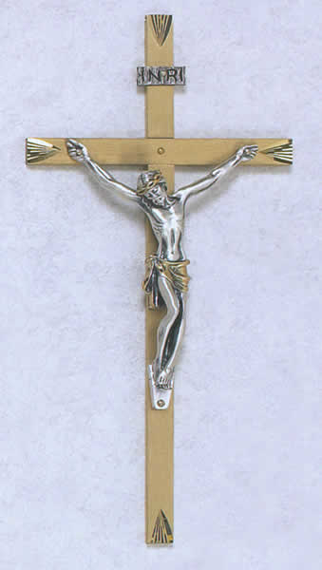
What is the Protestant Reformation?
The name given to the religious reform movement that divided the western Church into Catholic and Protestant groups.
VS.

Slide 5
Northern Renaissance
As the Renaissance moved Northward, so did its ideals
Christian Humanism (aka Northern Humanism)
Goal - reform the Catholic Church

Slide 6
Christian Humanism
To change society, must 1st change humanity
Human beings able to reason & improve selves
Reading for selves = more pious (having strong religious feelings)
Inner piety reform of church & society

Slide 7
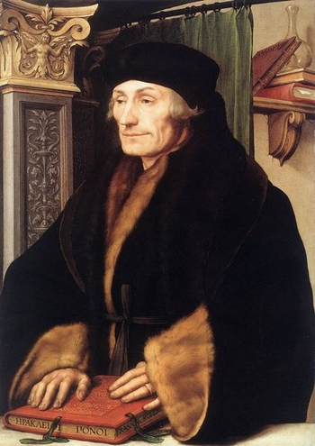
Erasmus
“the Philosophy of Christ”
Christianity should:
show people how to live good lives
not just give a set of beliefs to follow
focus inward
In other words…

Slide 8
The Church should “walk the walk” not just “talk the talk!”
NO!
YES!

Slide 9
Erasmus’ Egg
Reform NOT Break
Ideas laid foundation
“Erasmus laid the egg that Luther hatched”
Luther

Slide 10
Reasons for the Reformation
Commoners believed that upper levels of church were wealthy & oppressive
Smaller autonomous cities/republics wanted to run own affairs in a modern way (church = too feudal & old)
Monarchy – rid kingdom of Church taxes, property, and political influence & take them as their own

Slide 11
Reasons for the Reformation (cont.)
Clerical immorality – violated celibacy & accused of drunkenness, gambling, and other vice
Clerical ignorance – many barely read or write
Clerical absenteeism and pluralism – esp. higher level officials – often absent and held more than one office at a time (often purchased their office)

Slide 12
How to Attain Salvation
People’s spiritual needs - not met
Main concern - salvation (“How do I get to Heaven?!”)
Church answers:
Veneration of relics
Obtaining indulgence

Slide 13
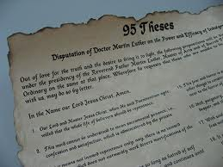
What is an Indulgence?
The release from all or part of the punishment for sin in (a place between Earth & afterlife where one “serves time” for their sins & is purified. Time spent here is directly proportional to the number & severity of sins committed in one’s life.)
Luther opposed sale of them
http://www.youtube.com/watch?v=WiSCnZ4wSMo

Slide 14
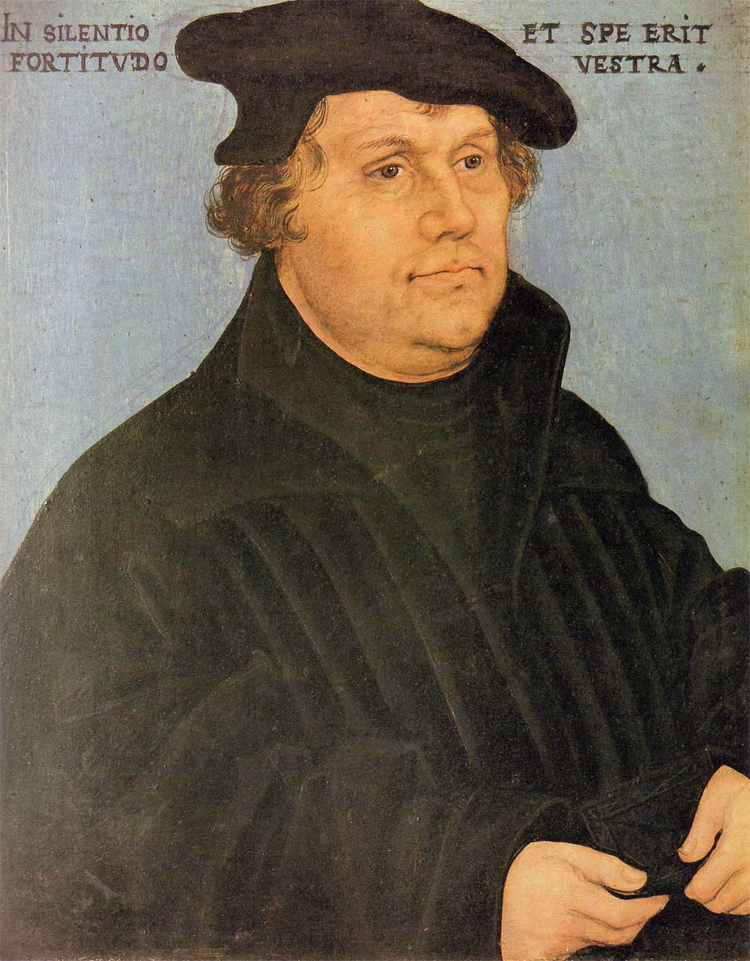
Martin Luther
Monk & professor of theology
Wittenberg, Germany
Conflicted by the difference in Catholic teachings/practices vs. what was said in the Bible

Slide 15
They Said - He Said
To Obtain Salvation…
They (Church) said: must have faith AND do good works
He said: faith in God alone will earn one salvation (key teaching known as “justification by faith alone”)
Luther’s theory based on Bible - became the sole source of religious truth to Protestants

Slide 16
Luther’s 95 Theses
October 31, 1517
Nailed to door of church in Wittenberg
95 Theses - spelled out the abuses of the Church
Printing Press - HUGE impact on Reformation - Why?

Slide 17
Backlash
Did NOT intend to break with Church - just wanted REFORM
Church wants him to recant (take back) his criticisms
Luther says…NO
Result -
Luther is excommunicated & defrocked (banned from the church & stripped of his position) in 1521
Angers not only the Pope, but Charles V - Holy Roman Emperor

Slide 18
The Diet of Worms
IS NOT a means of obtaining nutritional sustenance from eating nothing but those little squiggly things in your garden…
IS a legislative assembly of the Holy Roman Emperor in the German city of Worms (pronounced Vuhrms)
http://www.youtube.com/watch?v=r5P7QkHCfaI

Slide 19
Edict of Worms
Made Luther an outlaw
All Luther’s works to be burned
Luther to be captured & turned over to Charles V

Slide 20
Peasant Revolts
June, 1524
Luther “disappeared” - the worst was rumored
Peasants revolted against nobility & clergy (thought Luther would approve)
Imperial army retaliated
100,000 peasants dead

Slide 21
Happy Ending??
German Princes united under Luther (benefit = autonomy from HRE)
1555- Peace of Augsburg (treaty)
Charles V conceded to formally accept the division of Christianity in Germany
German princes could choose the faith of their state (not an individual choice)

Slide 22
Major Contributions of Luther & the Reformation
Translation of the Bible into German
Opened door to religious freedom
Abolition of vows of celibacy for Protestant clergy
Caused Catholic Church to consider reforms

Slide 23
Why Did Lutheranism Spread?
Many saw Luther’s reforms as the answer to church corruption
Throw off the rule of the RCC and HRE
Welcomed the chance to seize church property
Tired of German $ going to support churches in Italy

Slide 24
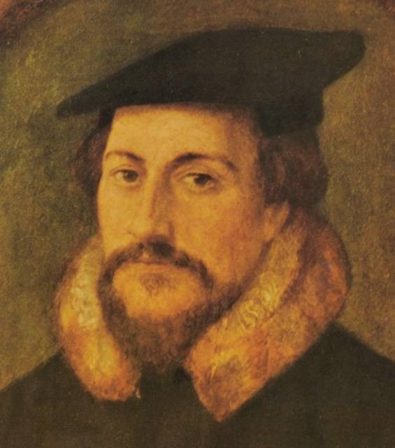
Calvinism
John Calvin - founder
Doctrine of justification by faith alone
Predestination - God had determined in advance those who would be saved and those who would not

Slide 25
Calvin’s Reforms
I can’t dance?
Geneva
The Consistory
Special court
Enforced moral discipline
Oversaw morality
Punished deviants
Crimes = singing obscene songs, dancing, swearing, drunkenness, playing cards
But I like this song!!!…

Slide 26
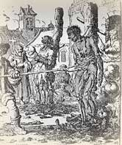
Anabaptists
“Re-baptizer”
A radical adult Christian group that believed:
All believers equal
Any member could be minister
Complete separation of Church & State
Persecuted by both Catholics & Protestants
Today - Mennonite & Amish

Slide 27
Anti-Semitism
Jews continued to be persecuted against during the Reformation
Luther - expected Jews to convert (called for persecution when they did not)
In Catholic states - Jews segregated into ghettos

Slide 28
The Catholic Reformation
Protestantism spreading rapidly through Europe
Church sees need to reform
Pillars of Catholic Reformation
1. Society of Jesus (Jesuits)
Ignatius of Loyola, began missions to restore Church
2. Reform of Papacy – started by Pope Paul III
3. Council of Trent – met off & on for 18 years
Reaffirmed traditional Catholic beliefs
Included the 7 sacraments & faith and good works
Banned selling indulgences!

Slide 29
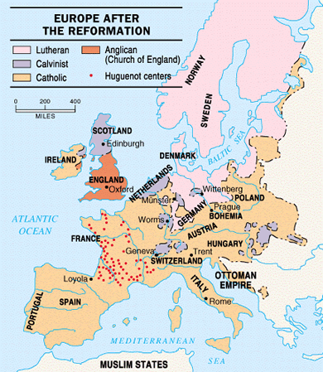

Slide 30
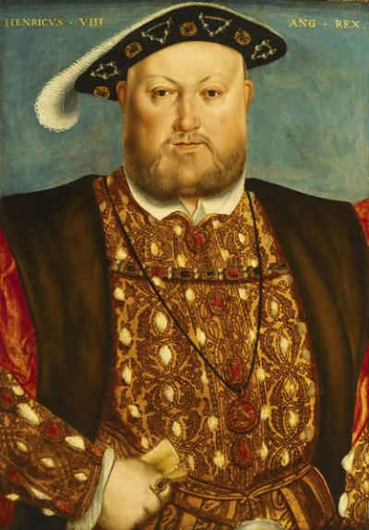
Reformation in England
Political, not religious motives for reform
Henry VIII – King of England
Needs a male heir to carry on
the Tudor Dynasty
Married Catherine of Aragon
(Aunt of Charles V,HRE Emperor)
Have a daughter, Mary
No son, so Henry wants a divorce!
In the Catholic Church, you
need an annulment, granted by the
Church. The Pope grants it for a King.

Slide 31
Reformation in England (cont)
The Pope refused to grant the annulment, too political (King of Eng vs. HRE Emperor)
After a long argument, Henry decided to break from Catholic Church
Archbishop of Canterbury granted divorce
Act of Supremacy(1534) est. Church of Eng.
King control over doctrine, appointments, etc
Dissolves Catholic claims, sells land & possessions
Remained close to Catholic teachings

Slide 32
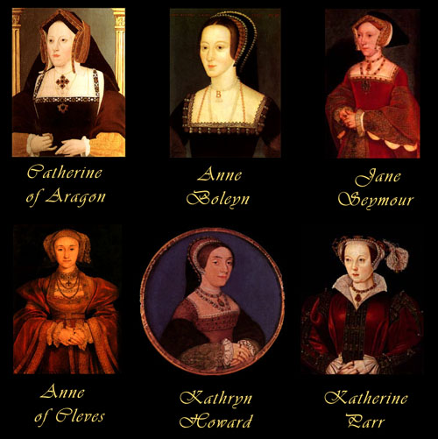
Henry & his wives
Henry was desperate for a son. So much so he married 6 times!!
The saying goes…
Divorced, Beheaded, Died
Divorced, Beheaded, Survived

Slide 33
The Church of England
1547 – Henry died
His 9 year old son, Edward VI, took the throne
The Church of England- aka Anglican Church
Became more Protestant
Angering Catholics
1553 – Edward dies
His half-sister Mary (Catholic) takes throne
She wants to restore Catholicism
“Bloody Mary” has 300+ Prot burned as heretics
Increases tensions btw Cath & Prot

