Slide 1
The Progressive Era
Outcome: Progressive Presidential Leadership

Slide 2
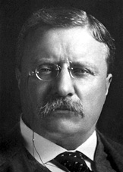
Theodore Roosevelt

Slide 3
Theodore Roosevelt
Theodore Roosevelt (1858-1919)
Childhood
Born into extreme wealth in New York City
Started out weak & in poor health
Had severe asthma (not expected to live past age 5)
Would partially lose sight in boxing mishap
Father stressed physical fitness (built him a gym)
Lifelong advocate of sports and mental activity
Educated by tutors
Graduated from Harvard, which he entered at age 17

Slide 4
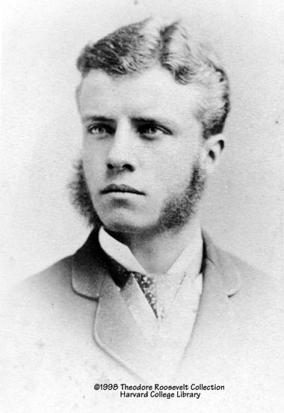
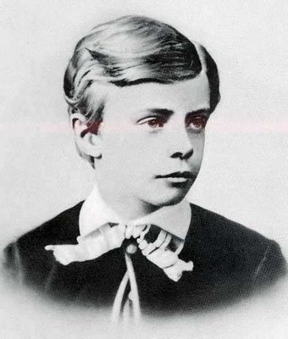
Young Teddy

Slide 5
Theodore Roosevelt
Personal Life
Father died while TR was at college (heartbroken)
In 1884 his wife and his mother died on the same day
Baby daughter = Alice
1884-1886 (The Grieving Period)
Went to live in Dakota Badlands
Became a respected rancher & conservationist
1886- married childhood sweetheart (Edith) & had 5 more kids.

Slide 6
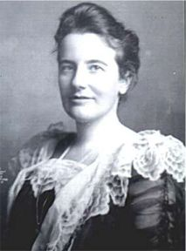
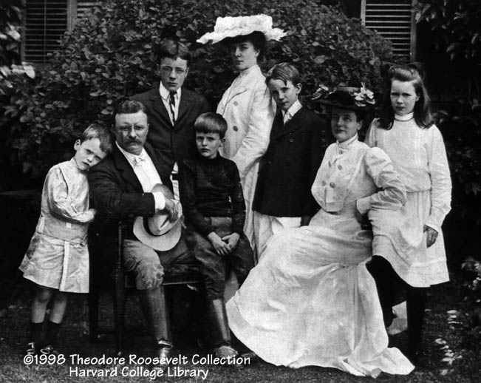
Edith Roosevelt

Slide 7
Theodore Roosevelt
Early Career
Elected to the New York State Legislature at age 24
Became a police commissioner in NYC
Became Assistant Secretary of the Navy in 1897
Quit in 1898 to fight in the Spanish-American War in Cuba
Famous for leading his “Rough Riders” up San Juan Hill
Due to this war, the US acquired Guam, the Philippines, and Puerto Rico
Became (R) Governor of New York in 1899
Attacked corruption and made many enemies
Made a name as a progressive reformer

Slide 8
Theodore Roosevelt
Road to Presidency
1900 – Chosen as McKinley’s V-P running mate
New York’s Conservative (R’s) supported his nomination
Felt safe w/TR in this “do-nothing” job. (Harmless)
1901- McKinley was shot and killed; TR becomes president at age 42

Slide 9
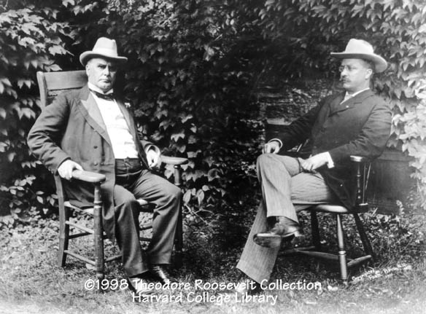
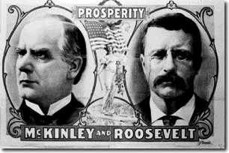
McKinley & Roosevelt

Slide 10
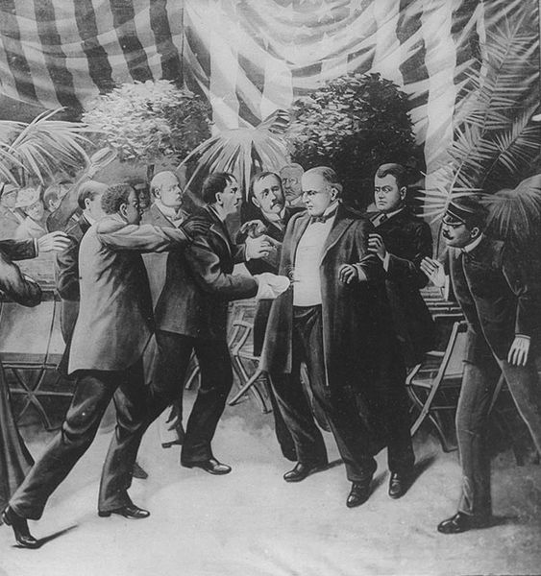
McKinley Assassination
McKinley was shot twice by Leon Czolgosz
Leon Czolgosz was an anarchist
McKinley died 8 days later
Teddy Roosevelt became the next president

Slide 11
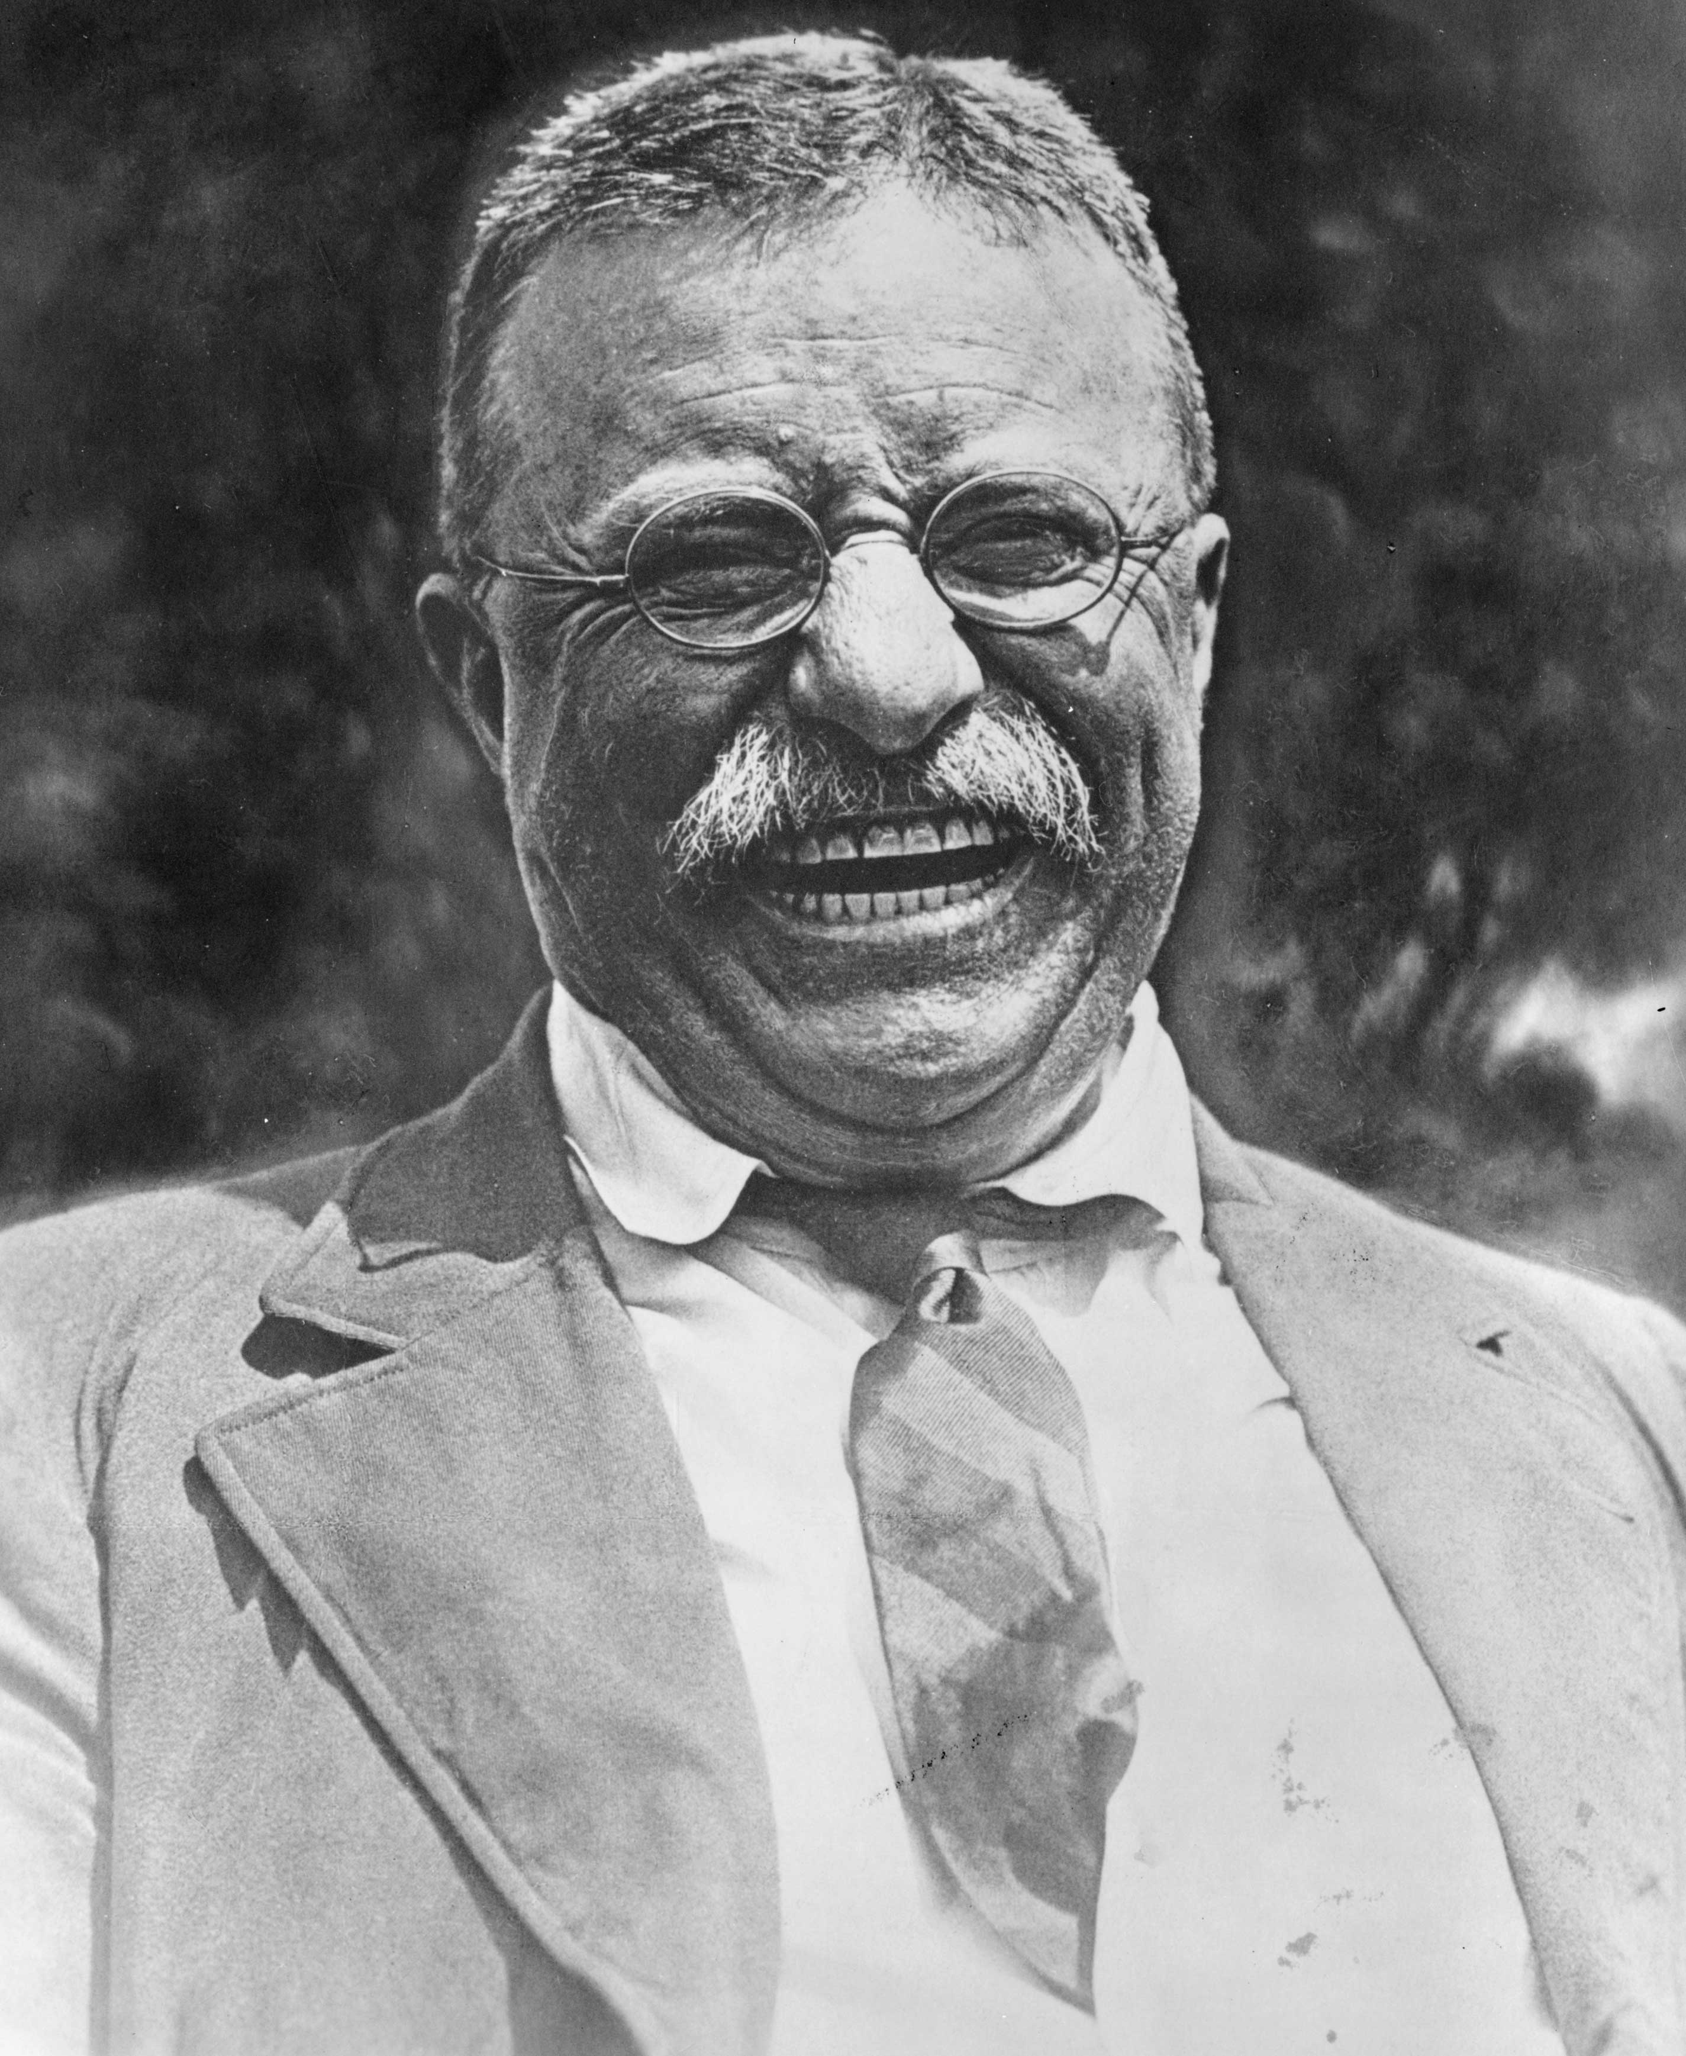
Theodore Roosevelt
Presidential Style
Playful, fun, dramatic, loved the press and the public
Expanded presidential power and controlled Congress
“Big Government” is needed to regulate “Big Business”

Slide 12
Theodore Roosevelt
The Square Deal: Program for helping the common man
Some said he was a “traitor to his own class”
Settled Coal Strike of 1902
TR forced owners to negotiate with the union
TR threatened to use the army to run the mines
Workers made gains with government on their side (rare)

Slide 13
Theodore Roosevelt
Worked to break up monopolies & end special privilege
Nickname: “trust-buster”
Used Sherman Anti-Trust Act to break up the Northern Securities railroad monopoly (JP Morgan)
Started suits against Standard Oil and U.S. Steel
Signed Elkins Act ending railroad rebate practice

Slide 14
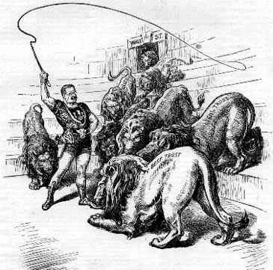
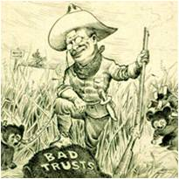
“Trust Buster”

Slide 15
Theodore Roosevelt
Social Legislation
Pushed passage of health laws (influenced by Upton Sinclair)
Ex: Meat Inspection Act & Pure Food & Drug Act
Conservation – set aside 240 million acres as protected public lands

Slide 16
Theodore Roosevelt
Foreign Affairs
1906- Won Nobel Peace Prize for mediating Russo- Japanese Peace
Big Stick Diplomacy- “Speak softly and carry a big stick”
Keep peace through power & preparedness
Sent “Great White Fleet” on world tour as show of US strength
TR was a “Warrior without a war”
Created Roosevelt Corollary to the Monroe Doctrine
Freed Panama from Colombia to secure land needed to build the Panama Canal (TR’s “Big Ditch” opened in 1914)

Slide 17
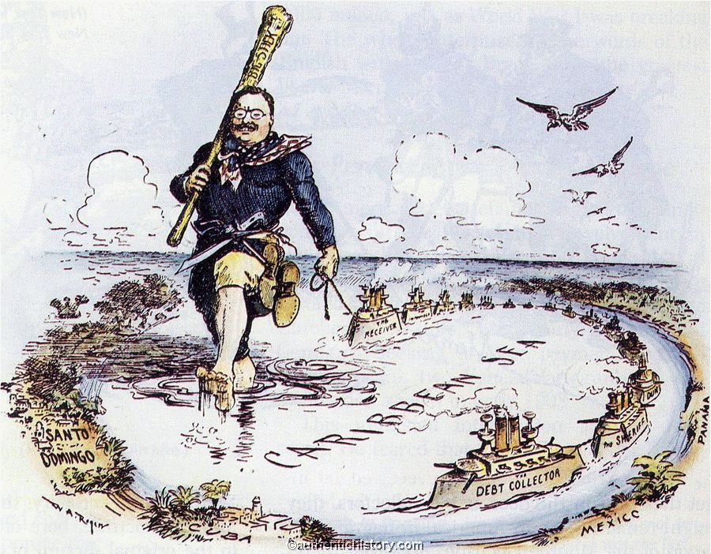
Big Stick Diplomacy

Slide 18
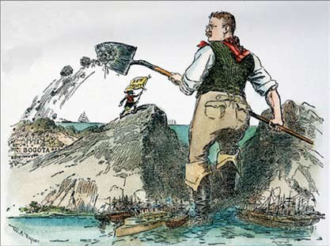
Panama Canal

Slide 19
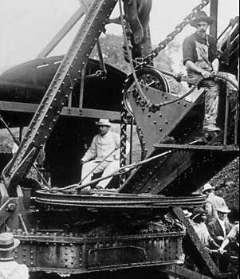
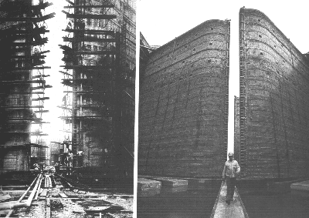
Panama Canal

Slide 20
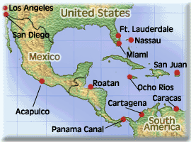
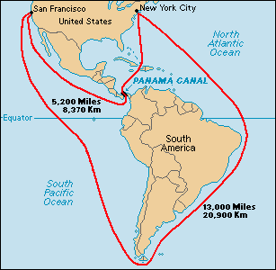
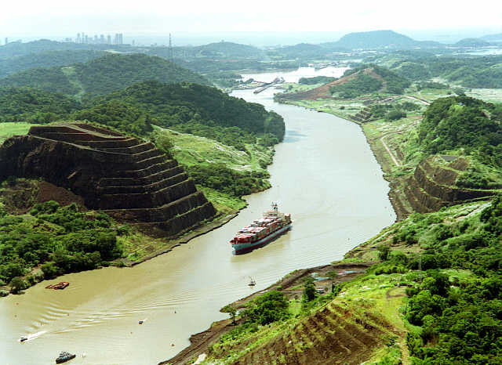

Slide 21
Theodore Roosevelt
Life after Presidency
1909- TR is replaced by close friend William H. Taft and travels the world
TR was only 50 and not ready to quit politics
1912- Tried to run as Progressive “Bull Moose” candidate but fails
1914-1917- TR encourages US entry into WWI even offering to fight
1919- TF died while preparing to run in 1920 election

Slide 22
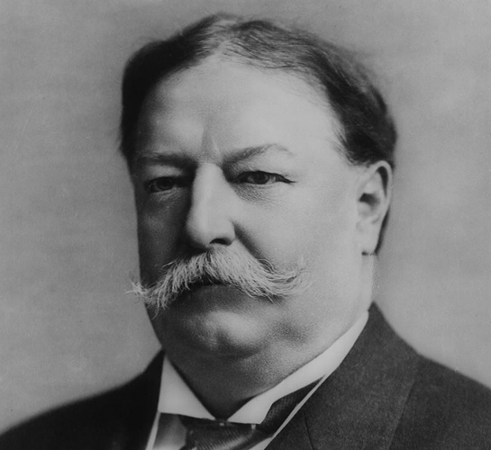
William H. Taft

Slide 23
William H. Taft
William H. Taft (1857-1930)
Childhood & Early Life
Born into wealthy Ohio family
Admired his father ---> lawyer, judge, Attorney General, Sec. of War
Educated in law at Yale University
Dream ---> to become Chief Justice of the US Supreme Court

Slide 24
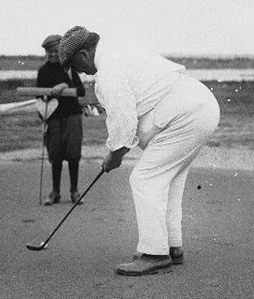
William H. Taft
The Man
Physically large
Honest, loyal, no vices
Poor speaker, lacked tact, and procrastinated

Slide 25
William H. Taft
Road to Presidency
1908- Hand picked by TR as successor
Doubted his own qualifications (driven by wife’s ambitions)
Supported at first; TR believed Taft would continue his reforms
Taft would prove himself more conservative than TR or Wilson

Slide 26
William H. Taft
Successes as President (R) 1909-1913
Added more land to public parks & forests (not as much as TR)
Broke up more than 90 monopolies, including Standard Oil in 1911
Set up the Dept. of Labor & Bureau of Mines to protect workers
Supported the passage of the 16th and 17th Amendments
Established the 8 hour day for government workers

Slide 27
William H. Taft
Caused Split Between Progressives & Conservative Republicans
Signed Payne-Aldrich Tariff Act ---> raised tariffs
Pleased big business
Angered progressives and especially farmers
Appointed a Secretary of the Interior who:
Favored industrial development of wilderness area
Was slow to preserve public lands
TR became his #1 critic

Slide 28
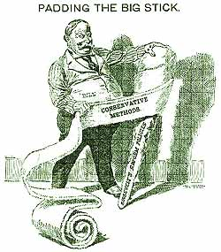
Taft Was More Conservative

Slide 29
William H. Taft
Election of 1912 (3-Way Race)
Progressive (R’S) supported TR & Conservative (R’s) supported Taft
Taft wins the (R) nomination
TR forms Progressive Bull Moose party (split weakens R party)
(D) Woodrow Wilson is elected and TR is labeled “the spoiler”
1921- named Chief Justice of the Supreme Court by President Harding
Served until 1930
Considered it the “greatest honor” of his life

Slide 30
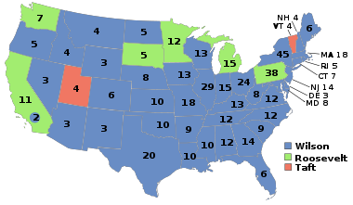
Election of 1912

Slide 31
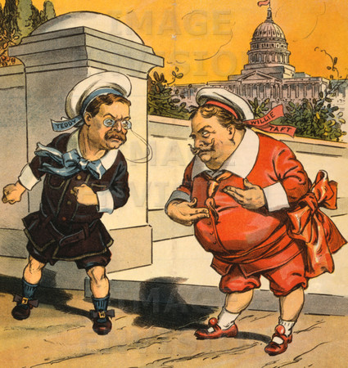
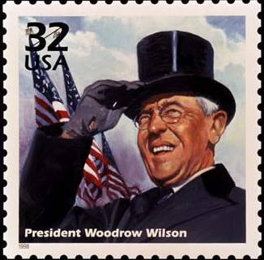

Slide 32
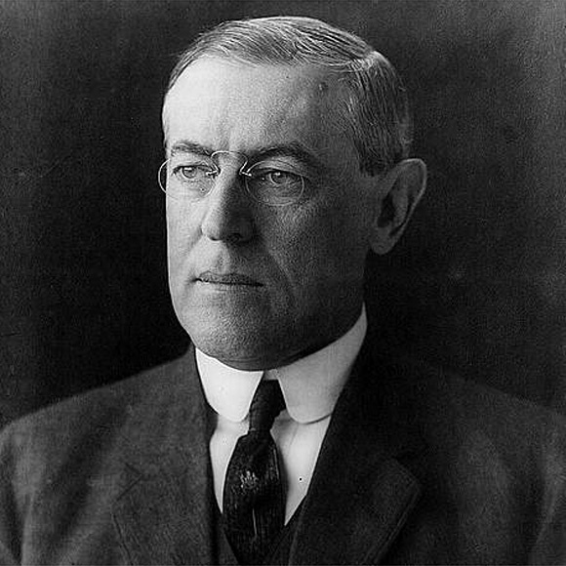
Woodrow Wilson

Slide 33
Woodrow Wilson
Woodrow Wilson (1856-1924)
Childhood
Born in Virginia to a middle –class family
Father was a minister who provided his son with a strict upbringing
Family moved often (South)

Slide 34
Woodrow Wilson
Early Career
Graduated from Princeton University in 1879
Practiced law in Atlanta for one year
Became professor of law & economics at Princeton
1902- Named president of Princeton University
1910- Elected governor of New Jersey

Slide 35
Woodrow Wilson
Presidency
Won 3-Way election of 1912
Carried 40 of 48 states, but just 40% of the vote (minority president)
Republicans would blame TR for Wilson’s victory

Slide 36
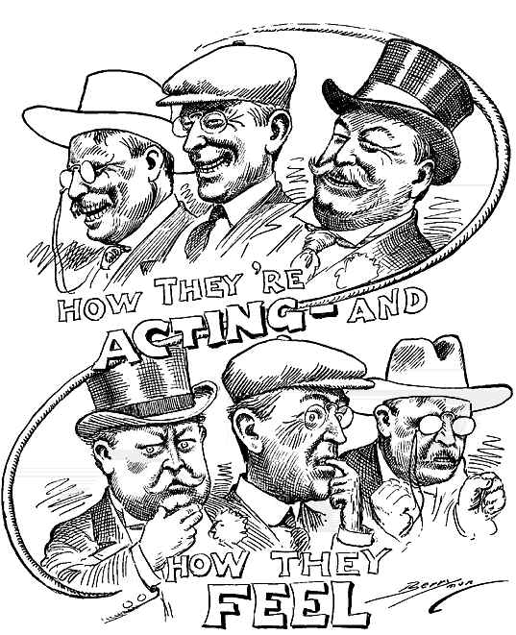
Election of 1912

Slide 37
Woodrow Wilson
Successes came under his program called New Freedom
Underwood Simmons Act (1913) lowered import tariffs
Created the Federal Reserve System to stabilize banking
Keating-Owen Act curbed the use of child labor
Federal Farm Loan Act gave farmers low interest loans
Worked for passage of Clayton Anti-Trust Act (1914) which strengthened government’s ability to break up monopolies
All 4 Progressive Era Amendments (16th, 17th, 18th, 19th) went into effect while he was president

Slide 38
Woodrow Wilson
War broke out in Europe in 1914 (later called WWI)
Wilson called for US neutrality (He was a pacifist)
1917- Entered war with reluctance, saying we must go to war to : “make the world safe for democracy”
Focus would now be on foreign affairs

Slide 39
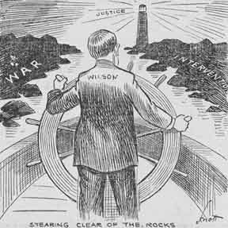
Woodrow Wilson
To Be Continued…
We will talk more about Wilson in the next two units:
World War I
The 1920s

