Slide 1
(A)
Notes:
Aug 2011 #40
Answer is #3

Slide 2
(B)
Notes:
201306 #36

Slide 3
(C)
Notes:
201208 #23

Slide 4
(D)
Notes:
200908 #40

Slide 5
(E)
Notes:
200806 #41

Slide 6
(F)
Notes:
200906 #34

Slide 7
(G)
Notes:
Aug 2007 #20

Slide 8
(H)
Notes:
200706 #22

Slide 9
(I)
Notes:
June 2005 #30

Slide 10
(J)
Notes:
200706 #34

Slide 11
(K)
Notes:
200606 #43

Slide 12
(L)
Notes:
200408 #24

Slide 13
(N)
Notes:
200206 #28

Slide 14
(O)
Notes:
200106 #39

Slide 15
(P)
Notes:
Aug 2011 #32

Slide 16
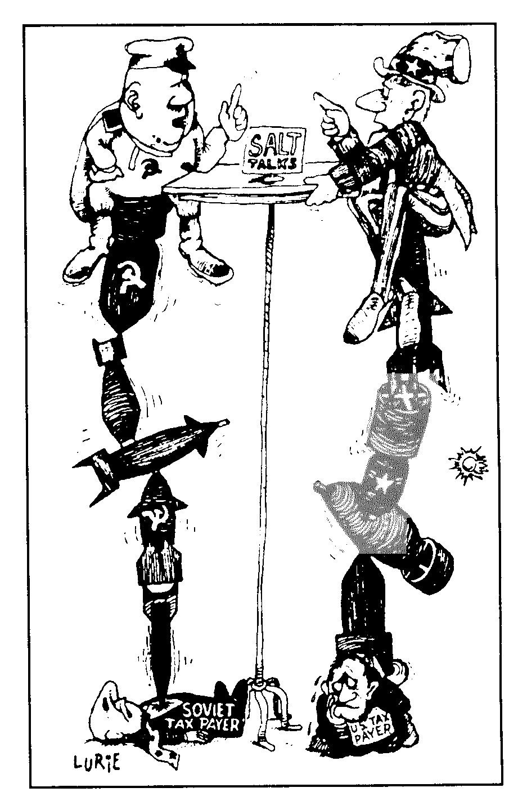
(Q)
Notes:
199908 #39

Slide 17
(R)
Notes:
June 2011 #29

