Slide 1
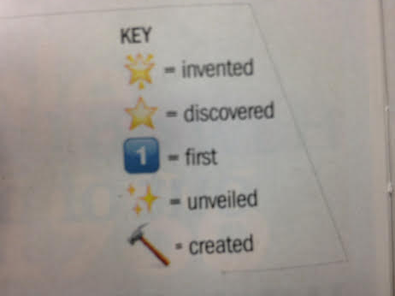
You have 5 minutes to complete as many as possible.

Slide 2
