Slide 1
Classical Civilization in the Mediterranean: Greece and Rome

Slide 2
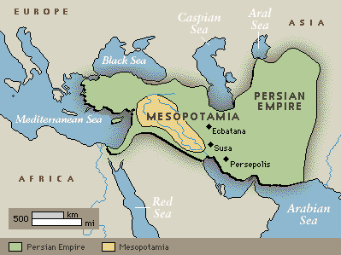
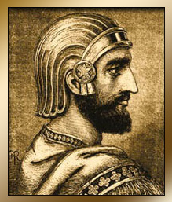
Persia
By 550 BCE, Cyrus the Great had established a massive empire from the Middle East to India
Tolerant of local customs

Slide 3
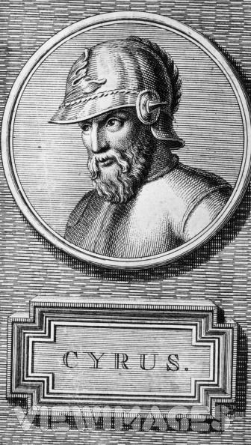
Persian Empire

Slide 4
Greece
Greeks were an indo-European people who took over the Balkan Peninsula by 1700 BCE
Early kingdom of Mycenaeans around 1400s
Kingdom in Homer’s epics about the Trojan War
Rapid rise in Greek Civilization from 800 BCE to 600 BCE

Slide 5
Indo/European Migrations

Slide 6
Greek Development
City-state concept, rather than a single political unit.
Trade and economy flourished
Alphabet based off of Phoenician alphabet

Slide 7
Greek Development
Olympic games
Athens and Sparta become the two most powerful city-states
Sparta
Strong military aristocracy dominating a slave population
Athens
Strong commercial, intellectual, and artistic state (also with slaves)

Slide 8
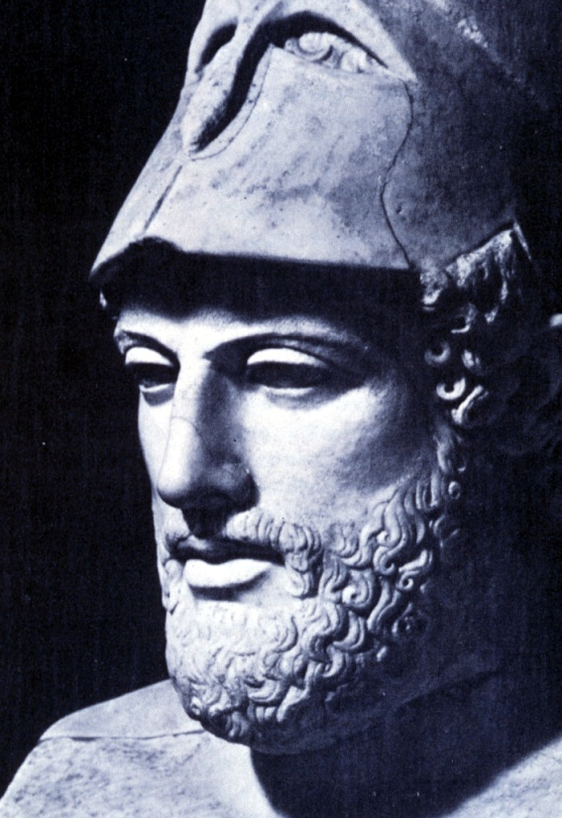
Athens and Sparta
Both city-states cooperated between 500 and 449 to defeat a huge Persian invasion
After this, Athenian and Greek civilization in general reached its zenith
In Athens, Pericles sets the model for democratic negotiation

Slide 9
Peloponnesian War
431-404 BCE
Athens v. Sparta
Sparta technically wins, but both city-states are so weak that ambitious kings from Macedonia soon conquer the cities.
Philip II of Macedon
Alexander

Slide 10
Greece at Peloponnesian War (Athens and Sparta colors are backwards!)

Slide 11
Hellenistic Empire
Alexander expands Greek influence beyond the peninsula, to…
Asia Minor
Egypt
Middle East
India
Short-lived…Alexander dies at 33 after 13 years of conquest.

Slide 12
Hellenistic Period
Greek Art and Culture merge with other Middle Eastern forms during this time period.
Trade flourished
Important scientific centers were established like Alexandria, in Egypt

Slide 13
Hellenistic Empire

Slide 14
Greek Politics
Politics comes from “polis,” Greek for “city-state.”
Citizens felt that the state was theirs…rights and responsibilities
Participation in the military too
Diversity in political forms
Unlike China’s elaborate bureaucracy

Slide 15
Greek Politics
“demos” = “the people”
Democracy
General assemblies in which all citizens could participate
Direct democracy…not elected representatives.
Met every 10 days
Only a minority were active participants

Slide 16
Greek Politics
The most widely preferred political framework centered on aristocratic assemblies
Sparta: Singularly militaristic aristocracy
Other city states were aristocratic, but not necessarily bent on the impact of the military
Aristocracy comes from Greek terms, meaning “rule of the best”

Slide 17
Rise of Rome
The Roman state begins around 800 BCE as a local monarchy in central Italy.
The monarchy is driven from power in 509 BCE and the Roman Republic was born
Extends influence over the Italian peninsula

Slide 18
Rise of Rome
Roman conquest spread quickly during the Punic Wars from 264 to 146 BCE.
Fought armies of the Phoenician city of Carthage under leadership of Hannibal
Romans seize the entire western Mediterranean along with Greece and Egypt

Slide 19
Punic Wars

Slide 20
Rise of the Roman Empire
Politics in Rome grew unstable
Julius Caesar takes power in 45 BCE
Following his assassination, Augustus Caesar takes power in 27 BCE
200 years of peace, known as Pax Romana through the reign of Marcus Aurelius in 180 CE.

Slide 21
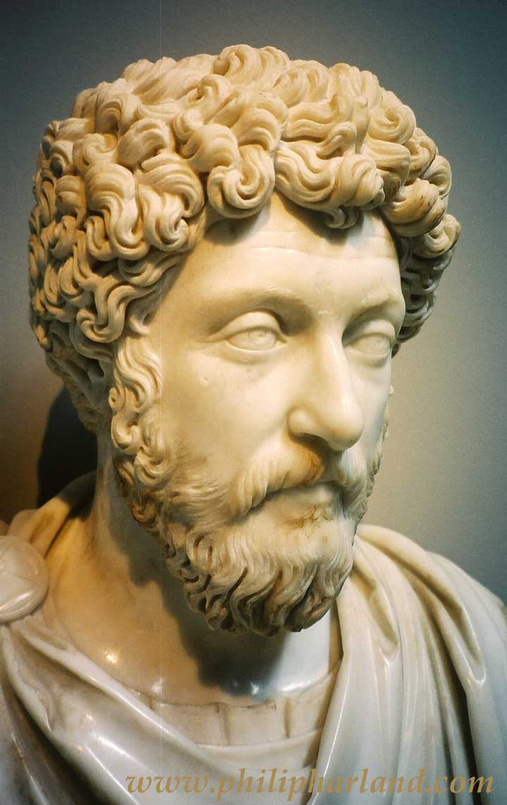
Pax Romana
Empire maintains great vigor
Spreads peace throughout the Mediterranean world
Expansion of trade, culture, arts, architecture, etc.

Slide 22
Roman Empire

Slide 23
Provinces of the Roman Empire

Slide 24
Roman Empire
Slow, decisive fall, lasting over 250 years, finally falling in 476 CE
Emperor Constantine adopts Christianity as official religion in 313 CE to attempt to unite empire
Specifically in the western half of the Roman Empire, effective government became local.
Invasions from nomadic peoples from the north
Loyalty of non-Roman army recruits were suspect

Slide 25
Roman Politics
In the Roman Republic, the constitution guaranteed that citizens would gather in periodic assemblies
To elect magistrates entrusted with the will of the common people
Legislative body was the SENATE

Slide 26
Roman Politics
Senate was comprised of mostly aristocrats
Two consuls shared primary EXECUTIVE power
In times of crisis, the senate could choose a dictator to hold emergency powers
Cicero, a Roman Senator, engaged in political theory by writing on the issues of political ethics, duties of citizens, and importance of incorruptibility.
Represents Confucianism, but with less hierarchy and obedience, or bureaucratic virtues.
During the Empire, the Roman senate became rather meaningless.

Slide 27
Roman Law
By 450 BCE the Roman Republic introduced its form of codified law, the Twelve Tables of Roman Law.
Restrain the upper classes from arbitrary action against the lower
Subject all citizens to common legal principles.
LAW takes over characteristics of families, fathers, or landlords

Slide 28
Roman Law
With citizenship in the Roman empire came full access to Rome-appointed judges and uniform laws.
Property rights
commerce

Slide 29
The Roman State
Placed great premium on military service/conquest
VAST PUBLIC WORKS
Roads/harbors (military/commerce)
Stadiums
Public Baths
Gladiator contests
Theaters
Aqueducts

Slide 30
Roman Coliseum

Slide 31
Roman Aqueducts

Slide 32
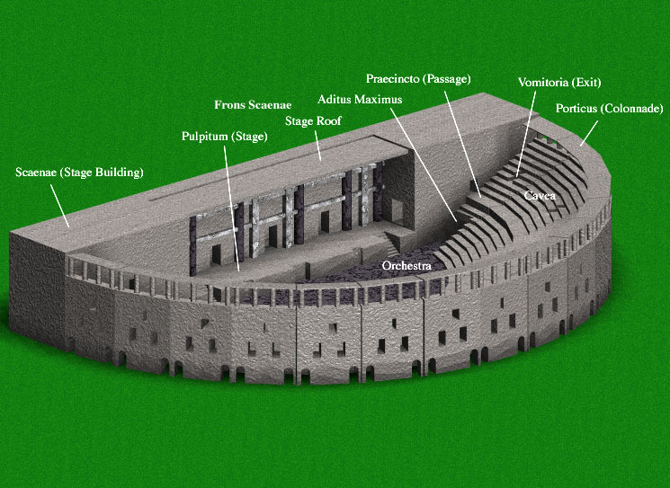
Roman Theaters

Slide 33
Roman Religion
Government sponsored official religious ceremonies etc, but were tolerant of different strains
Attacked Christianity, but only because they didn’t put they allegiance to the state first
In difference to China and India, the Romans did not create a “great world religion”

Slide 34
The Greco/Roman Economy
Substantial portion of the population were farmers (not in the cities!)
Poor soil conditions
Conversion of economy to market economy because of the wholesale production of olives and grapes.
Required substantial capital
Conquered territory to get access to grain producing fields
Sicily and Northern Africa

Slide 35
The Greco/Roman Economy
Trade with civilizations outside of the Mediterranean was less profitable…
Goods were inferior to Asian (China/Indian) goods
Most traders were foreigners from the middle east, or descendants of Phoenicians and Lydians.
Merchants had higher status in Rome (forming class underneath landed Patricians)
Merchants fare better in the Mediterranean than they did in China

Slide 36
Greco/Roman Slavery
Aristotle produced elaborate justifications for the use of slavery
Athens used slaves for housekeeping and in silver mines
Sparta uses slaves in agriculture
Rome expands use of slavery, also as tutors for children
Neither Greece or Rome were particularly interested in technological innovations.
Slave reliance impacts this…
The Mediterranean world lags behind India and China in technological innovation, which accounts for its trade imbalance with Asia

