Slide 1
OPEC
The World’s Largest Cartel

Slide 2
What’s A Cartel?

Slide 3
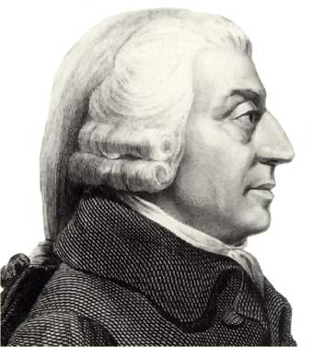
Cartels
People of the same trade seldom meet together, even for merriment and diversion, but the conversation ends in a conspiracy against the public, or in some contrivance to raise prices.
Adam Smith, The Wealth of Nations, 1776

Slide 4
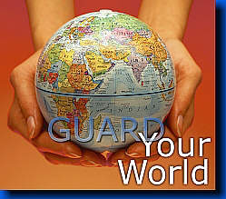
Cartels
regulate production and marketing
fix prices
limit supply
limit competition.

Slide 5
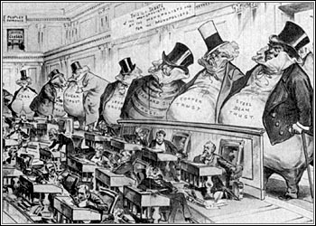
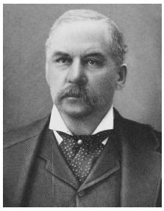
The Sherman Antitrust Act 1890 prohibited cartels in the United States

Slide 6
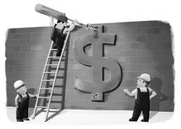
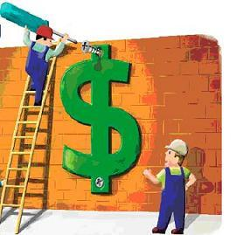
Price fixing

Slide 7
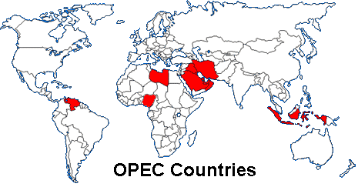
OPEC is organized by sovereign states.
It cannot be held to antitrust enforcement

Slide 8
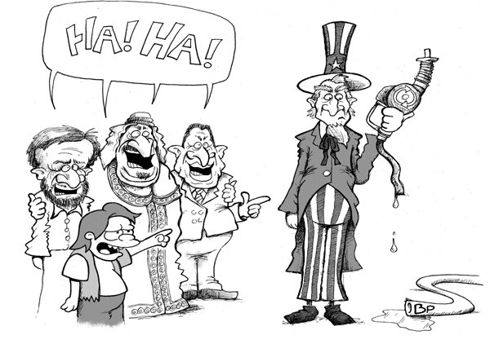

Slide 9
World Oil Production

Slide 10
1973 Energy Crisis
OPEC refused to ship oil to western countries that had supported Israel in the Yom Kippur War, which they fought against Egypt and Syria.
This caused fourfold increase in the price of oil, which lasted five months.

Slide 11
Immediate Economic Impact of 1973 Oil Embargo
Oil demand is very price inelastic (i.e. large change in price for small change in quantity)
In the United States, the retail price of a gallon of gasoline rose from a national average of 38.5 cents in May 1973 to 55.1 cents in June 1974
Meanwhile, NYSE shares lost $97 billion in value in six weeks

Slide 12
1979 Oil Crisis
During the Iranian Revolution, the Shah of Iran, fled the country in early 1979, allowing Ayatollah Khomeini to gain control.
Protests shattered the Iranian oil sector. While the new regime resumed oil exports, it was inconsistent and at a lower volume, forcing up prices. Saudi Arabia and other OPEC nations increased production to offset the decline, and the overall loss in production was about 4%.

Slide 13
1979 Oil Crisis
A widespread panic resulted, driving the price far higher than would be expected under normal circumstances.
In the US, the Carter administration instituted price controls.
Over the next 12 months the price of crude oil rose to $39.50 (its all time highest real price until early 2006).

