Slide 1
The Medieval Church

Slide 2
The Role of the Church
After the fall of Rome the Church took over the central role in society.
The Church, despite its faults, did a lot of work in Medieval communities. The Church helped the poor and helped provide a sense of unity for the people through a common religion

Slide 3
The Papacy
The head of the Catholic Church was the Pope.
The Pope, (from the Latin word “papa” –father- was the Bishop of the city of Rome.
This Bishop claimed that they were descended from St. Peter who was the “Rock” upon which Jesus built his church.

Slide 4
Hierarchy of the Catholic Church
The Pope: Head of All the Church. Was centered in Rome
Arch Bishops and Cardinals
Bishops who ruled over a Diocese
Priests who ruled over a Parish

Slide 5
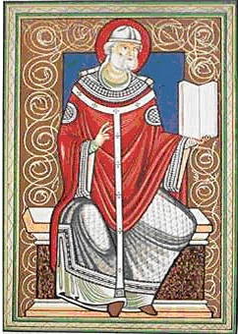
Pope Gregory I
Pope came to be accepted as leader of the Church—but to what extent?
Pope Gregory I wanted to strengthen the power of the Papacy.
He insisted that all bishops and the Byzantine Church were subject to his authority.
He established monasteries and made their ties to the Church stronger, converting non-Christians

Slide 6
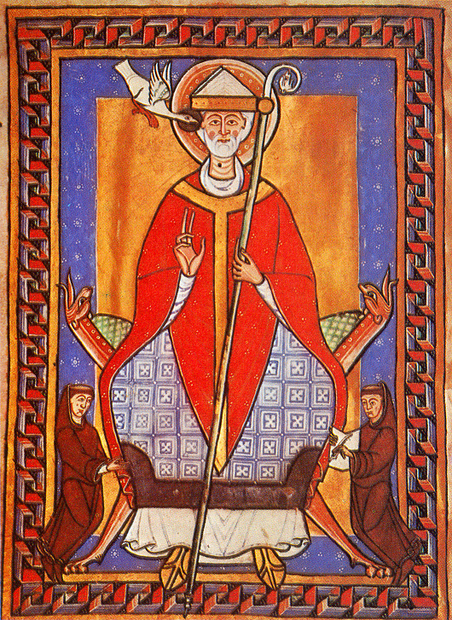
Gregory not only strengthened the spiritual power of the church, but also its political power.
He served as leader of the city of Rome and its surrounding territories which became known as the Papal States
The Papal States were the political territory of the Catholic Church.

Slide 7
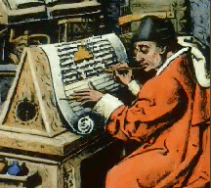
Monks and Their Missions
A Monk was a person who dedicated their life to the Church
Monasticism: The practice of living the life of a monk.

Slide 8
Monks were seen as the heroes of the Christian civilization.
They took care of the poor and provided the “social services” for the time.
They were seen as living the Christian ideal, a lifestyle that only a few could aspire to live.
Many monks were missionaries, they would go out and attempt to convert new groups or peoples to the Christian faith.

Slide 9
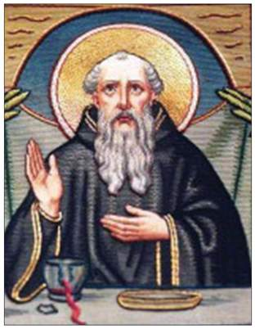
The original ideal of Monastic life was for a Monk to withdraw from secular (non-religious or worldly) life and live alone focusing on prayer and meditation.
A monk came along who
changed this structure,
this man was St. Benedict.
St. Benedict organized a
set of rules and regulations
for the establishment and
running of monasteries.

Slide 10
Benedictine Rules
St. Benedict called for Monks to live in poverty.
They were to study, do labor, and obey the abbot, or head of the monastery.
They had to pray often, work hard, talk as little as possible, and give up all of their private property to the Monastery.
His ideal was for monks to no longer be isolated, but to live in communities where they could perform more good.

Slide 11
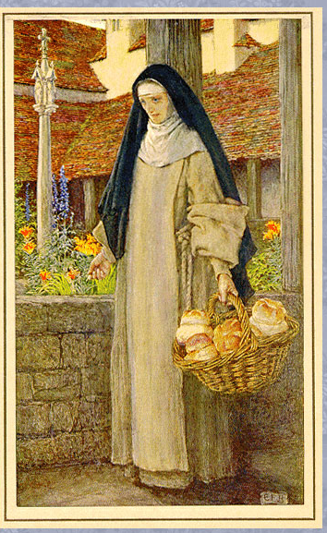
What about Women?
Women could also dedicate their lives to the church and its spiritual mission.
Women who dedicated their lives to the church were known as Nuns.
Nuns lived in convents which were headed by an Abbess.
Convents offered women opportunities they would not have if they stayed home and became wives and mothers. In convents women could get an education and be involved in a community.

Slide 12
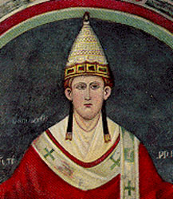
Conflict with the Pope
John also got into a conflict with Pope Innocent III over the selection of the Archbishop of Canterbury.
John thought, as king, he should be able to choose the next Archbishop, the Pope disagreed

Slide 13
“Weapons” of the Church
The church had powerful weapons that it could use against rulers of Europe.
People believed they needed to receive the sacraments of the Catholic Church in order to achieve salvation.
These sacraments included:
Eucharist (communion), Marriage, Holy Orders, Baptism, Extreme Unction (last rights), Confirmation, and Anointing of the sick.

Slide 14
John Begs Forgiveness
The Pope placed an interdict on England, which meant the people could not receive the sacraments.
John was forced to beg the Pope for forgiveness and pledge to make England a Fief of the Catholic Church. After that England owed a fee to the Church every year.
In this case, the Pope won out over the power of the monarch.

Slide 15
Papal States and Simony
The Papal States were the territories surrounding Rome which were controlled by the Pope and the Church.
As the Middle Ages went on the church became more involved in political affairs. The feudal government of the time complicated matters. Lords appointed these bishops and other church officials as their vassals, and they had to be loyal to their lords, bishops and abbots became more worldly and neglected their spiritual duties.
A practice known as simony developed where lords would sell church offices. This became an important source of income for lords and nobles.

Slide 16
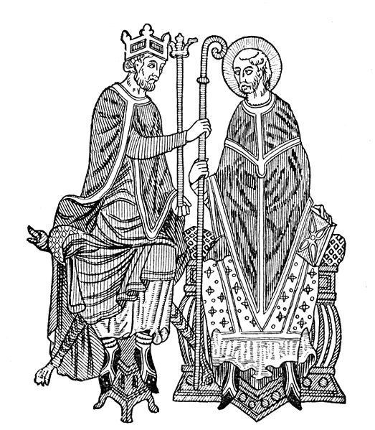
Church Reform
By the 11th century church officials realized that they need more control over appointments to the church.
They wanted to eliminate a practice which had developed which was known as Lay Investiture.

Slide 17
Lay Investiture
When an Abbot or Bishop was appointed to the church they were given symbols of their new office.
These objects were a ring and a staff, they symbolized the spiritual authority which was being granted, or invested, by the church. The ring represented marriage to the church and the staff was symbolic of the duty to be a good shepherd to the people.

Slide 18
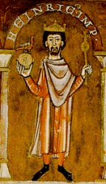
Pope Gregory VII and the Church wanted to end the practice of lay investiture and take that power back for the church.
Pope Gregory Declared that only the church had the authority to appoint church officials. He claimed that the church’s power was supreme and that the nobility did not hold any power over the church.
This led to a conflict with Holy Roman Emperor Henry IV.

Slide 19
Henry IV vs. Pope Gregory VII
Henry sent a letter to the Pope which declared that the Pope was a fake and had no real authority. His letter ended, “I, Henry, king by the grace of God, with all of my Bishops, say to you, come down, come down, and be damned throughout the ages”
Obviously, the Pope was not pleased by this. Pope Gregory VII excommunicated Henry IV and supported the overthrow of his power.

Slide 20
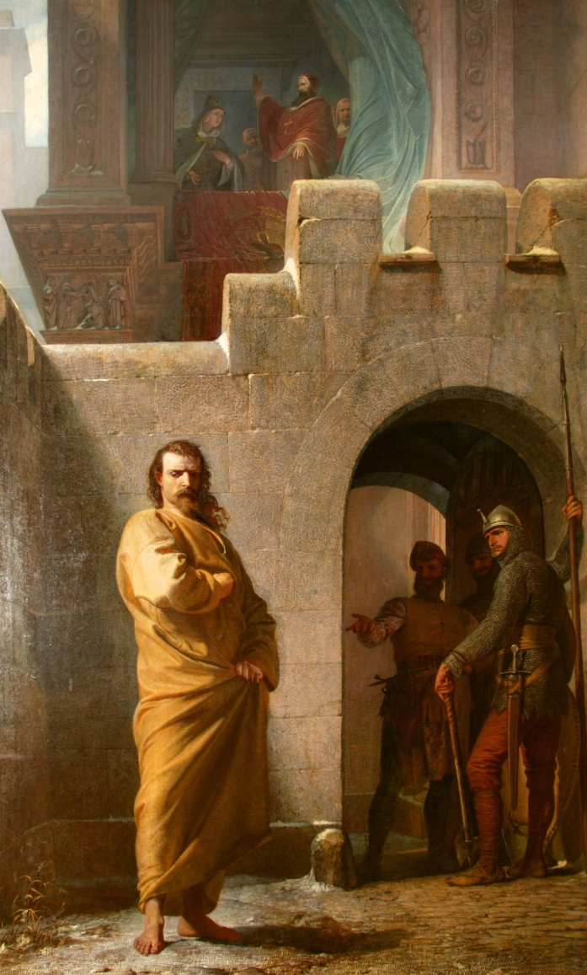
Henry IV, was faced with the prospect of losing his kingdom to lords who were rebelling against him and supporting the overthrow of his power.
Henry decided to go apologize to the Pope and be reinstated with the Church. Henry traveled to Canossa in northern Italy to meet the pope and apologize in person. He wore a hair shirt and stood outside barefoot in the snow. As a priest, the Pope had to accept Henry’s penance and lift his excommunication.

Slide 21
The Concordat of Worms
The dispute over lay investiture continued. Henry overthrew the Pope and then, Gregory died in exile. After they were both dead the conflict continued for several generations.
Finally in 1122 at Worms the Concordat of Worms passed. In this agreement the Church won the power to appoint church officials and the emperor got to give the new bishop the symbols of government authority while the church instilled the ring and staff which were symbols of spiritual authority.

Slide 22
The Church Supreme
The attempts to make the church more powerful did not end with Gregory VII. During the 12th and 13th century the Popes continued to strengthen the papacy.
Pope Innocent III declared the Act of Papal Supremacy (authority over all secular rulers) He stated that the Pope was,
“lower than God but higher than man . . . Judges all and is judged by no one. . . . Princes have power on earth, priests over the soul. As much as the soul is worthier than the body, so much worthier is the priesthood than the monarchy . . . NO king can reign rightly unless he devoutly serve Christ’s vicar.”

Slide 23
“Weapons” of the Church
The Church claimed that it held the power of salvation through the administration of the sacraments. The church could manipulate people and their leaders through the control of these sacraments.
The church could excommunicate someone, this was where they cut off a single person from receiving the sacraments.
The church could also place an interdict over an entire country. In this case no one in the entire country or region could receive the sacraments.

Slide 24
The Sacraments
The church had seven sacraments
Baptism: Done at birth to cleanse original sin.
Confirmation: Young men and women were confirmed in their baptism and were able to receive communion.
Eucharist: Communion, the bread and wine which was believed to be the body and blood of Christ.
Penance and Reconciliation: Also known as extreme unction, an attempt to remove sin from the soul before death.
Anointing of the sick
Holy orders: When men and women joined the church.
Matrimony: Marriage

