Slide 1
Mccarthyism
The Hysteria of the
Second Red Scare

Slide 2
The Search For
Internal Security

Slide 3
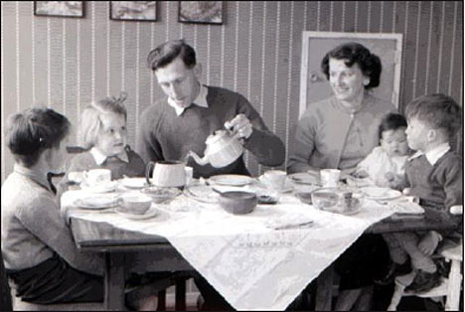
Search for Internal Security
Loyalty and conformity to the wishes of the country a must for the government and society for many Americans.
Were highly suspicious of anything or anyone considered different.
Regarded people with different opinions as a commie, or un-American.
Only way to measure loyalty was the intensity and consistency of a person’s anti-Communism.
Result: a witch-hunt to root out suspected Communists from every aspect of society.
Typical American Family
in the 1950s
http://img.dailymail.co.uk/i/pix/2008/01_05/spenderold2801_468x314.jpg

Slide 4
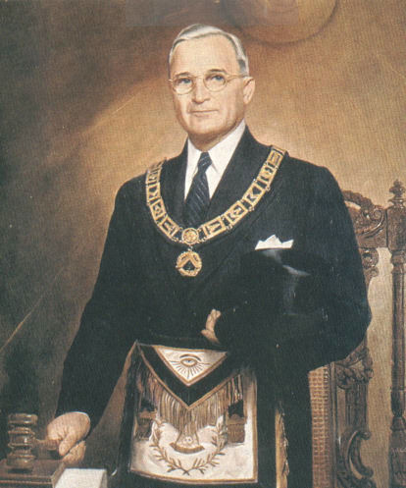
Basic Characteristics Truman’s Foreign Policy
Truman’s foreign policy plays on these sentiments.
Reinforced the traditional fears of the Soviets and communism.
Uncovered spy rings in Canada, Britain, and other nations confirm suspicions about the Soviet Union’s intent: total world domination through the subversion of existing governments.
POTUS Harry S Truman
In Masonic Garb
http://www.phoenixmasonry.org/10,000_famous_freemasons/images/harry_s_truman_pgm_missouri_1.jpg

Slide 5
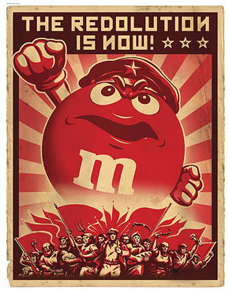
Basic Characteristics Truman’s Foreign Policy
Cabinet members make speeches that state that communists were everywhere in America and could be anybody.
Basic message: TRUST NOBODY.
Wanted people to turn in people they suspected of associating or sympathizing with communism.
Special targets placed on college campuses, Hollywood, publishing companies, and editorial staffs.
The Redolution
http://eatemandbeatem.com/redScare.jpg

Slide 6
Pre-McCarthy
McCarthyism

Slide 7
Pre-McCarthy McCarthyism Loyalty Review Board, Mar 1947
Full-scale “loyalty investigation” of all present and prospective federal employees.
No source of information, no matter how inaccurate or questionable, was to be ignored.
Impact of the LRB.
Business organizations, labor unions, and the government would use the list to fire or deny hiring employees.
Laid the ground work for the new Red Scare and the witch hunts of HUAC and Senator Joseph McCarthy.

Slide 8
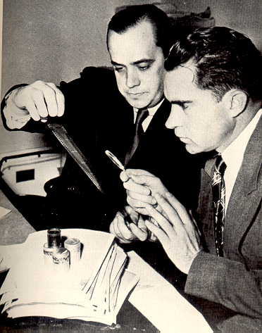
Pre-McCarthy McCarthyism HUAC (House Un-American Activities Committee)
Origins.
Originally founded in 1938 during the New Deal as a temporary investigations unit.
Fell out of favor in World War II, but was revived by newly-elected Congressman Richard Nixon of CA.
Would serve to destroy the lives of suspected Communists and advance the political careers of key individual politicians.
Richard Nixon (Right)
In His HUAC Days
http://jeremayakovka.typepad.com/photos/uncategorized/2007/07/11/nixon_stripling.jpg

Slide 9
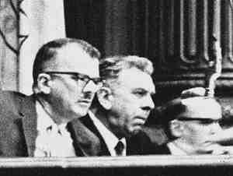
Pre-McCarthy McCarthyism HUAC (House Un-American Activities Committee)
Purpose.
Search for suspected Communists, root them out, and investigate the extent of their infiltration.
Members of HUAC
http://www.billmandel.net/i/huac_members.jpg

Slide 10
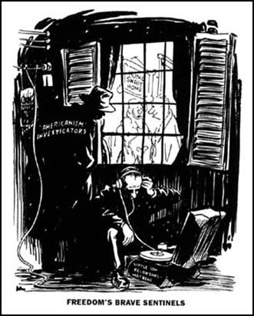
Pre-McCarthy McCarthyism HUAC (House Un-American Activities Committee)
How HUAC functioned.
Threatened and manipulated witnesses.
As a result, many would tell lies in order to save their own skin.
Refusal to answer questions or cooperate was similar to an admission of guilt.
Political Cartoon Criticizing HUAC Methods
http://www.spartacus.schoolnet.co.uk/USAhuac.JPG

Slide 11
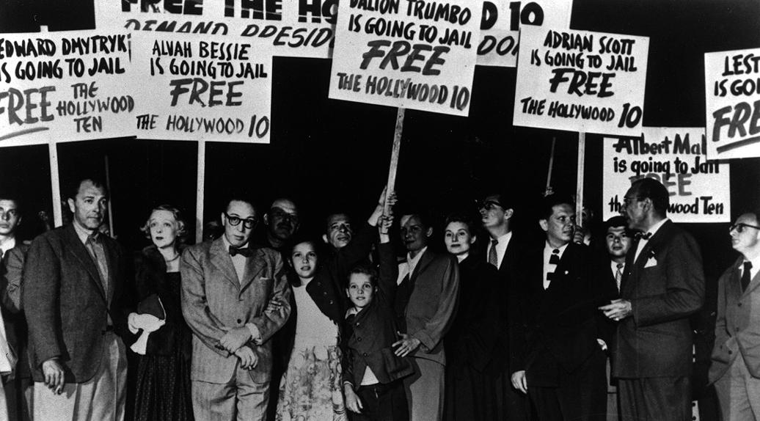
Pre-McCarthy McCarthyism HUAC (House Un-American Activities Committee)
The Hollywood Scandals of October, 1947.
Wanted to “expose those elements that are insidiously trying to…poison the minds of your children, distort the history of our country, and discredit Christianity.”
Was a failure in its attempt to prove Communist influence in the film industry.
Prominent Actors & Writers Protesting the Hollywood Ten Scandals
http://farm3.static.flickr.com/2346/2018958027_f09c48d75e_o.jpg

Slide 12
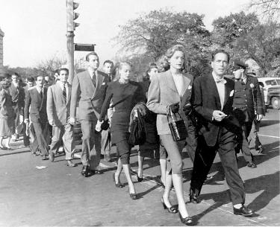
Pre-McCarthy McCarthyism HUAC (House Un-American Activities Committee)
What it did do:
Frightened movie, television, and radio executives into doing a housecleaning.
Blacklisted actors, actresses, writers, and directors who were suspected of having Communist sympathies.
Forced the movie, television, radio, comic book, and newspaper industries to set strict standards, many of which would last into the Eighties.
Humphrey Bogart & Lauren Bacall Leading An Actors Protest Against HUAC
http://people.cohums.ohio-state.edu/childs1/OutlineSecond%20Red%20Scare_files/image001.jpg

Slide 13
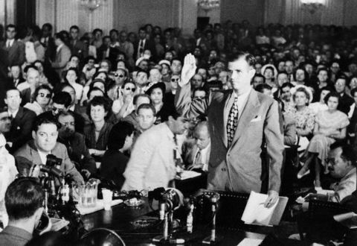
Pre-McCarthy McCarthyism HUAC (House Un-American Activities Committee)
Alger Hiss.
Was an official in the State Department during the New Deal and the early years of World War II.
President of the Carnegie Endowment for International Peace, one of the world’s richest philanthropic institute, since 1947.
Accused of being a Communist.
Alger Hiss Swearing To Tell The Truth Before the HUAC Hearings
http://southdakotapolitics.blogs.com/south_dakota_politics/images/alger_hiss_takes_oath.jpg

Slide 14
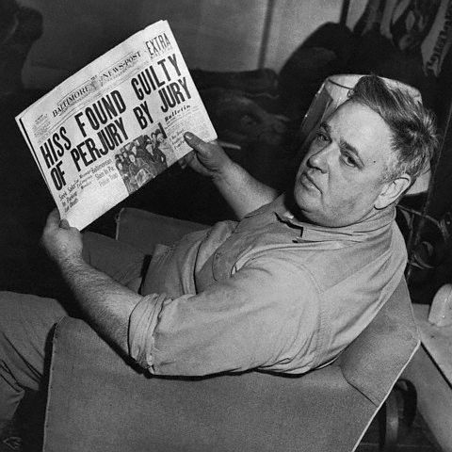
Pre-McCarthy McCarthyism HUAC (House Un-American Activities Committee)
Alger Hiss.
Hiss denies the accusations and demands to have a hearing by HUAC.
Hiss is charged with being involved in a Soviet spy ring.and passing classified government documents to the Soviets.
Hiss denies involvement.
HUAC does not buy it, sentences Hiss to five years in prison and a $10,000 fine for perjury.
Chambers Reading Of The Decision
Of HUAC On Alger Hiss
http://www.authentichistory.com/1950s/speeches/images/19500123_Whittaker_Chambers.jpg

Slide 15
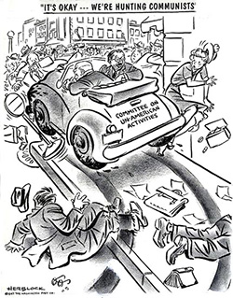
Pre-McCarthy McCarthyism HUAC (House Un-American Activities Committee)
Impact.
Would further uphold the belief that privileged, high-positioned individuals had betrayed the country.
HUAC would gain support from established Americas, as well as Irish, Italian, and Polish immigrants in the Midwest.
Criticism Of HUAC
http://www.moderntimes.com/blacklist/image/huac.jpg

Slide 16
Senator
Joseph McCarthy, WI

Slide 17
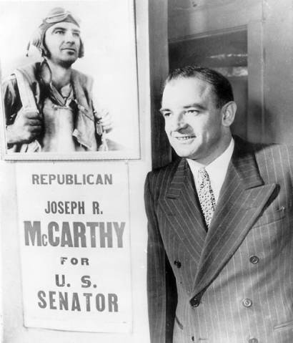
Joseph McCarthy McCarthyism Defined
An expression for wild, unfounded charges of disloyalty.
Basically conducted as a witch hunt.
McCarthy Campaigning For A Senate Seat
http://www.faculty.umb.edu/hannah_sevian/G660/TechPres/Fall2003/McCarthyism_files/image002.jpg

Slide 18
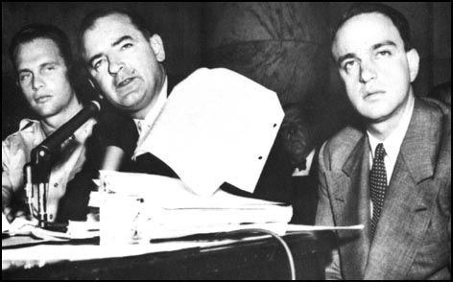
Joseph McCarthy McCarthy: Rise To Power
Wheeling Speech, February 9, 1950.
Declared that the United States had emerged from World War II as the strongest nation in the world.
Believed that it had been weakened in recent years “because of the traitorous actions of those who have been treated so well by this nation.”
McCarthy With “The List”
http://www.spartacus.schoolnet.co.uk/USAmccarthy3.jpg

Slide 19
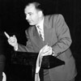
Joseph McCarthy McCarthy: Rise To Power
Wheeling Speech, (Cont.).
None were worse than “those bright young men” in the State Department “born silver spoons in their mouths.”
Blames the privileged, educated New Dealers brought in by FDR.
“I have in my hand the names of 205 men that were known to the Secretary of State as being members of the Communist party and who nevertheless are still working and shaping the policy of the State Department.”
Never substantiated a single name, but increased the accusations.
McCarthy Delivering
Wheeling Speech
http://www.wisconsinhistory.org/whi/feature/mccarthy/images/WHS_Image_ID_8006.jpg

Slide 20
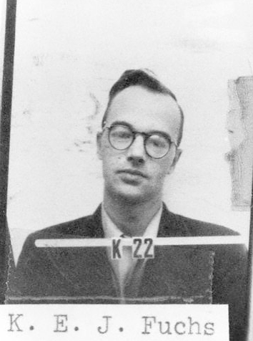
Joseph McCarthy McCarthy: Stroke of Luck--Spies
Klaus Fuchs.
German-born nuclear physicist who worked on the atomic bomb at Los Alamos.
Was passing secrets to the Russians.
Arrested by the British, sentenced to four years in prison for espionage, and implicated other American Communists in his activities, including officials in the American government.
Klaus Fuchs ID Badge
At Los Alamos
http://upload.wikimedia.org/wikipedia/commons/9/9e/Klaus_Fuchs_ID_badge.png

Slide 21
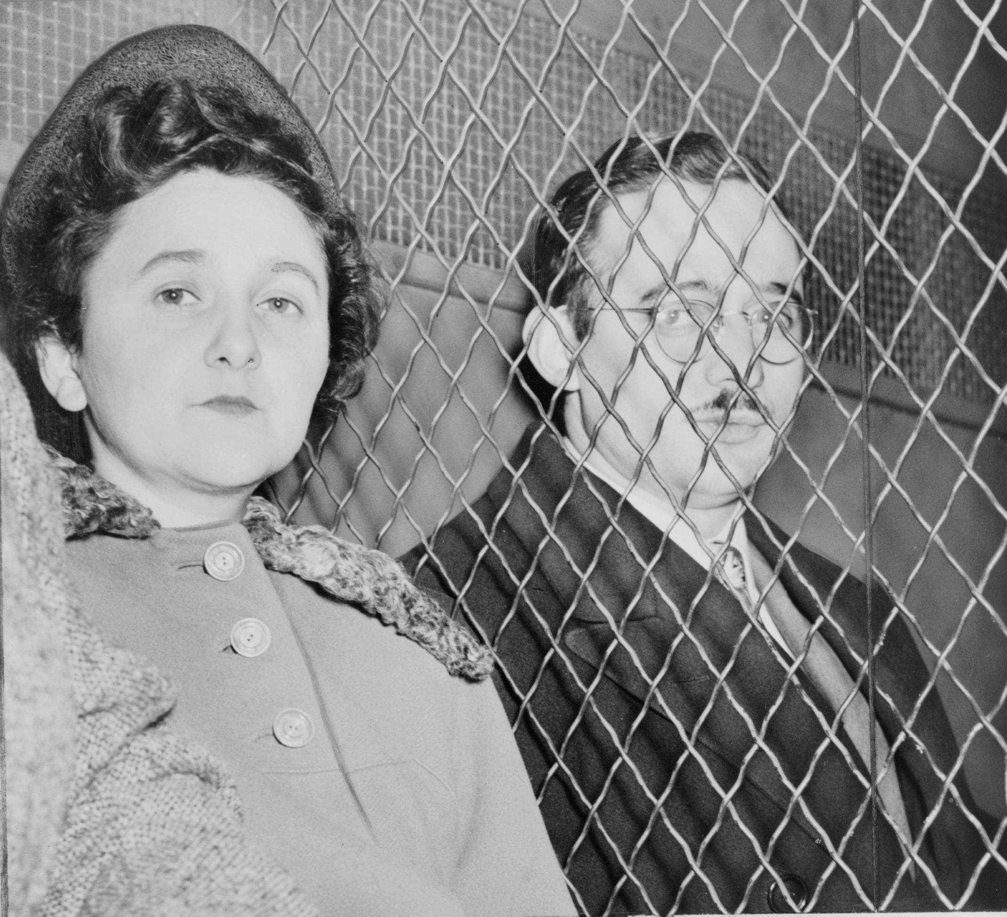
Joseph McCarthy McCarthy: Stroke of Luck--Spies
Ethel and Julius Rosenberg.
Charged with passing atomic secrets and speeding up Russian success with the atomic bomb.
Judge declared the crime “worse than murder.”
Rosenbergs sentenced to death and executed in 1953.
Ethel & Julius Rosenberg Awaiting Execution
http://upload.wikimedia.org/wikipedia/commons/6/68/Julius_and_Ethel_Rosenberg_NYWTS.jpg

Slide 22
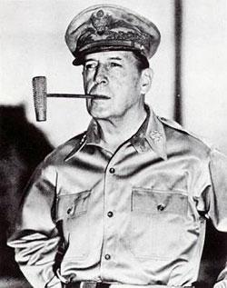
Joseph McCarthy McCarthy: Picks Up Steam
McCarthy supports General MacArthur following his dismissal by Truman.
Attacks General Marshall and General Eisenhower, accusing them of “being soft” on Communists in the military.
Some Americans felt McCarthy had gone too far, but money kept pouring into McCarthy’s election coffers.
General Douglas MacArthur
http://splinteredsunrise.files.wordpress.com/2008/03/douglas_macarthur.jpg

Slide 23
Joseph McCarthy McCarran Acts, 1952
McCarran Internal Security Act.
Made it unlawful to conspire to establish a totalitarian dictatorship.
All “communist-action” and “communist front” organizations were assumed to be such conspiracies.
Required to register all members and meeting notes with the Attorney General.
Gave the president the power to arrest and detain any person that would “probably” engage in acts of espionage and sabotage.

Slide 24
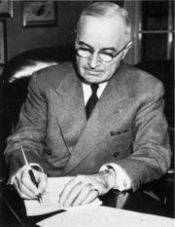
Joseph McCarthy McCarran Acts, 1952
Truman’s response.
Vetoes the bill, calling it “the greatest danger to freedom of speech, press, and assembly since the alien and sedition acts of 1798.”
Believed it was actually a step towards the totalitarianism it was meant to combat.
Congress overrides the veto.
POTUS Harry S Truman
http://content.answers.com/main/content/wp/en/thumb/7/73/180px-Truman_initiating_Korean_involvement.jpg

Slide 25
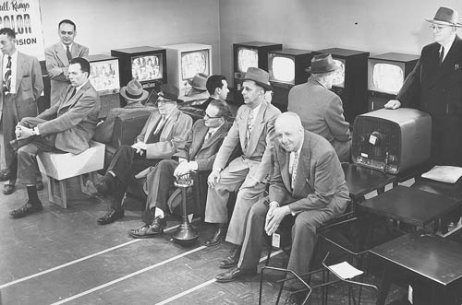
Joseph McCarthy Decline of McCarthyism, 1953-55
Army-McCarthy Hearings.
McCarthy accuses the U.S. Army of “coddling” Communists in the U.S.
Also questions the loyalty and integrity of several top generals.
First time many Americans actually witnessed McCarthy’s wild accusations.
Very offensive to the viewing audience, Army officials, and his fellow Senators.
Americans Watching The Army-McCarthy Hearings At A Television Store
http://www2.jsonline.com/news/2000/y2k/ourcentury/images/CENTURY-MCCARTHY2.jpg

Slide 26
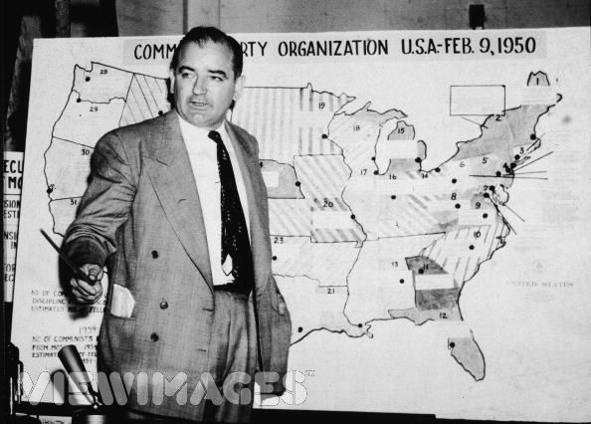
Joseph McCarthy Decline of McCarthyism, 1953-55
Army-McCarthy Hearings.
Result: Senate officially condemns McCarthy for “conduct unbecoming a member of the United States Senate.”
McCarthy’s power would decline until his death in 1957 from alcoholism.
Army-McCarthy Hearings
http://cache.viewimages.com/xc/51649986.jpg?

