Slide 1
JFK & The Cold War

Slide 2
JFK and the Cold War
“And so, my fellow Americans: ask not what your country can do for you--ask what you can do for your country. My fellow citizens of the world: ask not what America will do for you, but what together we can do for the freedom of man.”
JFK – Inaugural Address, January 20, 1961

Slide 3
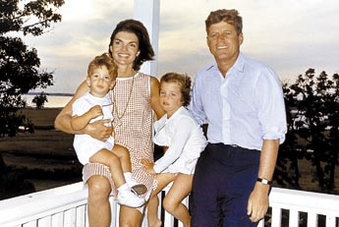
The Camelot Years
a. The Kennedy Mystique
press portrayed the Kennedys as a young, attractive, energetic, and stylish couple; with attention to arts and culture and an average every-day family
modern day Camelot

Slide 4
A New Military Policy
Flexible response – increased defense spending in order to boost conventional military forces – nonnuclear forces such as troops, ships, and artillery – and to create an elite branch of the army called the Special Forces, or Green Berets.
He also tripled the overall nuclear capabilities of the U.S.
Goal – allow the U.S. to fight limited wars around the world while maintaining a nuclear balance of power with the Soviets

Slide 5
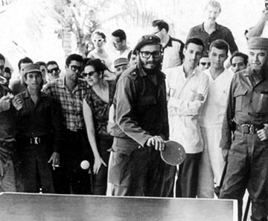
Crises over Cuba
A. the Cuban dilemma
Fidel Castro comes to power in 1959
Puts on mass public trials and executions
U.S. denounces Cuba and accepts thousands of Cuban refugees
Castro seizes U.S. businesses and Eisenhower cuts off imports of Cuban sugar
1960 – Cuba signs a trade treaty with the Soviet Union

Slide 6
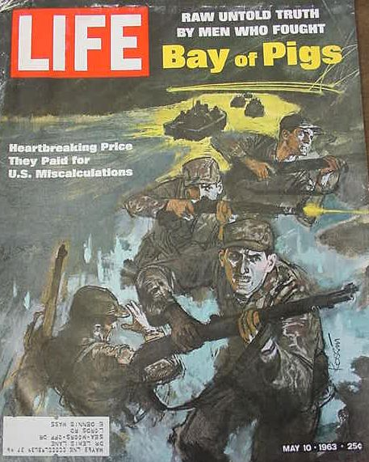
The Bay of Pigs
In March 1960 Ike orders CIA to train Cuban exiles for an invasion of their homeland
JFK continues with the plan
The plan: day before the invasion, planes would attempt to wipe out Castro’s airforce, then exiles would land at the beach, and the Cuban people would rise up against Castro and overthrow him

Slide 7
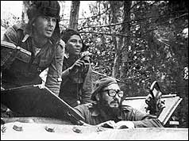
Bay of Pigs (Cont.)
Plan failed: JFK failed to provide the necessary resources to help the exiles and they were rounded up by Castro’s men
JFK goes ahead with a plan called Operation Mongoose in which gov’t agents worked to disrupt the island’s trade and continued working with mobsters to assassinate Castro

Slide 8
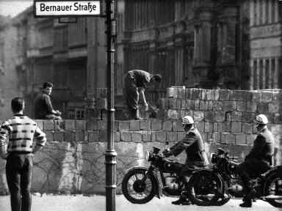
The Berlin Wall
Trying to shake off the embarrassment of the Bay of Pigs defeat, Kennedy agreed to meet Soviet premier Khrushchev in Vienna in the summer of 1961.
Khrushchev seized the opportunity in Vienna to threaten the president by renewing Soviet demands that U.S. troops be pulled out of Berlin. Kennedy refused

Slide 9
In August, the East Germans, with Soviet backing, built a wall around West Berlin. Its purpose was to stop fleeing East Germans from fleeing to West Germany.
As the wall was being built, Soviet and U.S. tanks faced off in Berlin. Kennedy called up the reserves, but he made no move to stop the completion of the wall

Slide 10
In 1963, the president traveled to West Berlin to assure its residents of continuing U.S. support. To cheering crowds, he proclaimed: "Freedom has many difficulties, and democracy is not perfect, but we have never had to put a wall up to keep out people in … As a free man, I take pride in the words, 'Ich bin ein Berliner' [I am a Berliner]."
The Berlin Wall stood as a gloomy symbol of the Cold War until it was torn down by rebellious East Germans in 1989.

Slide 11
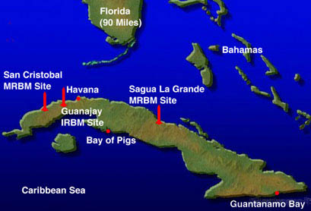
The Cuban Missile Crisis (1962)
In an attempt to counter any new American intervention and to improve the Soviet position in the nuclear arms race, Castro and Kruschchev devised a daring plan: installation of Soviet missiles and nuclear bombers in Cuba

Slide 12
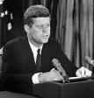
Cuban Missile Crisis
Oct. 14, 1962 – U-2 flights showed 65 sites for offensive medium-range ballistic missiles – could reach the U.S. in 3 minutes
JFK ordered a naval quarantine of the island (used the word “quarantine” rather than “blockade” since blockade was an act of war)
Oct. 22 – went on national television informing the Soviets of American policy and demanded their retreat
American forces around the globe went on alert
For almost a week, the world was on the brink of nuclear war

Slide 13
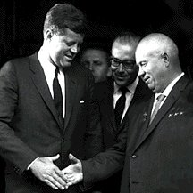
Cuban Missile Crisis (Cont.)
Khrushchev said that he would remove the missiles if the U.S. agreed not to attack Cuba and removed its missiles from Turkey
Kennedy publicly agreed to the 1st and privately to the second

Slide 14
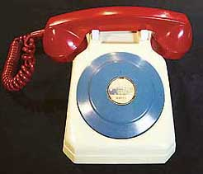
V. Trying to Ease Tensions
Two Agreements
1. Direct hotline between the White House and the Kremlin
2. Signing of the Limited Test Ban Treaty – called for an end to all nuclear tests in the ocean, the atmosphere and outer space – by the end of the year, 113 other nations had signed the treaty

