Slide 2
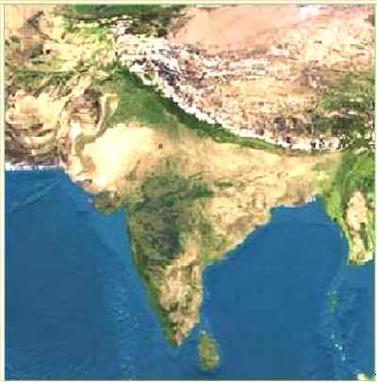
Chapter 2 Section 3: Ancient India
India is a land of great: Diversity
India has over 110 different languages with over 1100 dialects spoken. Its geography ranges from fertile forests, to desert, to high mountains.
Indian Subcontinent: A landmass that is smaller than a continent. India is a subcontinent of Asia. It is divided from Asia by the Himalaya and Hindu Kush mountain ranges.
MAP

Slide 3
Khyber Pass
Himalaya
Tallest mountains in the world. (29, 035 ft.)
Hindu Kush
Himalaya
Hindu Kush
To the NW, above the Indus river.
Khyber Pass
Mountain pass in the Hindu Kush.
This was the passage for invaders who entered India.

Slide 4
Ganges River
Most sacred river of India.
Indus River
Site of the first Indian Civilization
Deccan Plateau
Triangular region in central India between E. and W. Ghats.
Is very arid.
Eastern and Western Ghats
Mountains frame the Deccan, have fertile coastal plains

Slide 5
Monsoons
Monsoons are seasonal winds. These winds blow from different directions during different times of the year.
Winter
Monsoon
Summer Monsoon
Blows over the Arabian Sea and Indian Ocean bringing rain to India.
Arabian
Sea
Bay of
Bengal
Summer
Monsoon
Winter Monsoon
Blows over land and is dry.
Indian Ocean

Slide 7
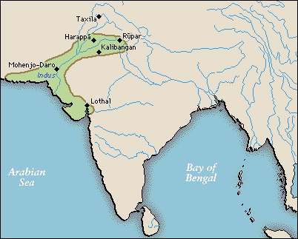
Began in: 3000 B.C. to 1500 B.C. in the Indus River Valley. It is thought that a civilization existed here that reached hundreds of miles from the Himalaya mountains to the shore of the Arabian Sea.
Harappa and Mohenjo-Daro
Population: It is thought that Harappa had up to 35,000 people at its height and that Mohenjo-Daro has between 35,000-40,000 people.

Slide 8
Features: There is evidence of streets laid out in grids, walled neighborhoods, multi-story buildings, water and sanitation systems, garbage chutes that took trash from houses to street-level garbage bins.
Houses were made of mud bricks baked in ovens are were square forming a grid pattern.

Slide 9


Urban Planning and the Economy of the Indus Valley Civilization
The Indus or Harappan civilization (3000–1500 B.C.) included more than a thousand settlements. Among them were the planned communities of Harappa and Mohenjo Daro.
Urban Planning in Harappa and Mohenjo Daro
  • All houses were built to the same plan—a square courtyard surrounded by rooms—though they varied in size.
  • Streets were laid out in a grid pattern. Main streets running north-south were crossed by smaller east-west roads.
  • Public wells supplied all residents with fresh water.
  • An advanced drainage system moved wastewater from bathrooms to sewage pits beyond the city walls.

Slide 10
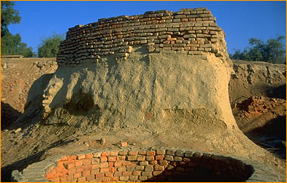
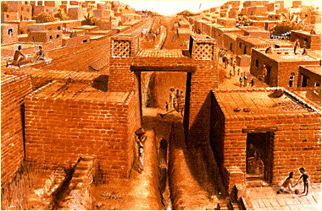
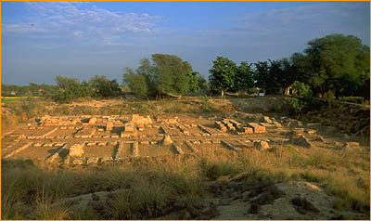
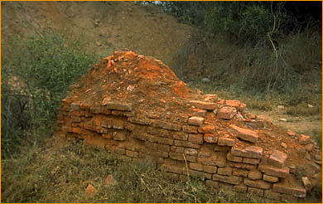
One of 8 public wells found so far

Slide 11
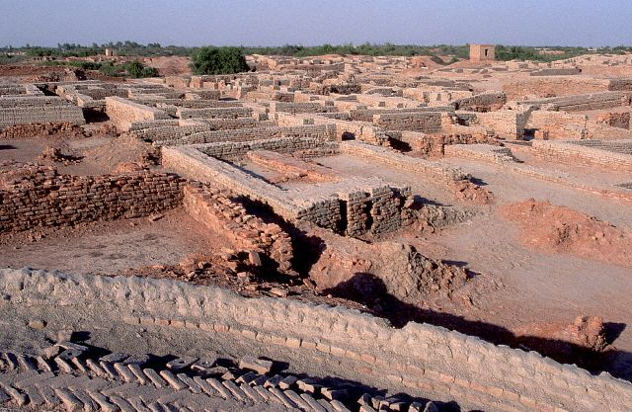
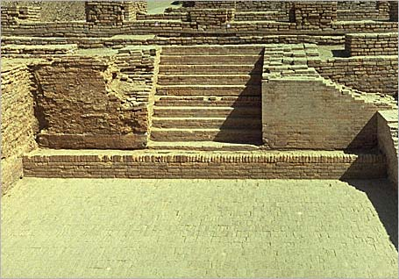
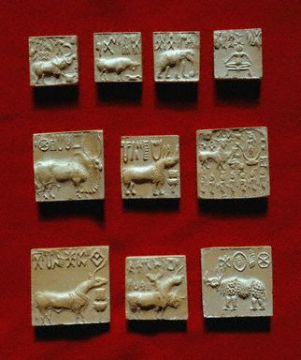
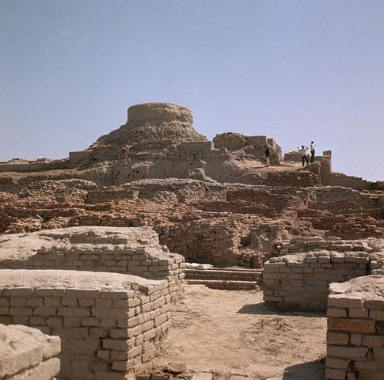
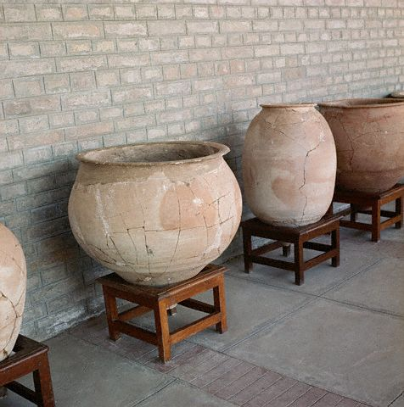

Slide 12

Urban Planning and the Economy of the Indus Valley Civilization
Divine Rule
  • As in Egypt and Mesopotamia, religion and political power were linked. Royal palaces also served as temples, and rulers based their power on a belief in divine right.
Economy
  • Their economy was based on agriculture, including wheat, barely, and peas. They probably traded with other city states in Mesopotamia by sailing across the Persian Gulf. They traded copper, lumber, gemstones, and luxury goods for Textiles and food. Trade may have also gone over land through the Khyber pass Indus Valley goods and raw materials were traded as far away as Mesopotamia.

Slide 13
A seal is a stone or other solid object with a design carved into it. When the stone is pressed against clay, wax, or another soft material, the design is imprinted onto the material. The image here shows a seal from Mohenjo Daro, most likely used as an amulet (a charm or ornament thought to protect against evil) and a way to identify merchandise. The Indus Valley produced many of these seals, often with animals pictured on them. Unicorns were the most common animals on seals.
The seal pictured here is part of the collection of Pakistan’s National Museum in the city of Karachi. The actual object measures about 2 inches (5 cm) on each side.

Slide 14
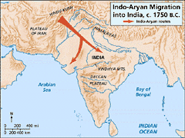
The Aryan Invasion Theory of India
Historians are not exactly sure what brought an end to the Indus Valley Civilizations. It may have been a natural disaster, climate change or a change in the course of the Indus River.
1500 B.C.: In this year many historians believe a group of Indo-European nomads began to move out of C. Asia. These people were known as the Aryans.
It is thought that they migrated south through the Hindu Kush using the Khyber pass.
Arrival in India: Advanced East from the Indus Valley, eventually occupying almost all of India. Some theorize that the Dravidians (The original people of India) recognized the advanced technology of the Aryans and eventually assimilated into Aryan culture and were not forced to migrate south.
Warfare: Were advanced fighters.

Slide 15
Agriculture: Tools and irrigation made it possible for the people to clear the jungle around the Ganges and create a rich farming region.
Basic crops in the north were grains, and in the south rice was common. People also began to grow cotton and spices.
Sanskrit: 1000 B.C: The written language known as Sanskrit enabled the peoples to write down their stories and religious chants and rituals. These eventually became the sacred texts of Hinduism, the Vedas.
Rajas: Princes of the Aryans, warring chieftains who fought each other seizing territory and prisoners.

Slide 16
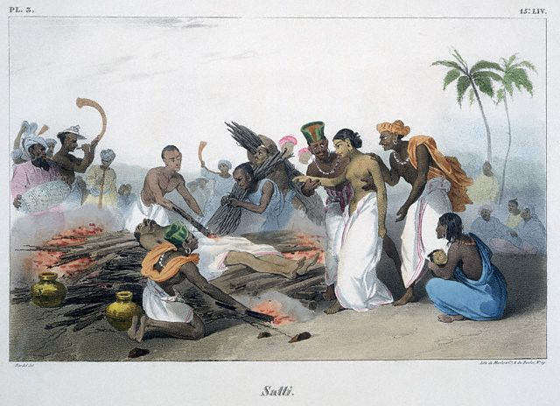
Family Life in Ancient India
Family was the most basic unit of Indian society. There was an ideal of an extended family including multiple generations living together.
Patriarchal: Indian society was male dominated. Only men could inherit property and only boys were educated.
Arranged Marriages: Parents usually arranged marriages for political and economic reasons when children were very young.
Status of Women: Women had very low social status.
There was a ritual of Suttee (Sati) where women were expected to throw themselves on the crematory fires of their dead husbands.
If they refused they were disgraced.

Slide 18
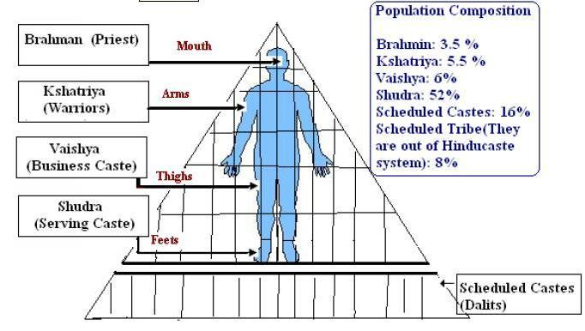
The Caste System
The Caste System is a system of social division in India.
There is some debate as to it origins, but it is made up of four main castes and several sub-castes. You are born into your caste and may not change your caste within your lifetime.
Brahmins
The top caste, the priests. They are the closest to Brahman
Kshatryias
Second Caste, the warriors and princes
Vaishya
Merchants, artisans and landowners
(Skilled workers)
Shudra
The workers, the lowest caste.
(unskilled workers)

Slide 20
Decline of the Indus Valley Civilization
Although the way the Indus civilization ended remains a mystery, archaeologists have identified these factors in its decline:
• Flooding
• Earthquake
• Change in climate
• Environmental change caused by human settlement
• Change in the course of the Indus River
• Influx of nomadic Aryan people from central Asia

