Slide 1
The Cuban “Melodrama”
A – Author
P – Place & Time
P – Prior Knowledge
A- Audience
R – Reason
T – The Main idea
The Spanish-American War: 1898

Slide 2
Cuba

Slide 3
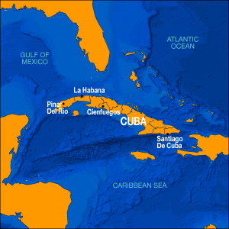
American Humanitarianism & Cubans effort for independence
A. Sympathized with desire for independence of Cubans from Spain
B. Outraged when over 200,000 Cubans died in concentration camps of hunger and disease
C. Cubans were fighting a guerilla war with the Spanish for their independence

Slide 4
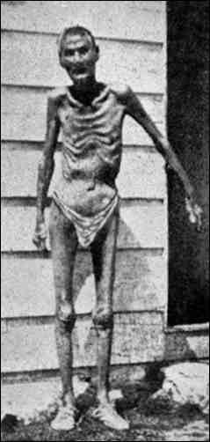
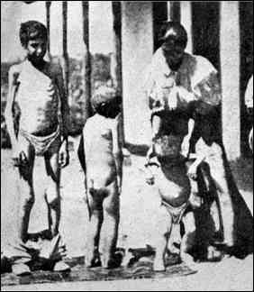
Valeriano Weyler’s “Reconcentration” Policy

Slide 5
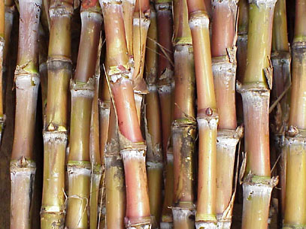
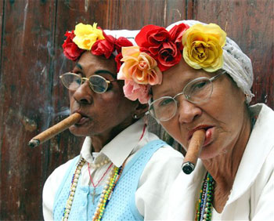
ECONOMIC INTERESTS
A. American merchants traded with Cuba to the amount of $100 Million a year
B. American investors placed $50 million in
sugar and tobacco plantations.

Slide 6
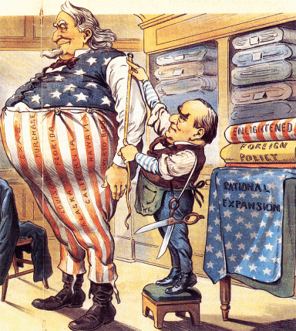
The Imperialist Tailor

Slide 7
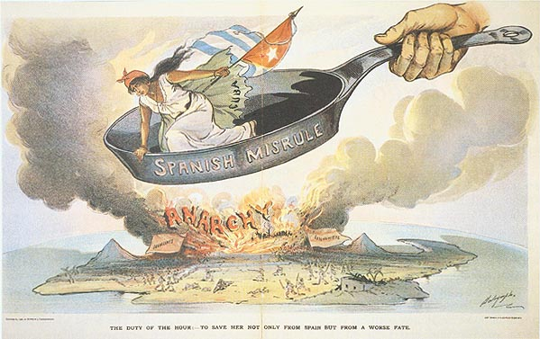
Spanish Misrule in Cuba

Slide 8
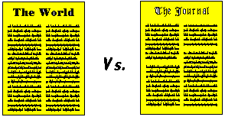
4. “Yellow Journalism”
- Both Newspapers sought to increase
circulation by sensationalized news stories.
A. William Randolph Hearst – NY Journal
B. Joseph Pulitzer – New York World

Slide 9
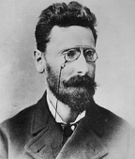
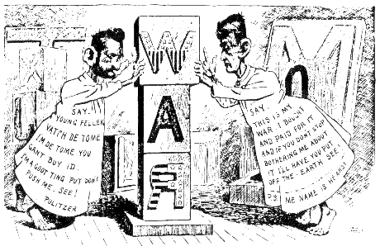
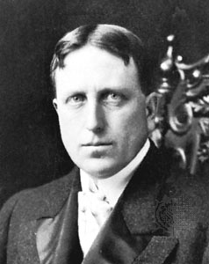
“Yellow Journalism” & Jingoism
Joseph Pulitzer
William Randolph Hearst

Slide 10
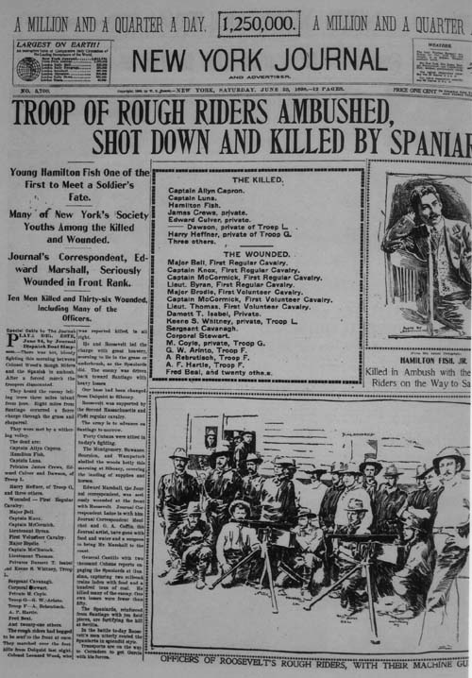
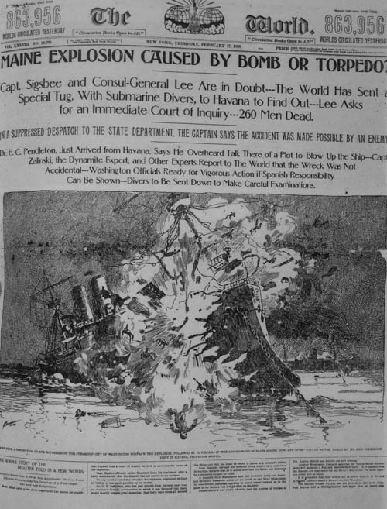
Sensationalism – Yellow Journalism

Slide 11
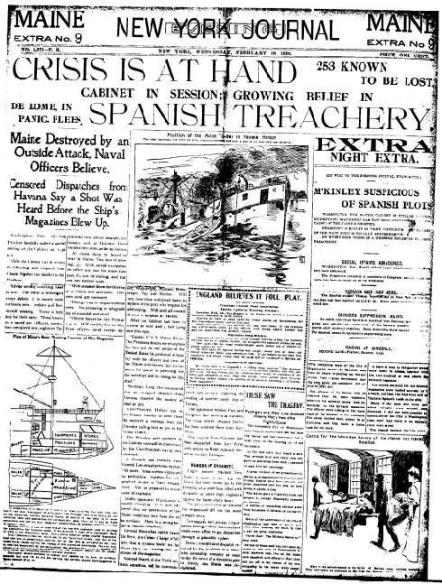
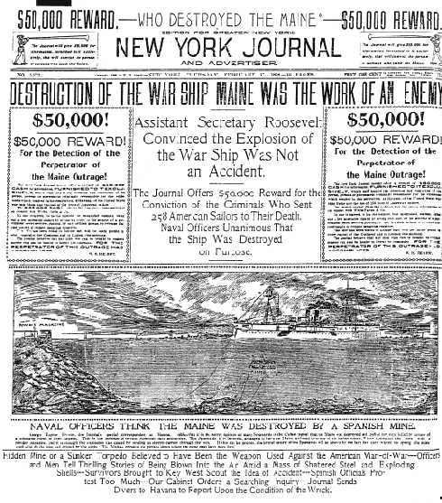

Slide 12
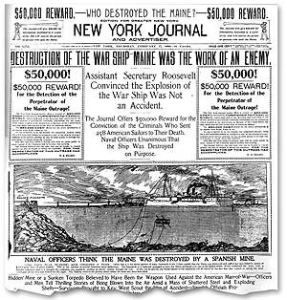
Hearst to Frederick Remington: “You furnish the pictures, and I’ll furnish the war!”

Slide 13
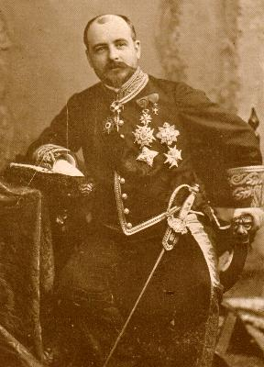
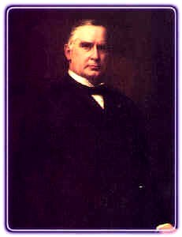
De Lome Letter

Slide 14
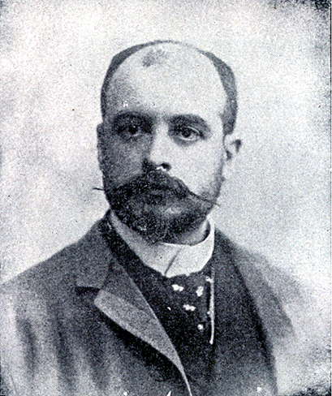
1 - De Lôme Letter
Dupuy de Lôme, Spanish Ambassador to the U.S.
Criticized President McKinley as weak and a bidder for the admiration of the crowd, besides being a would-be politician who tries to leave a door open behind himself while keeping on good terms with the jingoes of his party.

Slide 15
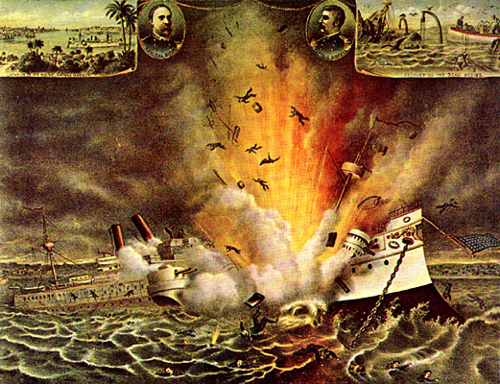

Slide 16
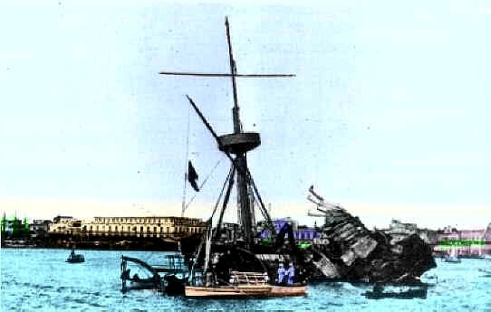
2. Sinking of the Maine – Feb 1898
A. American battleship visiting Cuba blown up 260 Americans killed
B. Cause: probably fire in a coal bin
C. But, American public goaded on by the
Yellow Press – blames SPAIN

Slide 17
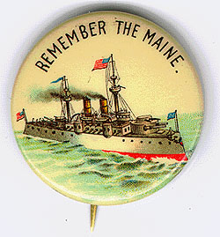
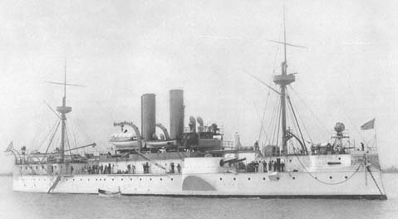
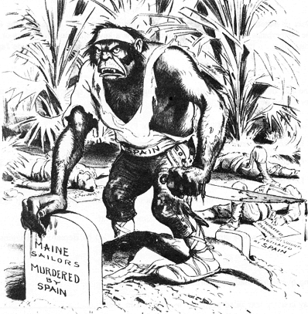
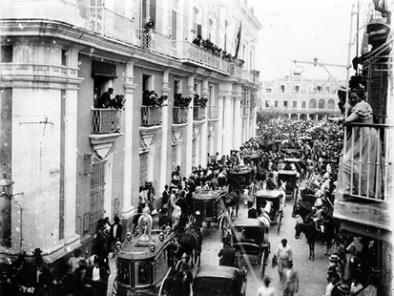
Remember the Maine and to Hell with Spain!
Funeral for Maine victims in Havana

Slide 18
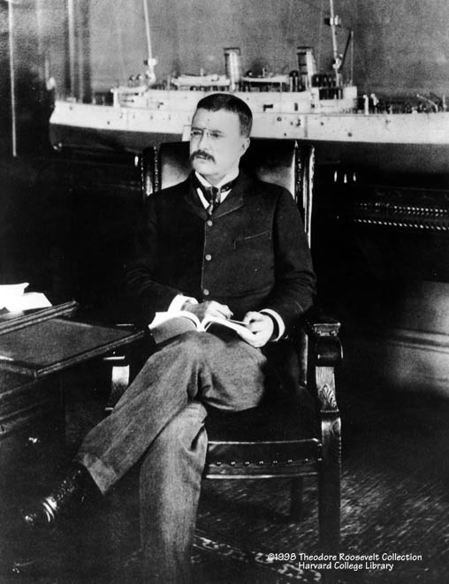
Theodore Roosevelt
Assistant Secretary of the Navy in the McKinley administration.
Imperialist and American nationalist.
Criticized President McKinley as having the backbone of a chocolate éclair!
Resigns his position to fight in Cuba.

Slide 19
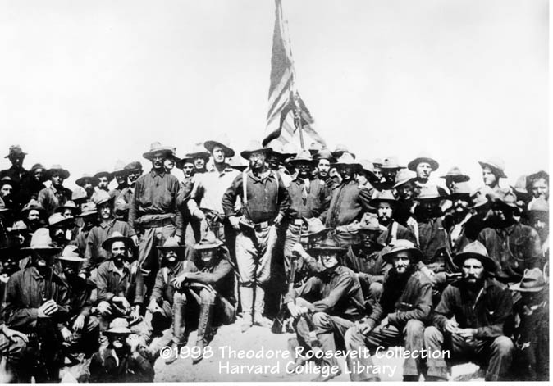
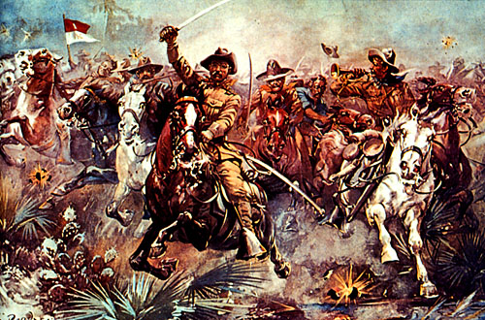
The “Rough Riders”

Slide 20
The Spanish-American War (1898): “That Splendid Little War”

Slide 21
The
Philippines

Slide 22
The Spanish-American War (1898): “That Splendid Little War”

Slide 23
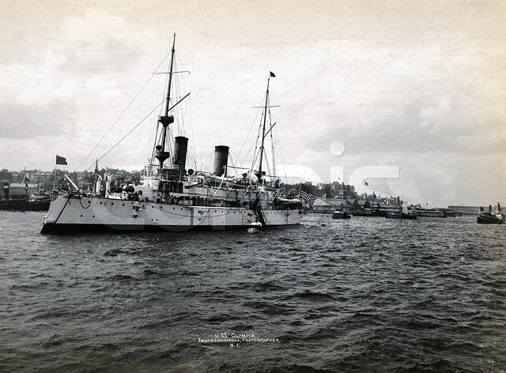
Manila Bay
What Happened at Manila Bay?
Surprise naval attack sunk the crumbling Spanish Navy
Made Americans feel very superior

Slide 24
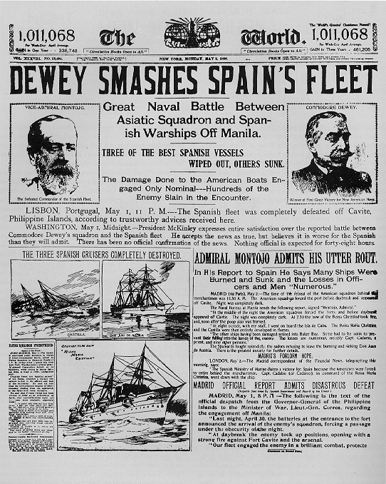
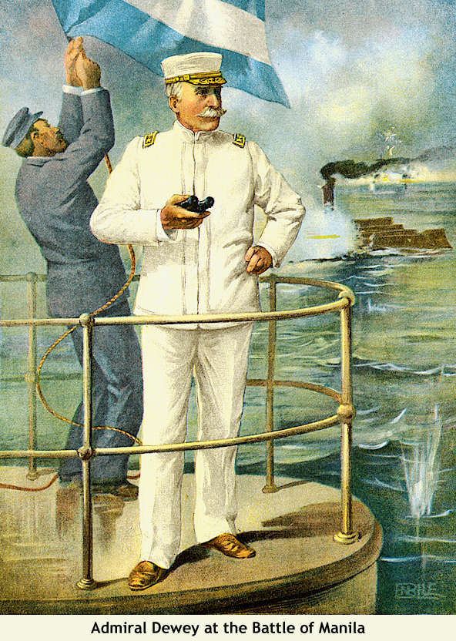
Dewey Captures Manila!

Slide 25
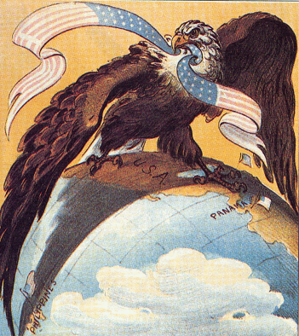
Our “Sphere of Influence”

Slide 26
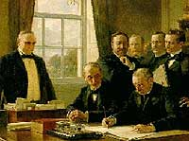
The Treaty of Paris: 1898
Cuba was freed from Spanish rule.
Spain gave up Puerto Rico and the island of Guam.
The U. S. paid Spain $20 mil. for the Philippines.
The U. S. becomes an imperial power!

Slide 27
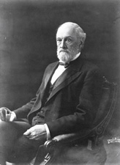
Cuban Independence?
Platt Amendment (1903)
Cuba was not to enter into any agreements with foreign powers that would endanger its independence.
The U.S. could intervene in Cuban affairs if necessary to maintain an efficient, independent govt.
Cuba must lease Guantanamo Bay to the U.S. for naval and coaling station.
Cuba must not build up an excessive public debt.
Senator Orville Platt

Slide 28
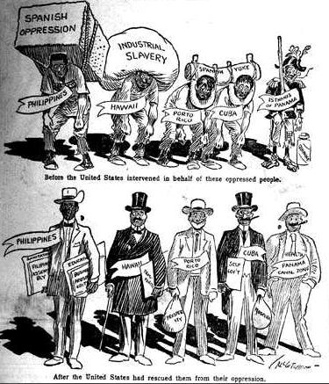
What the US Fought For

