Slide 1
Guns, Germs, and Steel
Jared Diamond

Slide 2
Civilized?
How do you describe someone that you consider “Civilized?”
How do you describe someone you consider “Uncivilized?

Slide 3
Essential Question
Why did human development advance at different rates on different continents for the last 13,000 years?
OR
Why did some groups advance faster than others in different parts of the world?

Slide 4
Hunters/Gatherers
Paleolithic | Neolithic
Hunter/Gatherer (nomad) | Settled groups in tribes/clans
Egalitarian | Centralized Government structure
Stone Tools | Bone/ Bronze Tools
Main focus: Food and survival | Farming takes care of food, more time for other things

Slide 5
If you are not focusing on finding food every second of every day, you will start to have more time to develop other things. (Job specialization)
Metallurgy
Agriculture
Herding
Complex Political Organizations
[Features of a civilization]

Slide 6
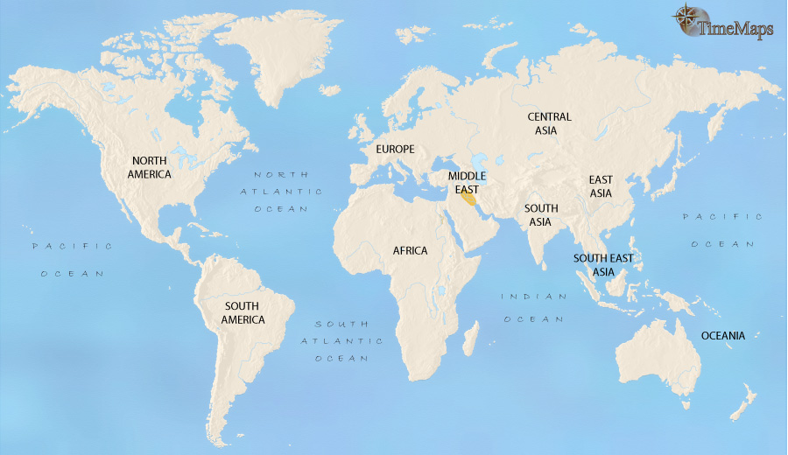

Slide 7
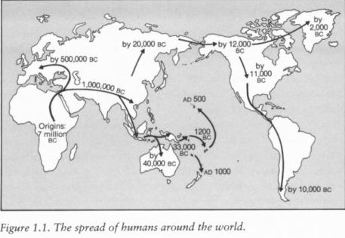

Slide 8
Reasons Eurasia Advanced
Domestication of Plants
Domestication of Animals
Epidemic Diseases
Axis orientation
Political Structure/Job Specialization/ TECHNOLOGY

Slide 9
Domestication of Plants
Wild plants were slowly chosen for farming
Big seeds/ Big fruit
These seeds were intentionally planted in fields, to yield higher amounts of food.
[Higher calories per acre]
More food = more people
When you are not worried about food, you can spend time on other things like innovation

Slide 10
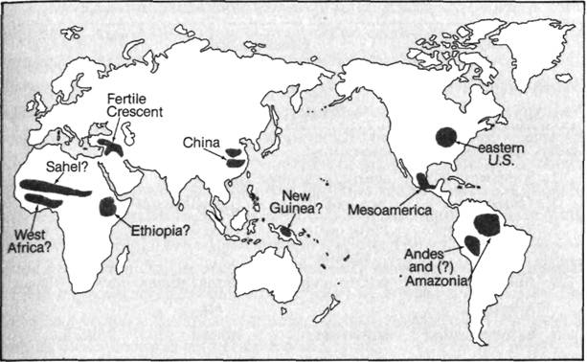

Slide 12
Domestication of Animals
Traits needed to domesticate:
Diet humans can supply
Rapid growth rate
Breed in Captivity
Submissive to humans
Can be fenced in
Used for land transport
Ice Age → North American animals died

Slide 14
Epidemic Diseases
Can only be sustained when large human populations are concentrated in villages and towns
Evolved from diseases of animals
Measles – dogs
Influenza – pigs
Smallpox – cows

Slide 15
Epidemic Diseases
When generations of humans have been exposed to the same germs, they begin to form antibodies, or immunities, to those diseases.
When new cultures who have never seen those diseases are exposed, the results are catastrophic.

Slide 16
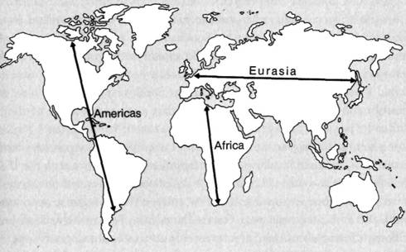

Slide 17
Continental Axis
East – West Axis: Eurasia
Domesticated species easily spread
Same latitude: same day length and climate
North- South Axis: Americas, Africa, Australia
Drastic changes in climate and day length limit spread
Geographical limitations over harsh terrains

Slide 19
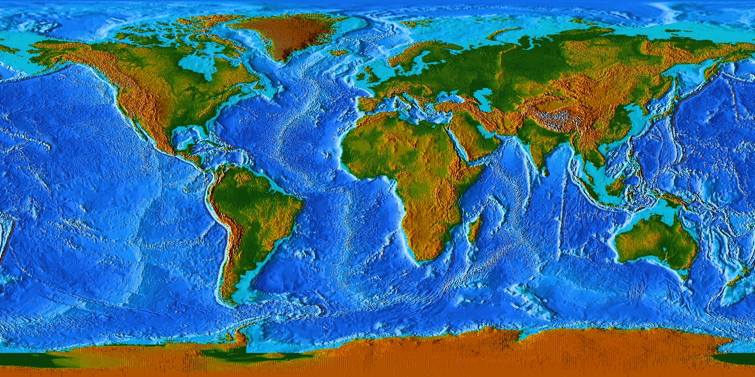

Slide 20
Technology
Food Surplus = Job Specialization = Political Structure
Technology
Metallurgy
Guns
Swords
Writing

Slide 21
