Slide 1
From Paleolithic to Neolithic
Identifying Changes in daily Life

Slide 2
Objectives
Students will be able to:
Identify six aspects of life that changed during the Neolithic period
Describe how daily life in the Neolithic period was different from daily life in the Paleolithic period
Explain the impact the development of agriculture had on Neolithic society

Slide 3
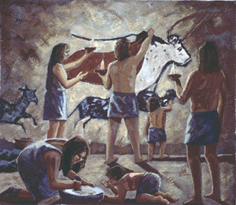
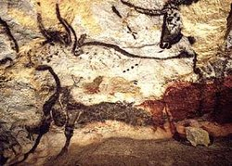
Background Information
The Neolithic period was part of the Stone Age, a time period in which people primarily used stones as tools and weapons. Dating from aprox. two million years ago to 3000 B.C.E., the Stone Age consisted of three time periods: the Paleolithic, or “Old Stone,” period from roughly two million years ago to 8500 B.C.E.; the Mesolithic, or “Middle Stone,” period from roughly 8500 to 8000 B.C.E.; and the Neolithic, or “New Stone,” period from roughly 8000 B.C.E. to 3000 B.C.E.

Slide 4
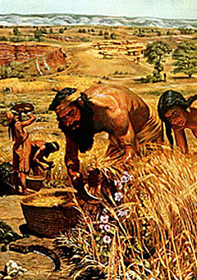
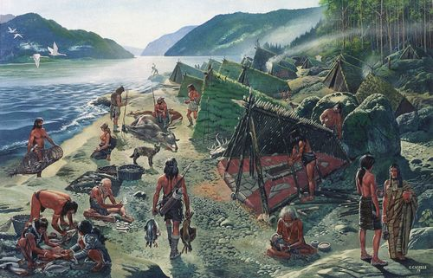
Background Information
The Development of agriculture, or farming, during the Neolithic period had a tremendous effect on human society. Farming changed so many aspects of daily life that scholars have often refereed to it as the “Neolithic Revolution or the “Agricultural Revolution.” However, these changes did not happen suddenly, as the word “revolution” suggests, but rather took place over thousands of years.

Slide 5
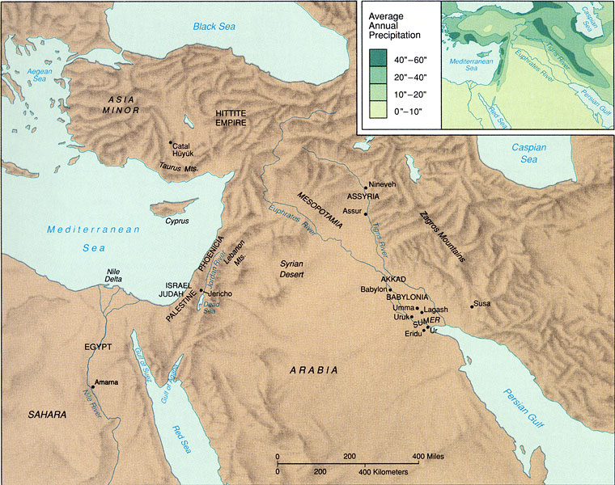
Background Information
The earliest Neolithic societies arose in the modern-day countries of Turkey, Israel, and Iraq and included such settlements as Catal Hoyuk, Jericho, and Jarmo. In these settlements, people began farming, building permanent shelters, making better tools and clothing, and developing trade and craftsmanship. Each of these changes made life more stable and comfortable for the people of the Neolithic period.

Slide 6
Directions
Cut out all the aspects of daily life tokens and arrange them in pairs. These six pairs of tokens represent an aspect of daily life during the Paleolithic period and the Neolithic period.

Slide 7
Directions
2. Match each pair of tokens to an aspect of daily life. Decide which token goes with the Paleolithic period and which token goes with the Neolithic period. Do not glue or tape until I see your work.

Slide 8
Directions
3. Read the information of each aspect of daily life and write at least three sentences explaining how this aspect of daily life changed during the Neolithic revolution.

Slide 9
Vocabulary
Neolithic Era – Origins
Neolithic Era – Culture
Origins of Writing
Specialization of Labor
Domestication
Sedentary agriculture
Neolithic or Agricultural Revolution
Cultural Diffusion
Civilization
foraging
Social differentiation

