Slide 1
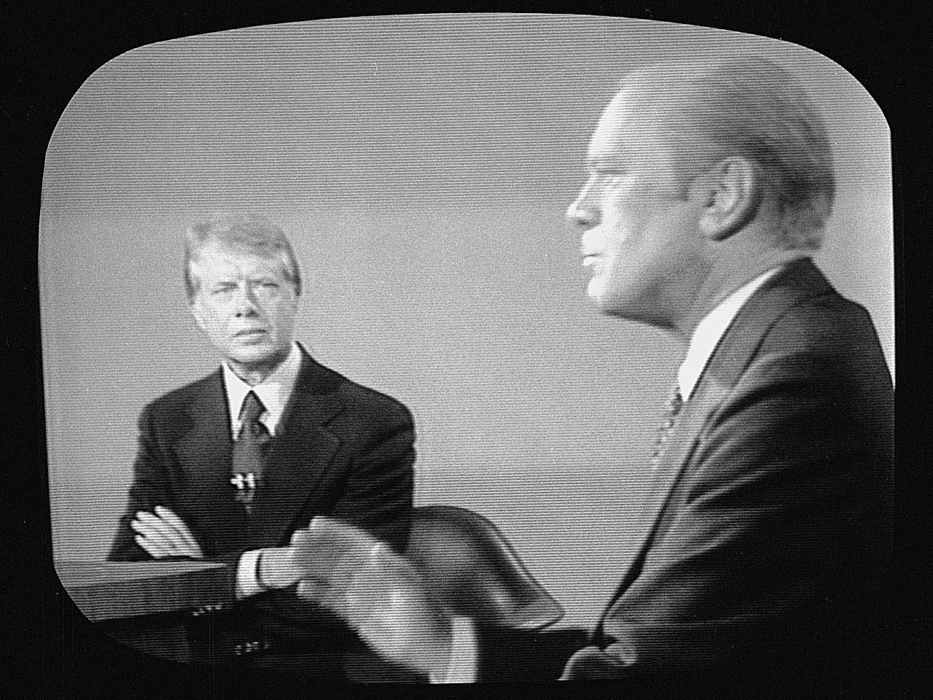
1970s: Ford and Carter Years

Slide 2
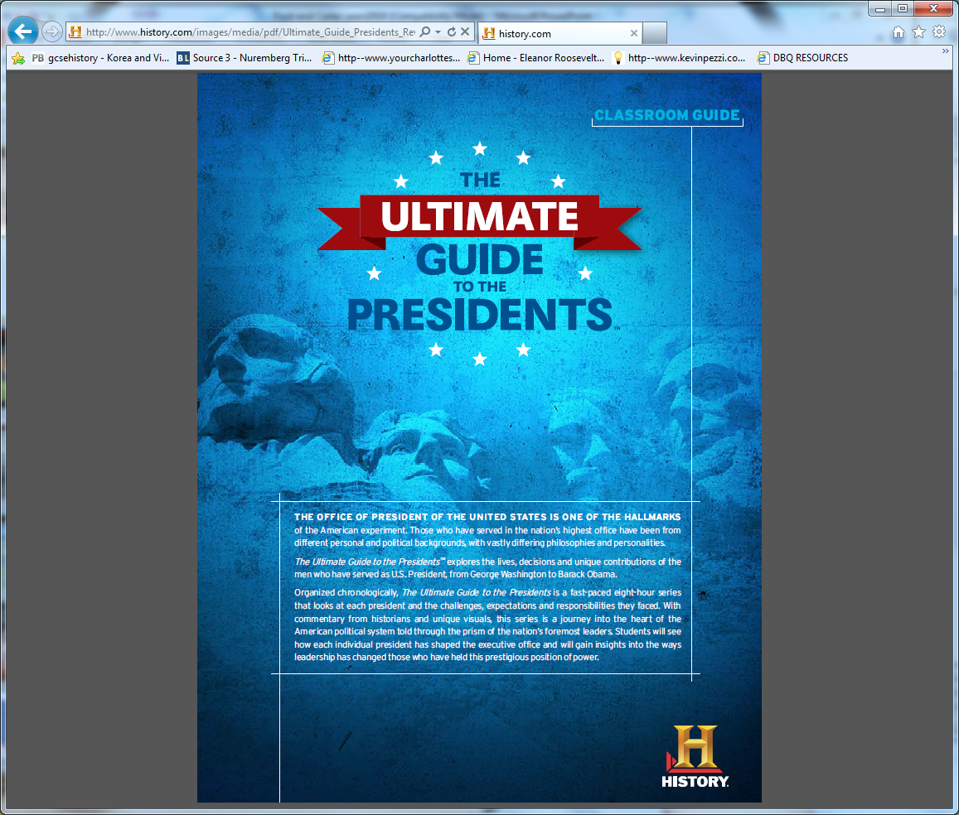
https://www.youtube.com/watch?v=xViukQv6hOg&list=PLkPAn-x0MAdj2rw4Z1f4NitTmN78qyN_O&index=8
*How did Ford become VP ?
*What was one of Fords first actions as president?
*What percent of Americans disagreed with his presidential pardon?
*What was his reasoning for pardoning Nixon?

Slide 3
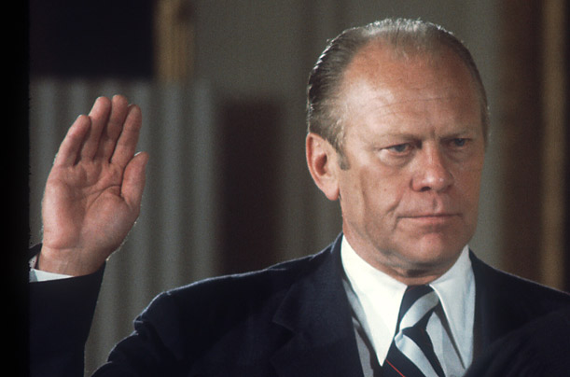
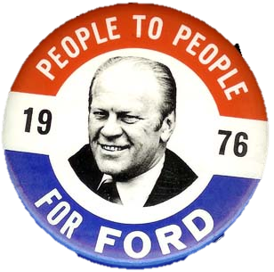
Gerald Ford
Nixon eventually forced to resign for lying and covering up Watergate Scandal
Ford became president, but will lose support for pardoning Nixon
Only president to never be elected as President or Vice President
Education for All Handicapped Children Act of 1975, established special education
Signed the Helsinki Accords, marking a move toward détente in the Cold War
This information goes in the empty squares on your notes

Slide 4
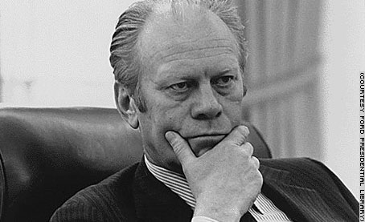
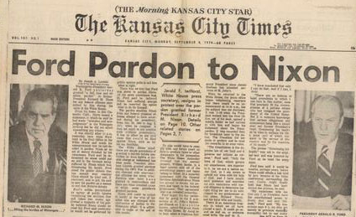
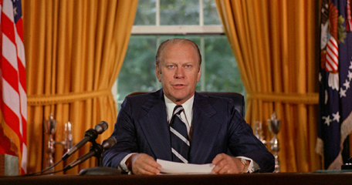
President Ford
On September 8, 1974, President Gerald Ford granted a full pardon to Richard Nixon.
Ford’s approval rating plunged from 71 percent to 50 percent.

Slide 5
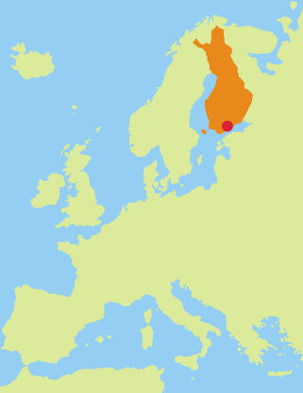
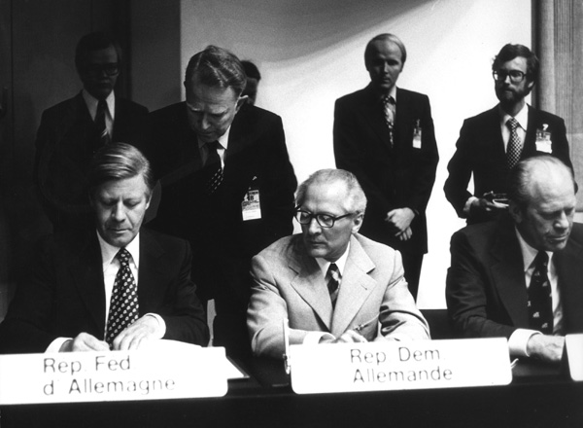
Helsinki Accords
Ford continued the foreign policy of Nixon.
In August 1975, Ford met with leaders of NATO and the Warsaw Pact to sign the Helsinki Accords.
  parties recognized the borders of Eastern Europe established at the end of World War II.
  The Soviets promised to uphold certain basic human rights but later went back on this promise
Helsinki, Finland

Slide 6
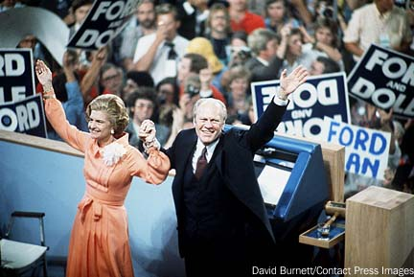
Ford ran for election 1976 against Democrat Jimmy Carter.
Ford and his wife Betty after 1976 Republican nomination

Slide 7

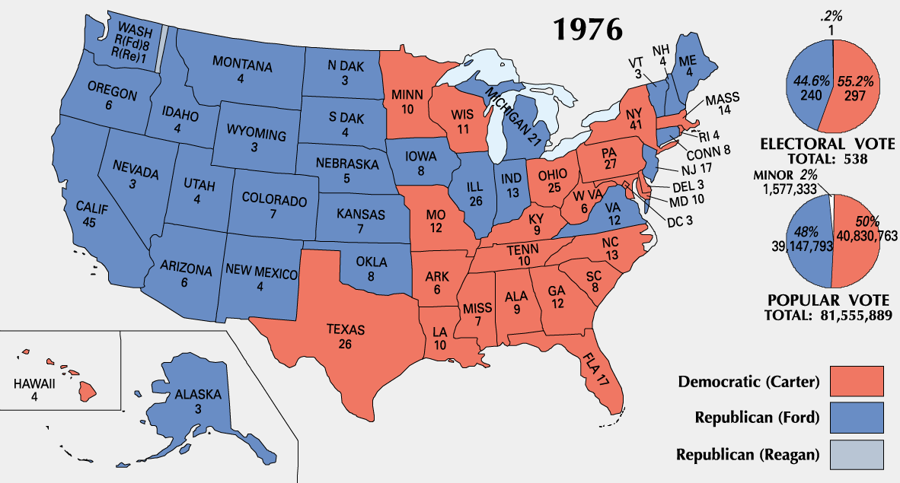
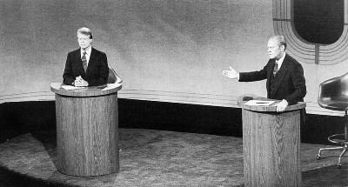
Ford and Jimmy Carter debate

Slide 8
*Give 3 examples of how Carter attempted to change the view of the president to something more humble?

Slide 9
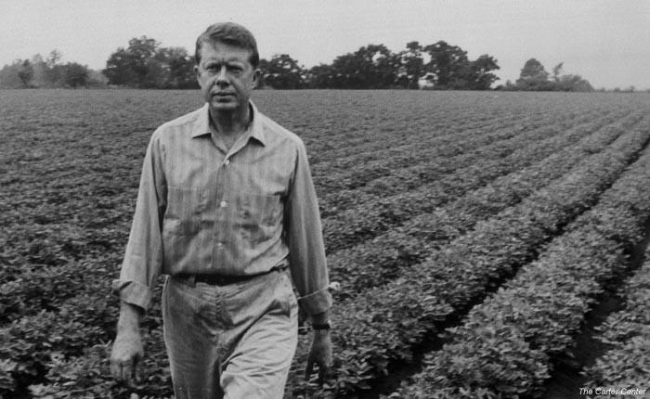
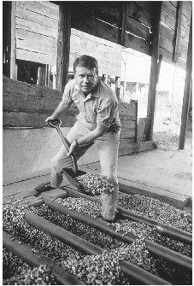
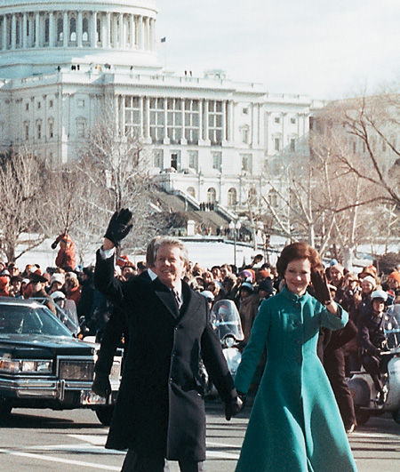
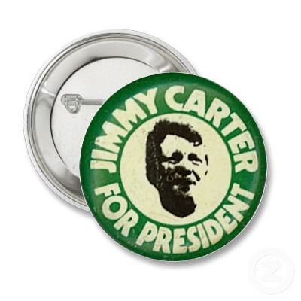
Jimmy Carter
In the election of 1976, Democratic candidate Jimmy Carter won with 50.1 percent of the popular vote.
Carter was seen as a person of high morals and an upstanding personality.

Slide 10
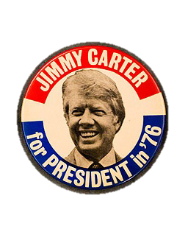
Jimmy Carter Overview
Elected for honesty and integrity
Focused on saving energy
Built foreign policy around Human Rights
Helped secure the Camp David Accords
Response to the USSR actions in Afghanistan and Iran hostage crisis seen as weak
This information goes in the empty squares on your notes

Slide 11
Disenchantment with Carter
Carter entered office with no clear political philosophy or vision:
  Deregulated the airline industry which lowered prices
  But…his attempts to reform welfare & Social Security failed
  He had no remedy for soaring inflation, interest rates, & bank failures that hurt the economy
In 1979, Carter gave the “national malaise” speech in which he discussed the importance of conserving energy but seemed to blame Americans for creating a “crisis in confidence”

Slide 12
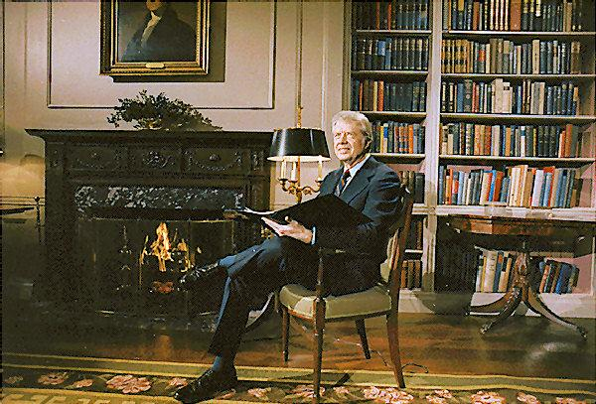
Carter on Energy
President Carter focused most of his attention on the energy crisis. His efforts
were unsuccessful.
Used “Fireside Chats” to communicate with people

Slide 13
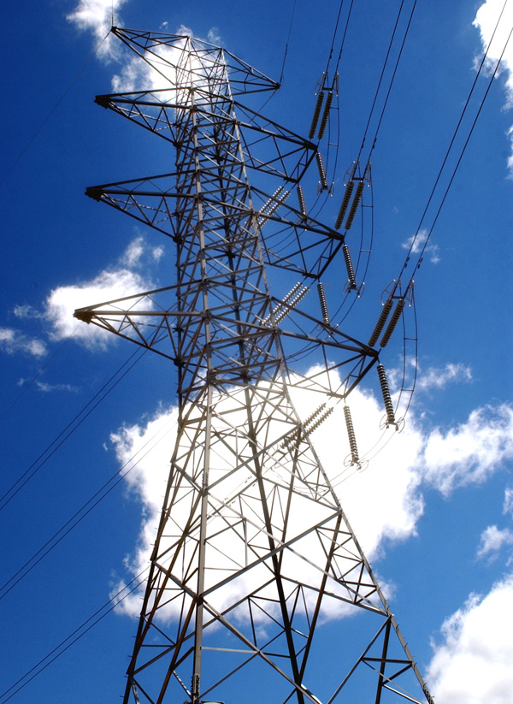


Energy Conservation
Carter proposed a national energy program to conserve oil and to promote the use of coal and renewable energy sources.
He asked Americans to reduce energy consumption, which most Americans ignored.
http://www.pbs.org/wgbh/americanexperience/features/bonus-video/presidents-economy-carter/

Slide 14


Environmentalism
During the 1960s and 1970s, Americans began to focus on environmental issues.
Americans argued that the use of pesticides had damaged wildlife and that pollution had fouled air and water.

Slide 15
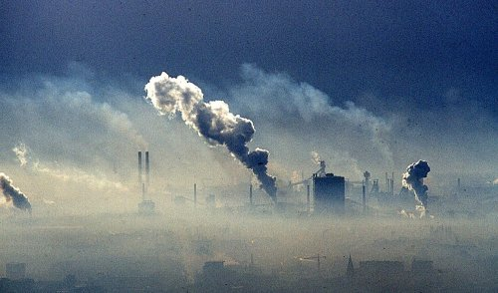


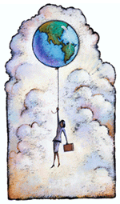

Environmental Problems
The environmental issues of the 1960s concerned all regions of the United States.
Environmental problems
  cutting down of trees in the Northwest
  smog from factories, power plants, and cars in the cities
  an oil spill off Santa Barbara, California
  pollution and garbage in Lake Erie.

Slide 16
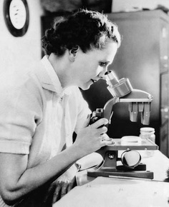
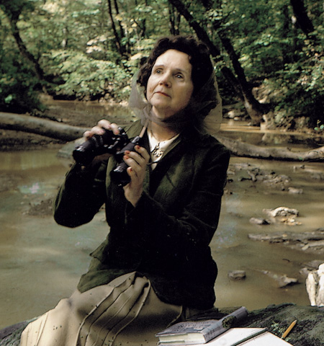
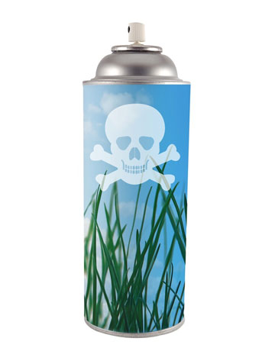

Silent Spring
Marine biologist Rachel Carson wrote of the increase of pesticides in her book Silent Spring.
She argued that the pesticides that killed insects were also killing birds and fish.

Slide 17
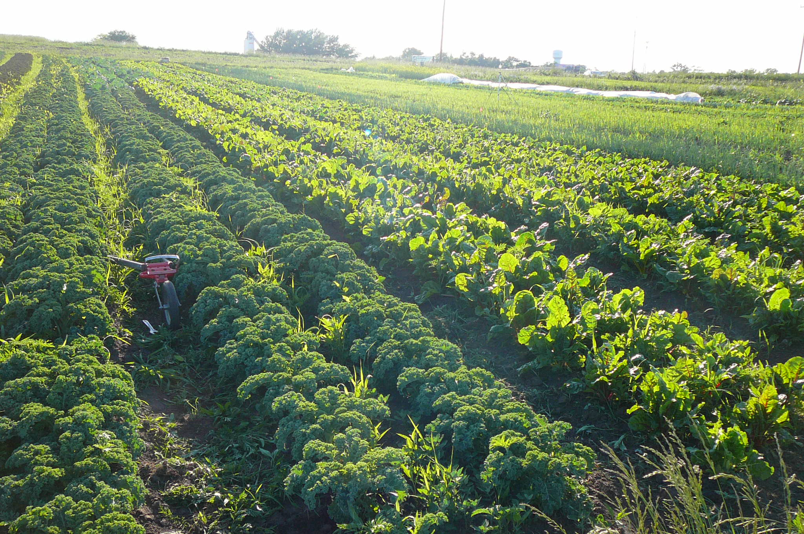
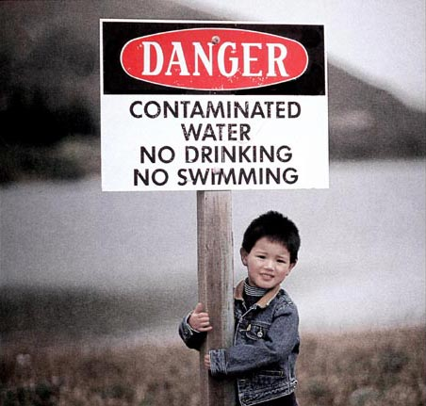
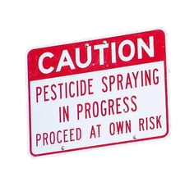
Side Effects of Pesticides
Highly toxic to workers and wildlife
Potentially cancerous
contaminates groundwater
Birth defects

Slide 18

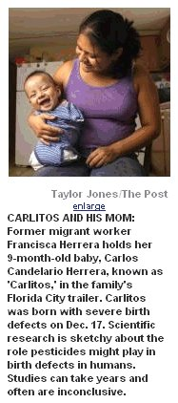
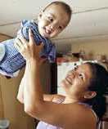
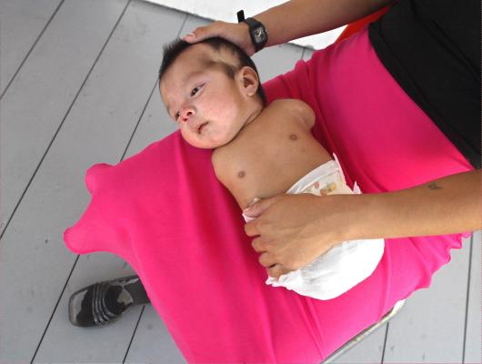
Birth Defects

Slide 19



Earth Day
In April 1970, the nation held its first Earth Day to focus on the country’s environmental concerns

Slide 20

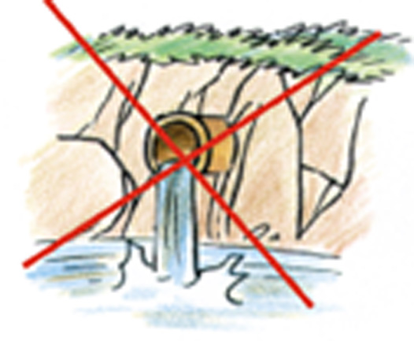
Environmental Protection
In 1970 Richard Nixon signed the Environmental Protection Policy Act, creating the Environmental Protection Agency (EPA).
  It took on the job of setting and enforcing pollution standards, promoting research, and coordinating anti-pollution activities with state and local governments.

Slide 21
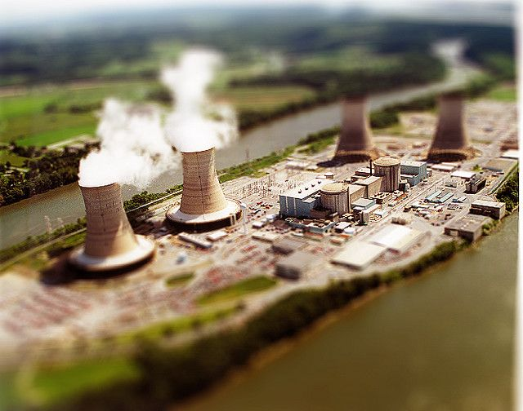
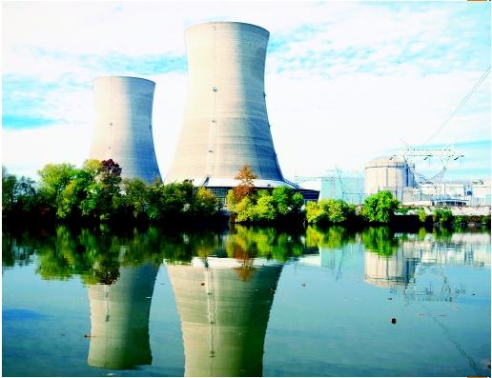
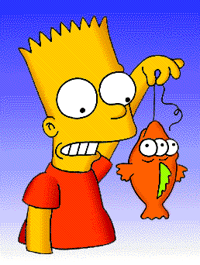
3 Mile Island
On March 28, 1979, one of the reactors at the Three Mile Island nuclear facility overheated, causing low levels of radiation to escape.
Although the plant was eventually declared safe, the incident left the public in doubt about the safety of nuclear energy.

Slide 22
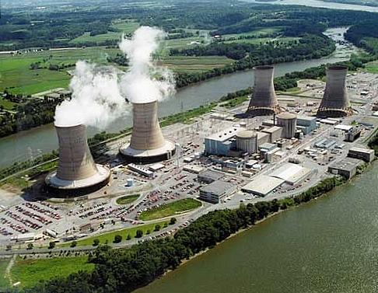

Slide 23
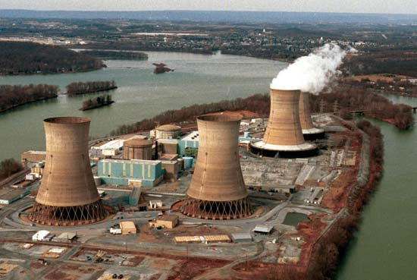

Slide 24
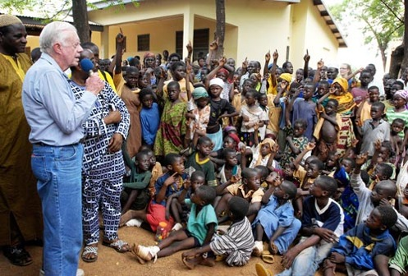
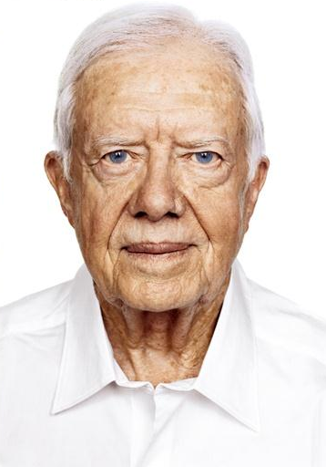
Carter’s Post Presidency
Some consider Carter to be the nation's greatest former President.
Champion of human rights and worked for several charitable causes.
Founded the Carter Presidential Center
  devoted to issues relating to democracy and human rights.
works with Habitat for Humanity International, an organization that works worldwide to provide housing for underprivileged people.

