Slide 1
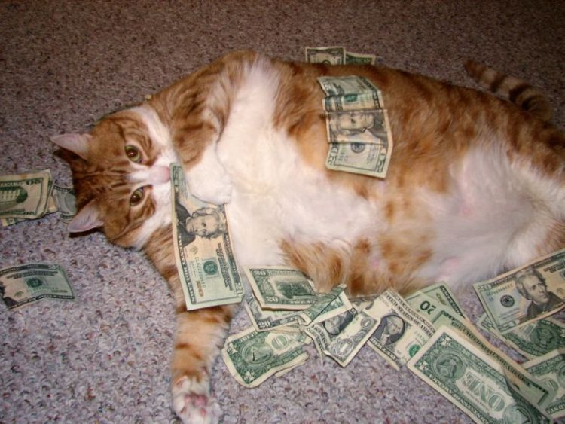
Outcome: The Fat Cats
The Industrial Age

Slide 2
The Fat cats
Setting the Stage:
Also known as “Captains of Industry,” “Industrial Giants,” & “Robber Barons”
Wealth fell into the hands of a few
By 1890 ---> 4,000 millionaires
Approx 90% of $ (wealth & assets) controlled by 10% of the population
1900 = 20 million Americans lived in poverty (very small middle class)

Slide 3
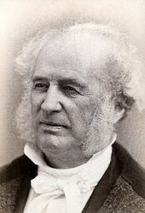
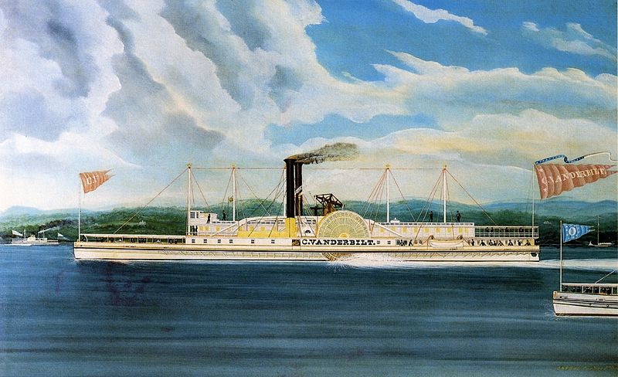
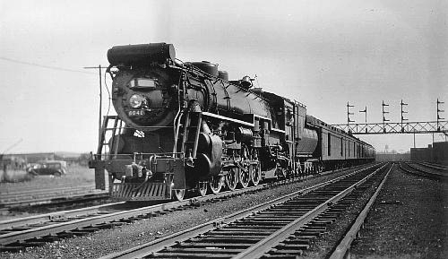
Cornelius Vanderbilt

Slide 4
The Fat cats
Who were they?
Cornelius Vanderbilt
Started out in shipping, buying his first ferry boat at age 16
Eventually had large fleet of ferries and ocean steamships
Saw railroads as the future; bought many RRs before/after Civil War
Became wealthiest man in America
Built Grand Central Depot in NYC
Made a deal with John Rockefeller to transport his oil
Would have been worth $143 billion in 2007 dollars

Slide 5
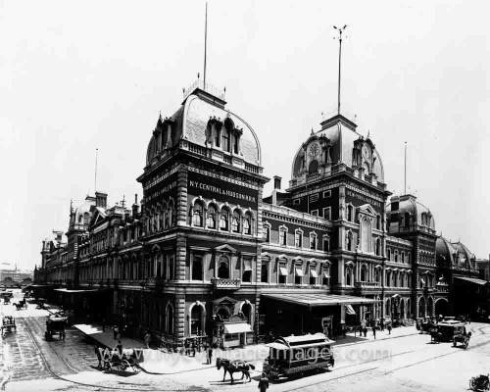
Grand central depot – New york

Slide 6
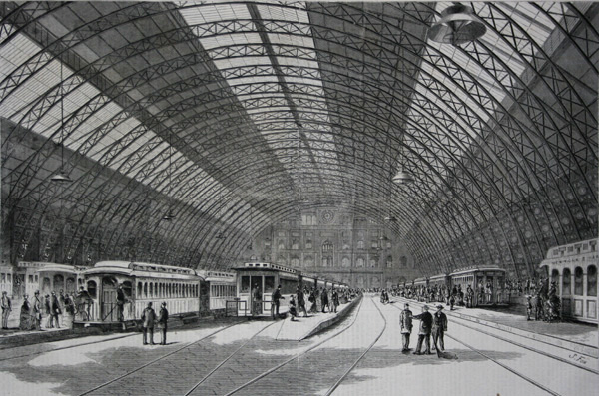

Slide 7
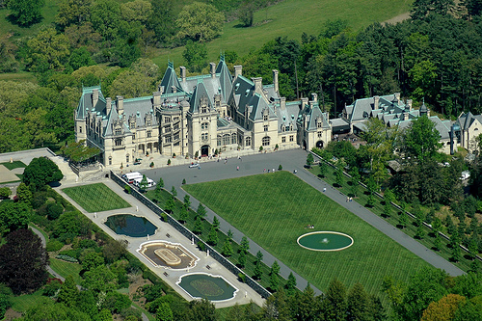
Biltmore estate in North carolina built by Vanderbilt’s grandson

Slide 8
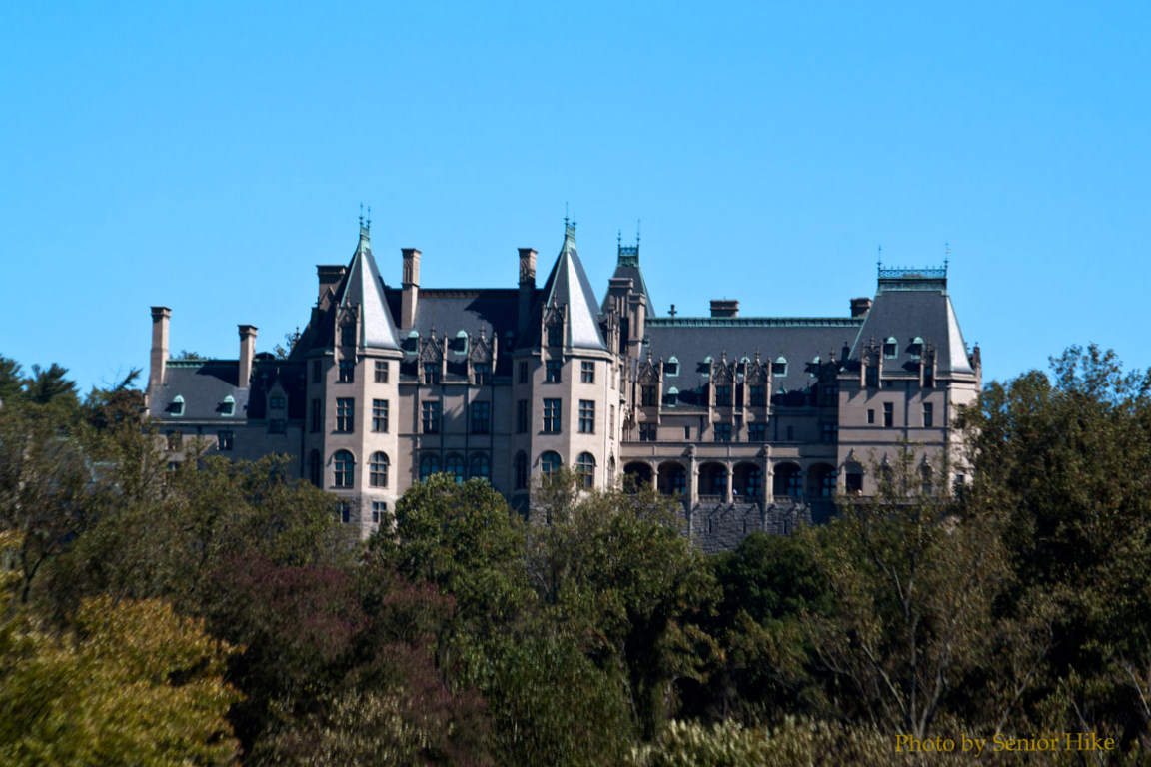

Slide 9
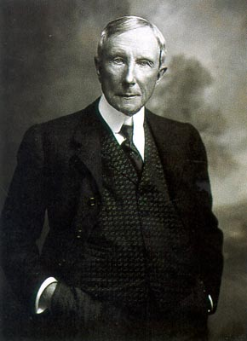
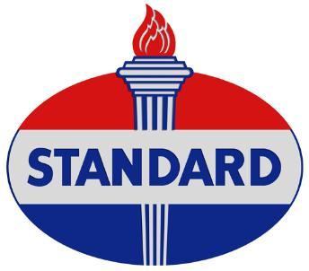
John D. Rockefeller

Slide 10
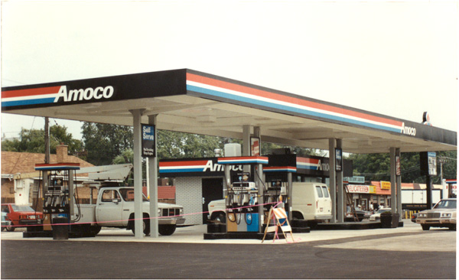
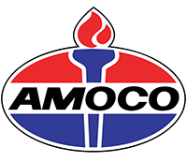
Standard oil became amoco oil

Slide 11
The Fat cats
Who were they?
J.D. Rockefeller
Founded Standard Oil Company in 1870
By 1880 ---> 90% monopoly; nation’s first billionaire
Drove out competitors by selling oil at a lower price than it cost to produce
Raised prices once he controlled the market
Gave away $500 million dollars

Slide 12
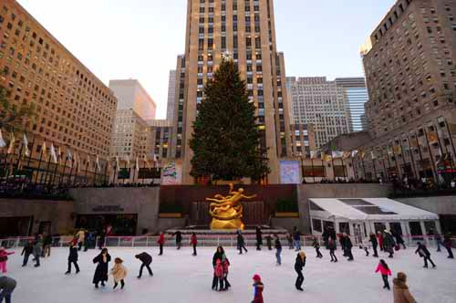
Rockefeller Center in NYC

Slide 13
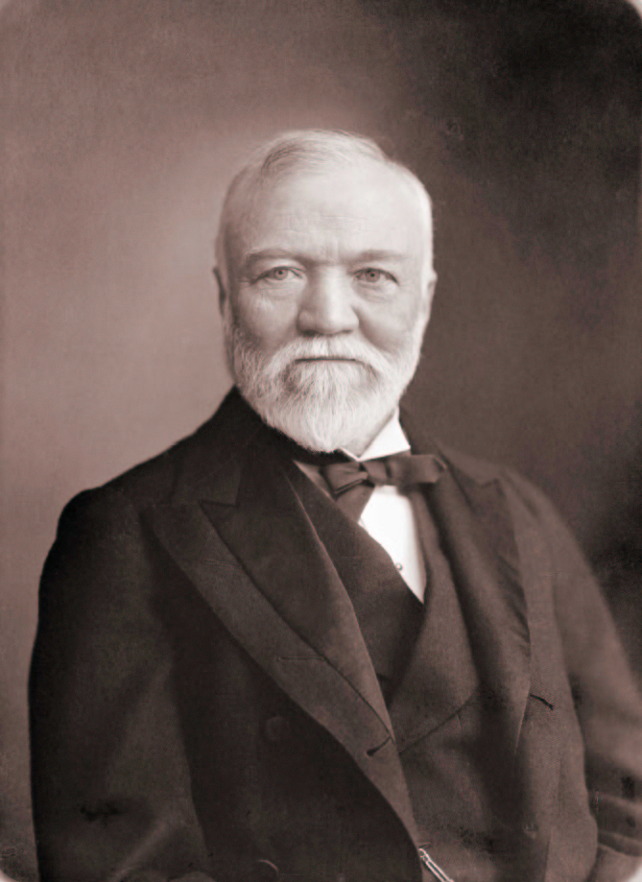
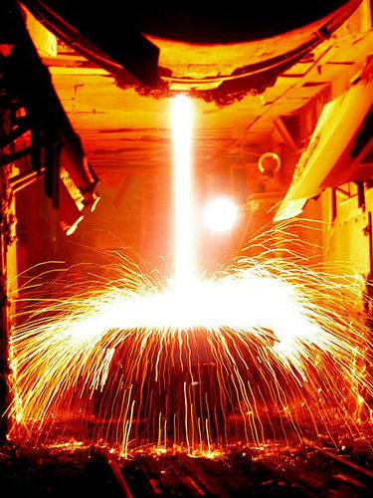
Andrew carnegie

Slide 14
The Fat cats
Andrew Carnegie
Rags to riches: born to poor Scottish family who immigrated to U.S.
Worked his way to become private secretary to the local superintendent of the Pennsylvania Railroad
Entered the Steel business in 1897
Controlled 25% of U.S. steel production
Sold his steel business to J.P. Morgan in 1901

Slide 15
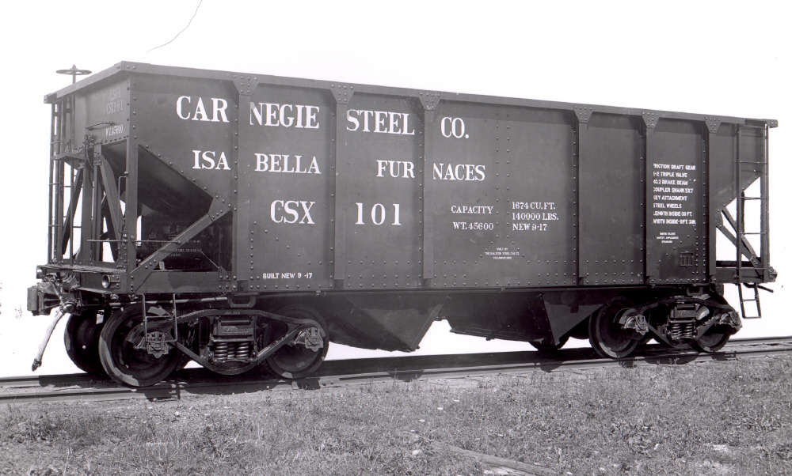
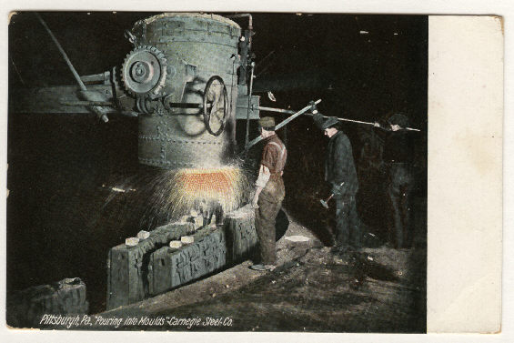

Slide 16
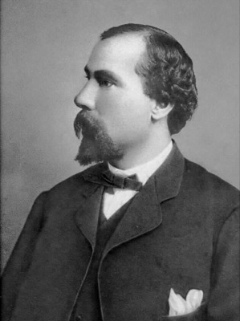
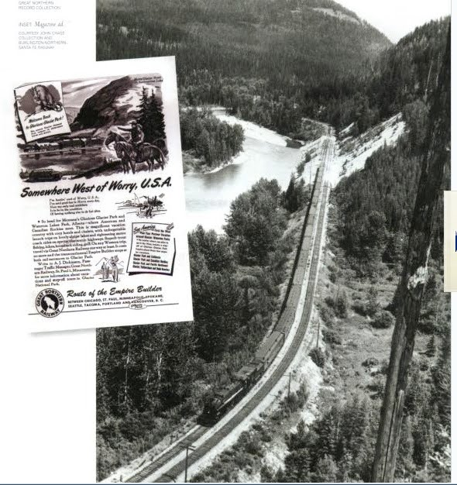
James J. Hill

Slide 17
The Fat cats
James J. Hill
Canadian born but settled in St. Paul
“Empire Builder” used no government land grants
Built Great Northern Railroad from Duluth to Puget Sound, WA
Home in St. Paul belongs to MN Historical Society

Slide 18
James J. Hill House in St. Paul

Slide 19
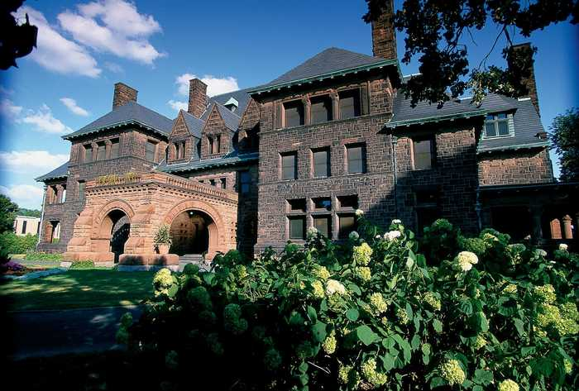

Slide 20
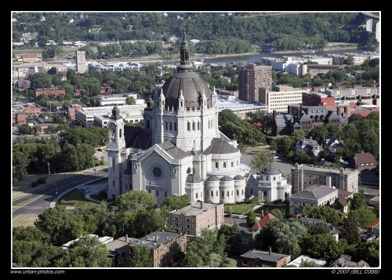
St. paul Cathedral

Slide 21
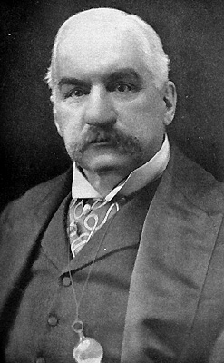
John p. Morgan

Slide 22
The Fat cats
J.P. Morgan
Was known as the “Giant of Finance”
Began his career as an accountant
Was a banker and a great organizer of companies like GE & AT&T
Bought Carnegie Steel in 1901; renamed it U.S. Steel

Slide 23
The Fat cats
How did they become rich?
Opportunity ---> a pure capitalist system allows for unlimited economic opportunity, but no guarantees
Laissez-Faire government meant unchecked free enterprise
Hands off attitude toward business/industry/economy
No income tax (not made law until 1913, 16th amendment)

Slide 24
The Fat cats
How did they become rich? (Continued…)
Labor abuses were permitted
No safety codes, No minimum wage
Unions were rare, even illegal
Monopolies formed (goal: to rid competition and control prices)
Integration tactics
Vertical integration: buying up resources, transportation, etc
Horizontal integration: merging like companies together
Bribery & Corruption
Rockefeller forced RR’s to pay him rebates on shipping
Political (bribing U.S. Senate = millionaire’s club)

Slide 25
The Fat cats
How did they become rich? (Continued…)
Improved Technology meant increased efficiency in:
Farming (McCormick’s Reaper & John Deere’s steel plow)
By 1880, 1 farmhand could harvest 135 acres a day on average
Young men migrated to cities adding to the industrial labor supply
Business & Industry
Edison ---> light bulb, stock ticker, etc
Bell ---> telephone, Sholes ---> typewriter
Corporations (Publically held companies) were formed.
Quick method of raising capital ($) for growth and expansion
Reduced risk (spread out among stockholders)
Ensures the longevity (life) of the company

Slide 26
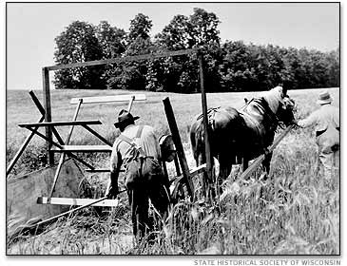
McCormick’s reaper

Slide 27
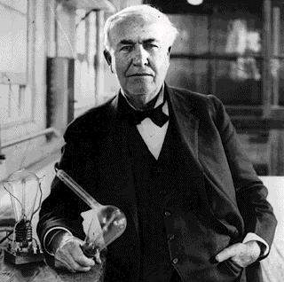
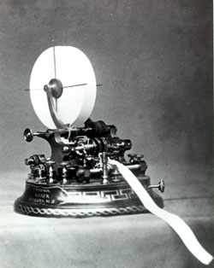
Thomas edison

Slide 28
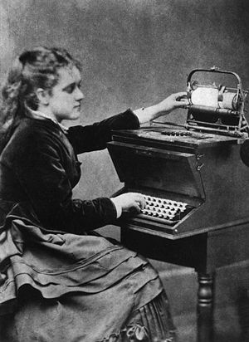
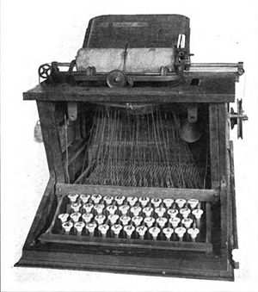
Sholes’ typewriter

Slide 29
The Fat cats
How did they become rich? (Continued…)
Social Darwinism ---> “rich were meant to be rich”
Life is a struggle and the poor are just weak &/or lazy
Justified a “hunt & kill” method to acquire wealth and power
Government Actions
Land Grants were used to encourage railroad construction and settlements
Protective Tariffs placed a tax on imported goods at compete with US goods

Slide 30
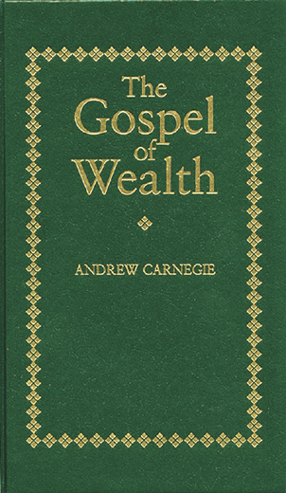
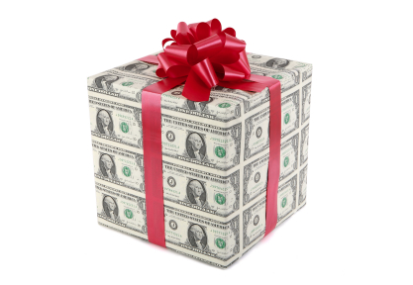
Philanthropy and the gospel of wealth

Slide 31
The Fat cats
Some became believers in Carnegie’s “Gospel of Wealth”
Rich have an obligation to improve society with their fortunes
Philanthropy: an active effort to improve society through contributions of one’s own wealth
Examples:
Carnegie: built many libraries & Carnegie Hall in NYC
Rockefeller: Donated $550 million dollars to many universities
Morgan: Donated $20M to University of the South, $10M to Harvard

Slide 32
Universities
Carnegie Mellon University
Drexel University
Rockefeller University
Spellman University
Vanderbilt University

