Slide 1
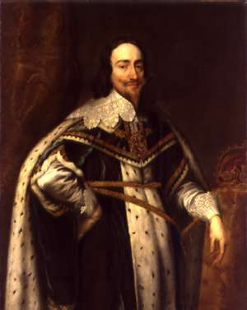
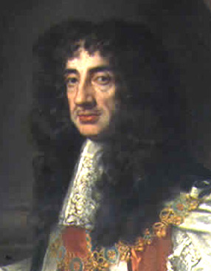
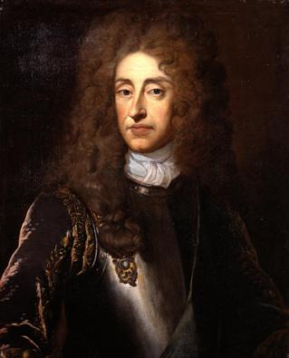
England
Charles I, Charles II, James II
(r. 1625-1649) (r. 1660-1685) (r. 1685-1688)

Slide 2
Key Terms
Early Stuarts: Charles I
English Civil War
Cavaliers
Roundheads
Oliver Cromwell & the Commonwealth
Restoration Stuarts: Charles II & James II
Restoration
Glorious Revolution
William & Mary
English Bill of Rights
Limited monarchy
Constitutional government

Slide 3
Essential Understanding
Political democracy rests on the principle that government derives power from the consent of the governed (the people). The foundations of English rights include the jury trial, the Magna Carta, and common law.
The English Civil War and the Glorious Revolution prompted further development of the rights of Englishmen.

Slide 4
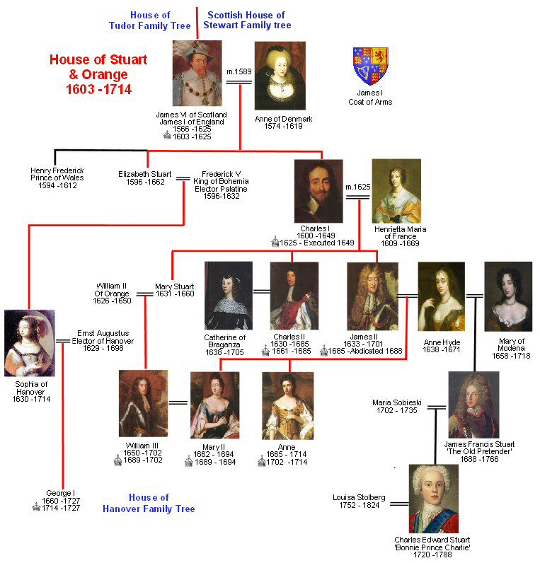

Slide 5
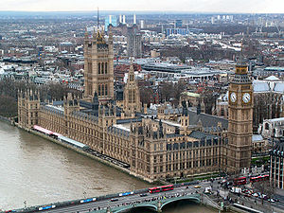
Monarchy vs. Parliament
Parliament: England’s legislative body
House of Lords which represented the nobility
House of Commons (the lower house) which represented everyone else
Parliament controlled the finances!
The Tudor’s dealt with Parliament well - the Stuarts did not!
Palace of Westminster

Slide 6
Tudors vs. Stuarts
Tudor monarchs believed in divine right but recognized the value of good relations with Parliament
Stuart monarchs weren’t as popular as the Tudors or as skilled in dealing with Parliament – they inherited problems that Henry and Elizabeth had long suppressed, resulting in a century of revolution that pitted the Stuart monarchs against Parliament

Slide 7
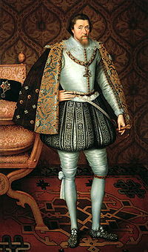
James I - King of England
James VI- King of Scotland became James I King of England
Reigned 1603-1625
He believed in the divine right of kings - kings receive their power from God and are responsible only to God
1611 - King James version of the Bible

Slide 8
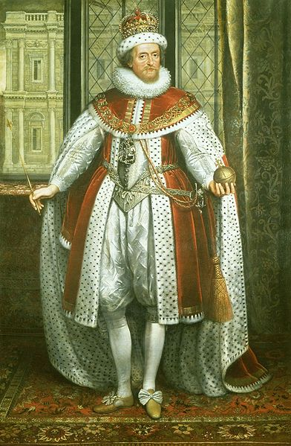
James I’s Accomplishments & Historical Significance
Often offended the Puritans in Parliament (Elizabeth flattered them to get her way)
Expanded English international trade and influence was actively pursued through the East India Company
The Thirty Years' War (1618–1648) was one of the most destructive conflicts in European history – began during his reign
James handed down to his son, Charles I a fatal belief in the divine right of kings, combined with a disdain for Parliament
These beliefs and attitudes led to the English Civil War and the execution of Charles I

Slide 9
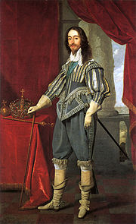
Charles I
Son of James I
Reigned 1625-1649
Married to a devout French Catholic
When he did not get what he wanted from Parliament he dissolved it in 1625

Slide 10
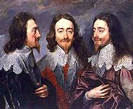
Charles I
Money came from taxing the people
Decrease in popularity
He had to call Parliament
Parliament took this opportunity to impose limits on the monarchs’ power
"Charles I, King of England,
the "Triple Portrait" by Anthony van Dyck

Slide 11
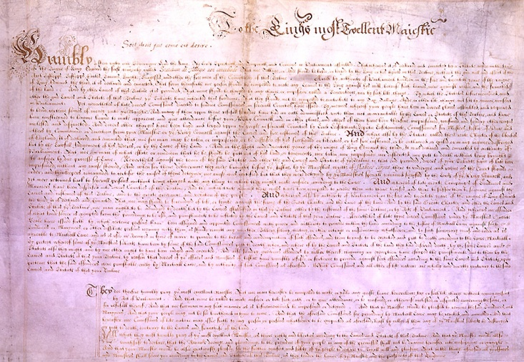
Petition of Right - 1628
The King would not:
imprison subjects without due cause
levy taxes without Parliament’s consent
house soldiers in private homes
impose martial law in peacetime
After agreeing to the petition, Charles I ignored it because it limited his power
The petition was important: it set forth the idea that the law was higher than the king

Slide 12
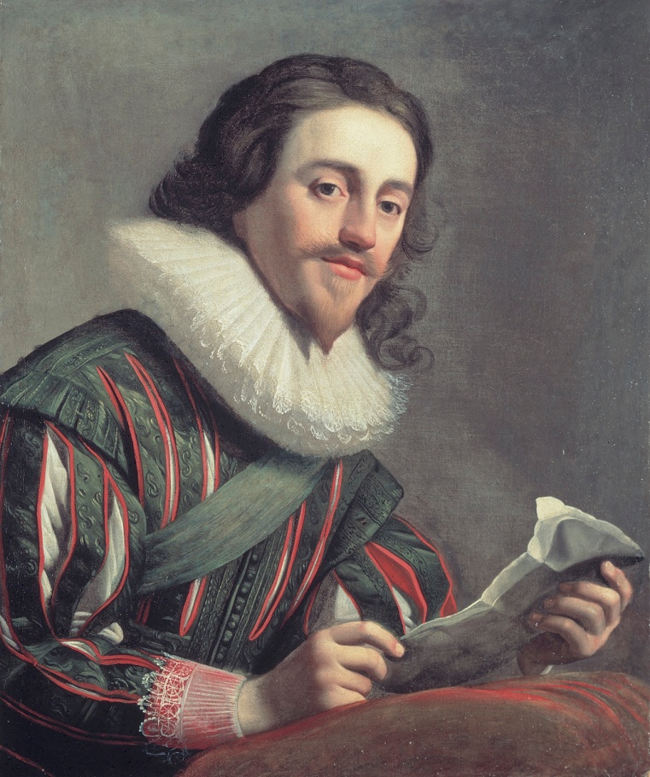
Charles I
1629 – 1640 Charles I dissolved Parliament and ruled personally
Charles tried to arrest Parliament’s leaders in January 1642 –they escaped
A mob of Londoners raged outside the palace
Charles fled London and raised an army in the north of England, where people were loyal to him

Slide 13
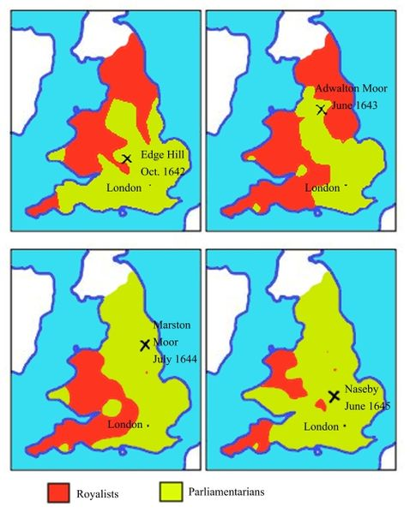
English Civil War: 1642-1649
Cavaliers: Supporters of the king or Royalists versus
Roundheads: Puritan supporters of Parliament
Oliver Cromwell, military genius, lead the New Model Army (Parliament)
His army was made up chiefly of extreme Puritans known as the Independents, who believed they were doing battle for God
Parliament won!

Slide 14
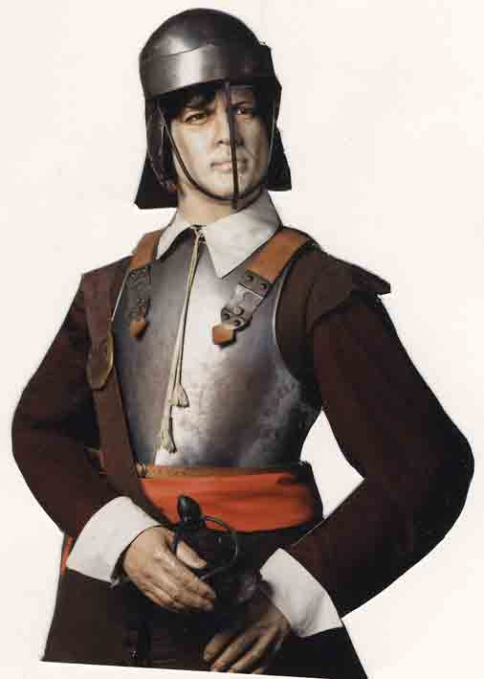
Royalists Cavaliers
Parliamentarians Roundheads
House of Lords
N & W England
Aristocracy
Large landowners
Church officials
More rural
House of Commons
S & E England
Puritans
Merchants
Townspeople
More urban

Slide 15
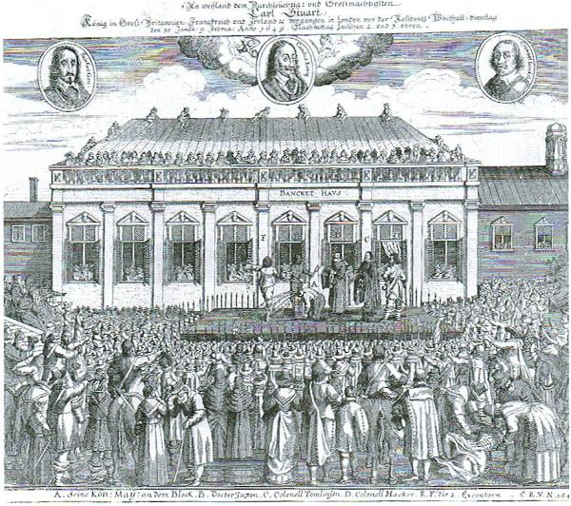
Death of King Charles I - 1649
Cromwell and the Puritans brought Charles to trial for treason. They found him guilty and sentenced him to death.
The execution of Charles was revolutionary. Kings had often been overthrown, killed in battle, or put to death in secret – but never before had a reigning monarch faced a public trial and execution by his own people.

Slide 16
Charles I’s Accomplishments & Historical Significance
Petition of Right imposed limits on the monarch’s power
Back and forth with Parliament led to the English Civil War (dissolving, then calling, then trying to arrest Parliament)
Executed for treason – the first time a reigning monarch faced a public trial and execution by his own people

Slide 17
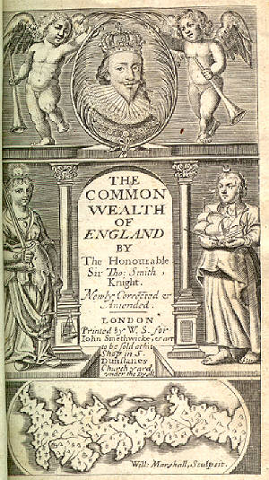
Commonwealth of England 1649-1653
Cromwell ruled with Rump Parliament
Rump Parliament abolished the monarchy and the House of Lords, and declared England a republic, or commonwealth
1653 - Cromwell dismissed Parliament (too difficult to work with) and set up a military dictatorship

Slide 18
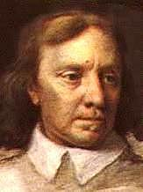
The Protectorate 1654-1660
Cromwell “Lord Protector”
Ruled until his death in 1658
He was buried in Westminster Abbey
When the Royalists returned to power his corpse was dug up, hung in chains, and beheaded

Slide 19
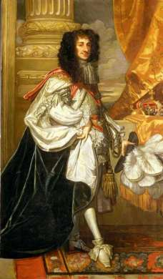
Restoration of the Stuarts
Parliament then restored the monarchy
Charles II took the throne from 1660 -1685
Under the restored Stuart monarchy, Parliament kept much of the power it had gained
It restored the Church of England as the state religion and restricted some rights of Catholics and Puritans

Slide 20
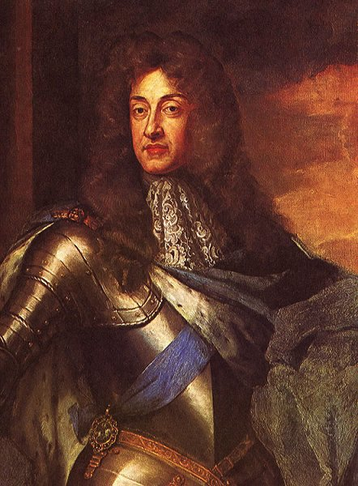
James II
1685 - James II (the younger brother of Charles II) became king when Charles II died
Devout and openly Catholic
James named Catholics to high positions in the government, armed forces, and universities
Conflict over religion again brewed

Slide 21
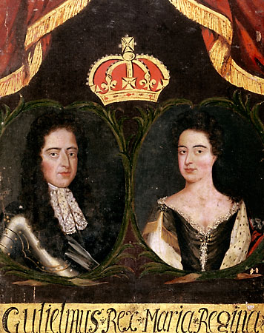
Glorious Revolution 1688
Parliament did not want James II’s Catholic son to assume the throne
The Dutch leader, William of Orange, a Protestant and husband of James’s daughter Mary, was invited to rule England
James II and his family fled, so with almost no violence, England underwent its “Glorious Revolution”

Slide 22
Charles II’s & James II’s Accomplishments & Historical Significance
Under the restoration Stuarts (Charles II and James II), Parliament kept much of the power it gained during the time of Cromwell and the Commonwealth
Conflict over religion remained a serious issue:
Stuarts = Catholic
Parliament = Church of England (Anglican)
Parliament invited William and Mary to rule England, which led to the Glorious Revolution

Slide 23
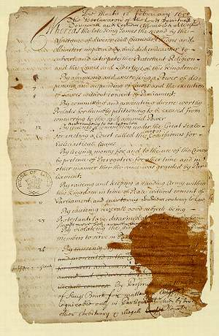
The Bill of Rights 1689
The Bill of Rights set the foundation for a constitutional monarchy
Helped create a government based on the rule of law and a freely elected Parliament
Parliament’s right to make laws and levy taxes
Standing armies could be raised only with Parliament’s consent
Right of citizens to bear arms
Right to a jury trial

Slide 24
Bill of Rights
Main provisions:
The King could not suspend the operation of laws.
The King could not interfere with the ordinary course of justice.
No taxes levied or standard army maintained in peacetime without Parliament’s consent.
Freedom of speech in Parliament.
Sessions of Parliament would be held frequently.
Subjects had the right of bail, petition, and freedom from excessive fines and cruel and unusual punishment.
The monarch must be a Protestant.
Freedom from arbitrary arrest.
Censorship of the press was dropped.
Religious toleration.

Slide 25
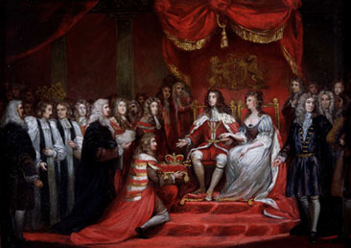
William and Mary Mary r.1689-94 and William r.1689-1702
Required to accept the Bill of Rights in order to rule - which they did
They are the only monarchs in British history to have reigned jointly

Slide 26
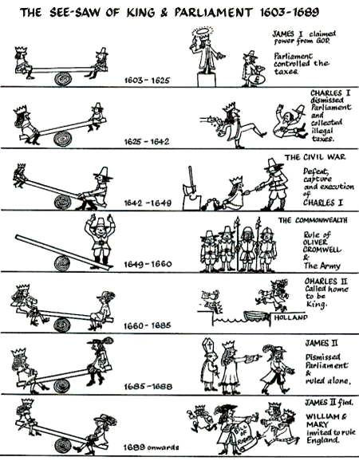

Slide 27
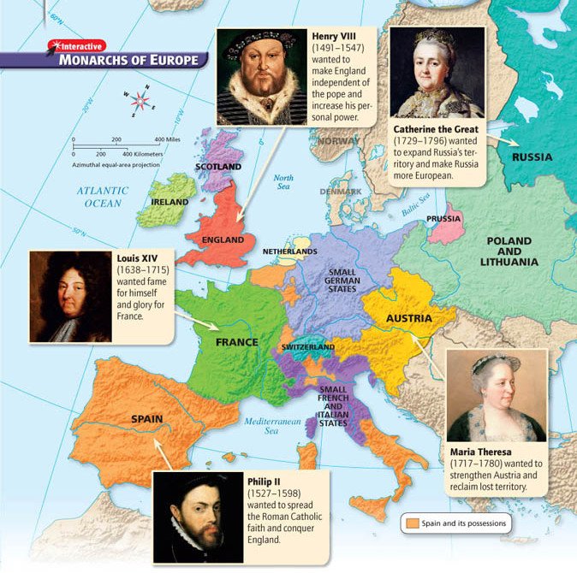

Slide 28
Looking Ahead
By the mid-1700s, absolute monarchs ruled four of the five leading countries in Europe – Britain, with its strong Parliament, was the only exception
As these five nations competed with one another, they often ending up fighting to maintain a balance of power
At the same time, new ideas were in the air – radical changes would soon shatter the French monarch, upset the balance of power, and revolutionize European societies

