Slide 1
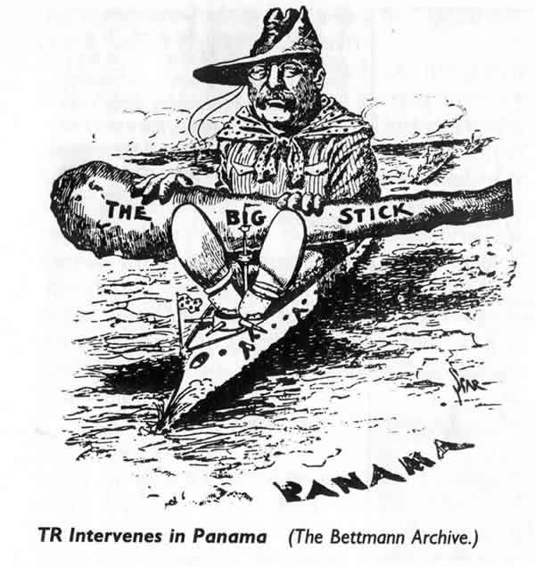
THE AGE OF U.S. IMPERIALISM
“Speak softly and carry a big stick; you will go far.”
- T. Roosevelt

Slide 2
America
Becomes
a Colonial
Power

Slide 3
Essential Question:
Why did America
Become an imperialist
power at the end
of the 19th century?

Slide 4
IMPERIALISM - definitions
1. Imperialism = the quest to build up a
territorial empire
.
2. Imperialism = control by powerful nation(s) over a less advanced or less civilized area.

Slide 5
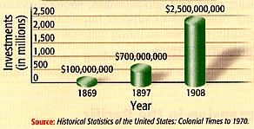
1. Commercial/Business Interests
U. S. Foreign Investments: 1869-1908

Slide 6
Dependency on Foreign Trade
By the 1890s, the American economy was increasingly dependent on foreign trade. A quarter of the nation's farm products and half its petroleum were sold overseas.

Slide 7
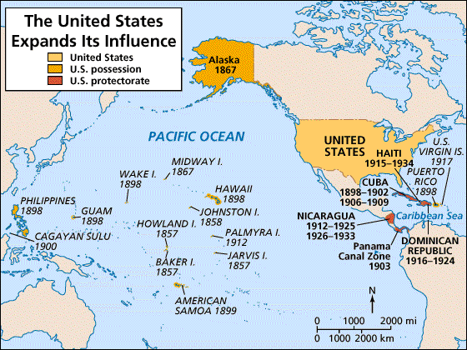
2. Military/Strategic Interests

Slide 8
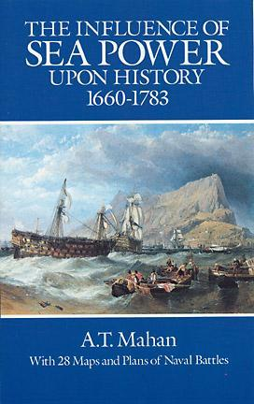
A Desire for Sea Power
Alfred Thayer Mahan, a naval strategist and the author of The Influence of Sea Power Upon History, argued that national prosperity and power depended on control of the world's sea-lanes. "Whoever rules the waves rules the world," Mahan wrote.

Slide 9
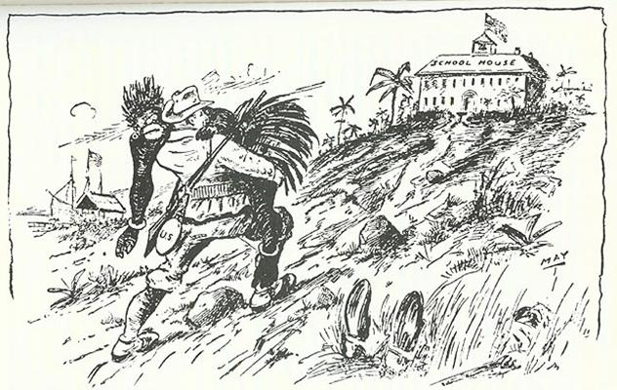
3. Social Darwinist Thinking
The White Man’s Burden
The Hierarchy of Race

Slide 10
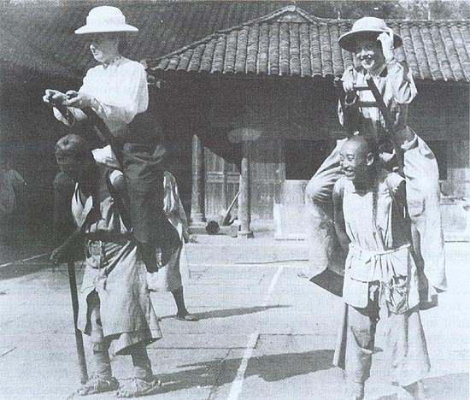
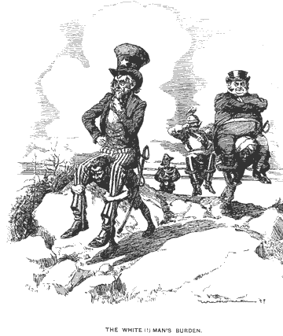
4. Religious/Missionary Interests
American Missionaries in China, 1905

Slide 11
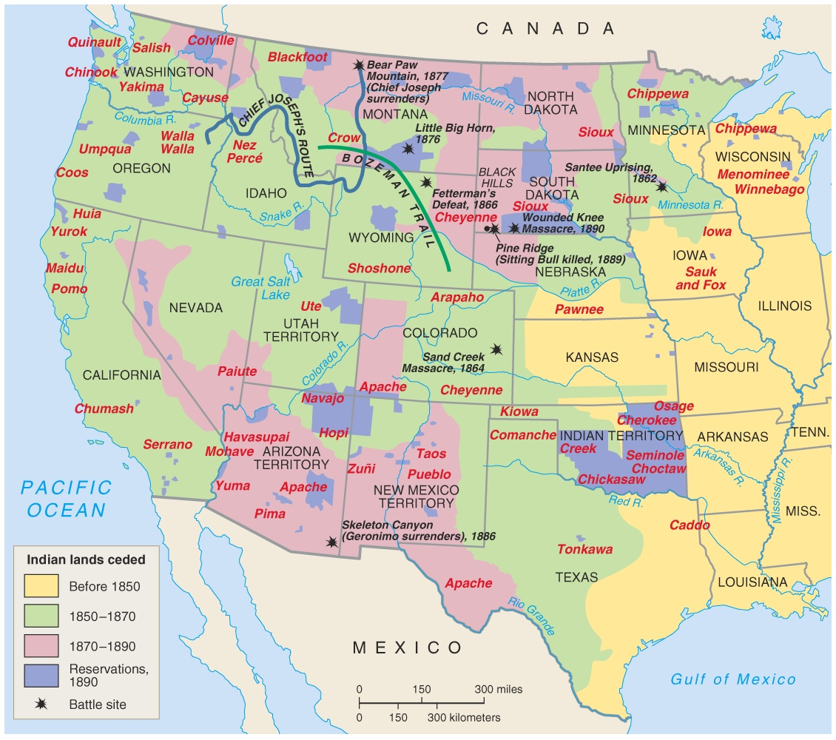
5. Closing the American Frontier

Slide 12
“The Sun never sets on the British Empire”

Slide 13
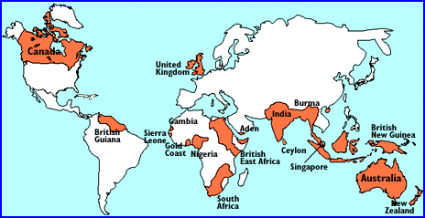
6. Compete with other world powers

Slide 14
Hawaii:
"Crossroads
of the
Pacific"

Slide 15
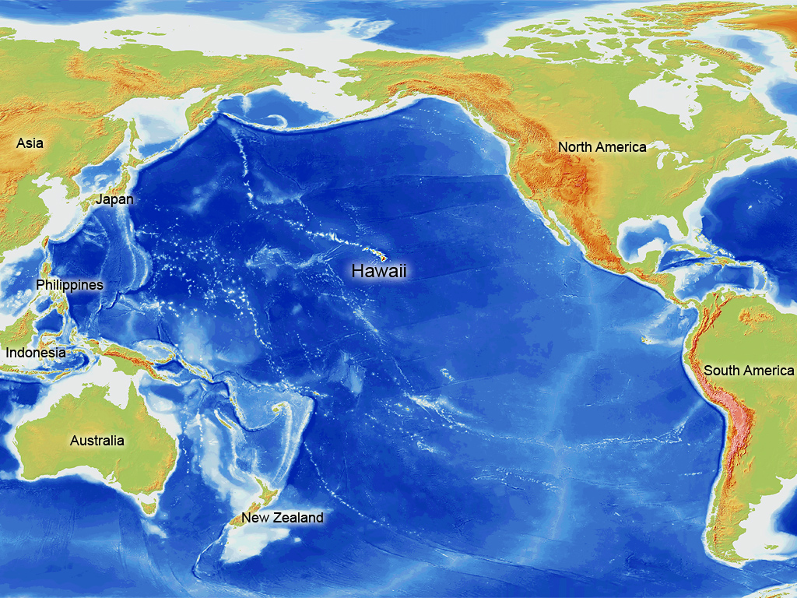

Slide 17
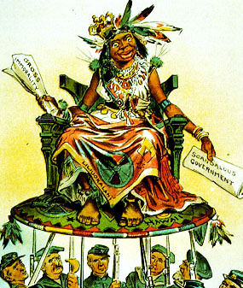
U. S. View of Hawaiians
Hawaii becomes a U. S. Protectorate in 1849 by virtue of economic treaties.

Slide 18
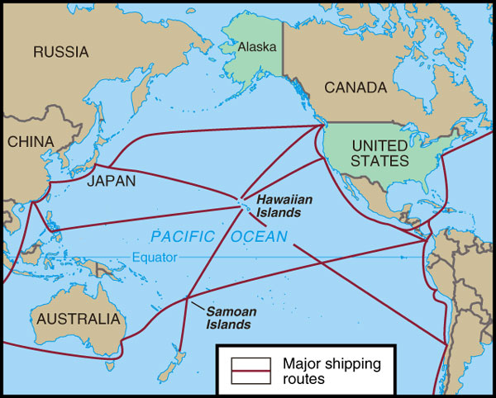
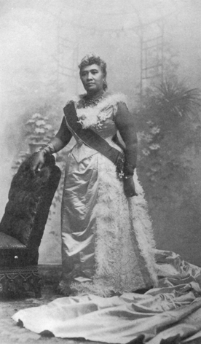
Hawaiian Queen Liliuokalani
Hawaii for the Hawaiians!

Slide 19
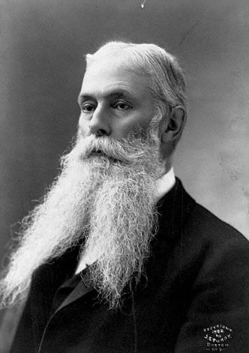
U. S. Business Interests In Hawaii
1893 – American businessmen backed an uprising against Queen Liliuokalani.
Sanford Ballard Dole proclaims the Republic of Hawaii in 1894.

Slide 20
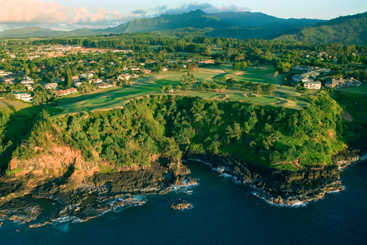
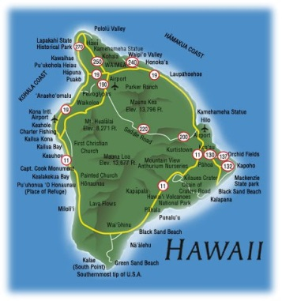
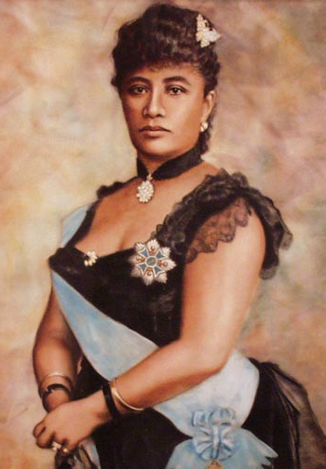
The Annexation of Hawaii
In 1893, a small group of sugar and pineapple-growing businessmen, backed by the U.S. military, deposed Hawaii's queen, seized 1.75 million acres of land, and conspired for U.S. annexation of the islands, which was achieved in 1898. Hawaii became a state in 1959.

