Slide 1
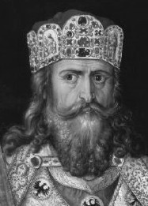
Outcome: Germanic Kingdoms Emerge & Charlemagne
The Middle Ages

Slide 2
Constructive Response Questions
Who was Charlemagne and why is he significant?

Slide 3
Germanic Kingdoms Emerge

Slide 4
Germanic Kingdoms Emerge
Germanic Kingdoms
In the upheaval between 400 and 600, small Germanic kingdoms replaced Roman provinces
Borders changed constantly
Family ties and personal loyalty were more important than public government and written law
Germanic stress on personal ties made it impossible to establish orderly government

Slide 5
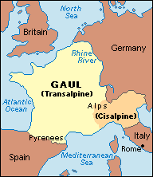
Germanic Kingdoms Emerge
Clovis and the Franks
The Franks had power in Gaul (modern day France and Switzerland)

Slide 6
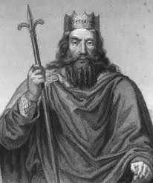
Germanic Kingdoms Emerge
Clovis was leader of the Franks
Christianity was a constant variable in the Middle Ages
Clovis brings Christianity to the region
Fears defeat by another Germanic tribe and appeals to Christian God:
Battle shifts in his favor and Franks win
Clovis and 3,000 of his warriors ask a bishop to baptize them
By 511, Clovis had united the Franks in one kingdom

Slide 7
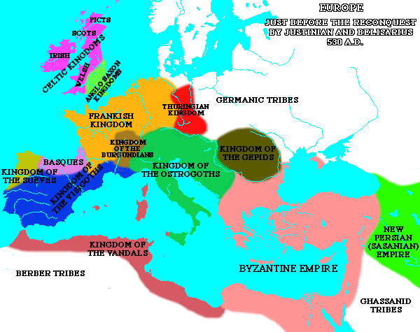
Germanic Kingdoms Emerge
A Frankish Empire Evolves
The Franks now controlled the largest and strongest of Europe’s kingdoms
When Clovis died in 511, the Franks controlled most of modern day France

Slide 8
Germanic Kingdoms Emerge
Frankish position of Mayor of the Palace:
Position which had become the most powerful in Frankish kingdom
Official power: Had charge of the royal households and estates (like a lord)
Unofficial power: Led armies and made policy, essentially ruling the kingdom

Slide 9
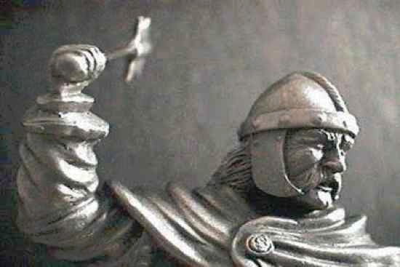
Germanic Kingdoms Emerge
Charles Martel or Charles the Hammer
By 719, Charles held more power than the king as mayor of the palace
Charles was part of the Franks and therefore was Christian

Slide 10
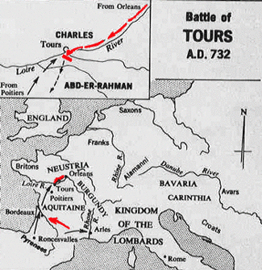
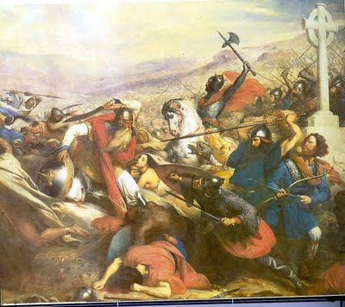
Germanic Kingdoms Emerge
Charles Martel or Charles the Hammer
Defeated Muslim raiders from Spain at the Battle of Tours in 732
Historians argue that if the Christians had lost, Muslims could have taken over Europe
Charles was a Christian hero; Christianity wins
At his death, he passed his power to Pepin the Short (not necessarily short)
Pope anoints Pepin “King by the grace of God,” thus beginning the Carolingian Dynasty- family that would rule the Franks from 751-987

Slide 11
Charlemagne

Slide 12
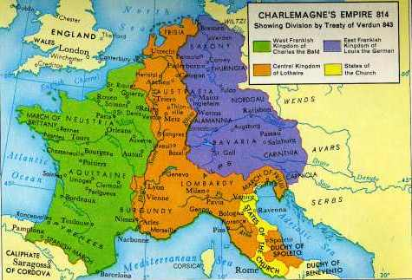
Charlemagne
Charlemagne Becomes Emperor
Pepin the short died in 768
Charles the Great, better known as Charlemagne takes over in 771
Imposing figure standing 6 foot 4 inches tall

Slide 13
Charlemagne
Charlemagne as King
Was now the most powerful king in Western Europe
Charlemagne built an empire greater than any known since the Romans
His conquests against the Muslims to the south and east spread Christianity
He united Western Europe for the first time since the Roman Empire
The empire became known as the Holy Roman Empire
Charlemagne strengthened his power by weakening power of the nobles
Sent out royal agents to check on powerful landowners
Regularly visited his kingdom
Encouraged learning- surrounded himself with scholars and opened new monasteries

Slide 14
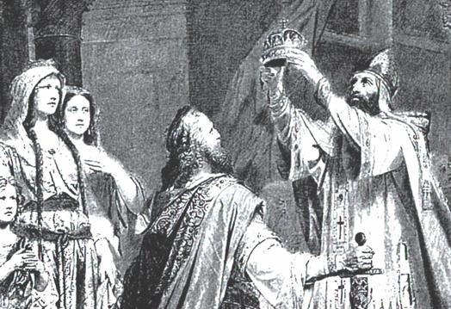
Germanic Kingdoms Emerge
In 800, he traveled to Rome to protect the pope → the pope rewards Charlemagne by crowning him emperor
This historic coronation showed that the pope had more power than the king

Slide 15
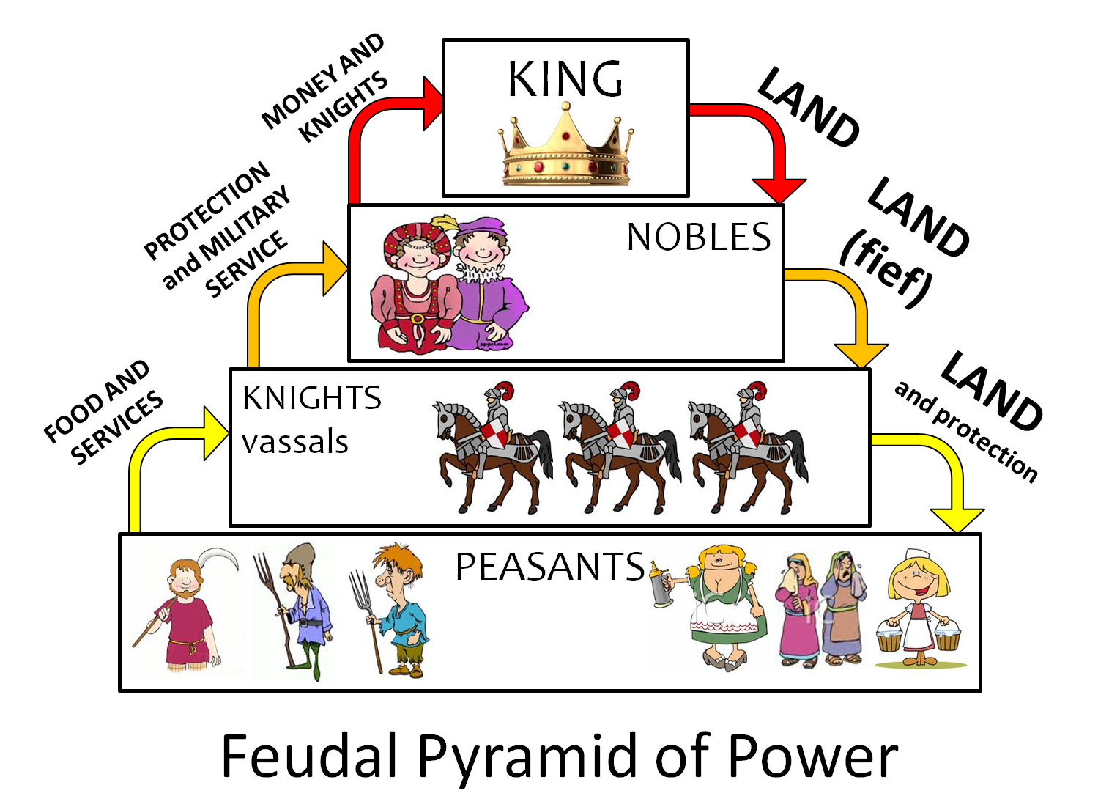
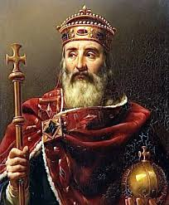
Germanic Kingdoms Emerge
Charlemagne died in 814, his grand sons split up the kingdom- bad idea
Carolingian kings lost power and authority broke down
This lead to the rise of feudalism

Slide 16
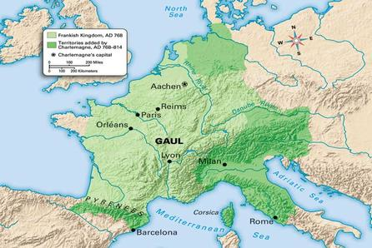
Germanic Kingdoms Emerge
Result: Through Christianity, Clovis was able to unite the Franks into a strong Christian, military power. Charles Martel solidified Christianity’s strength in Europe which helped lead to the eventual rise of the more powerful Frankish king Charlemagne.

Slide 17
Constructive Response Questions
Who was Charlemagne and why is he significant?

