Slide 1
Art, Architecture, and Innovations

Slide 2
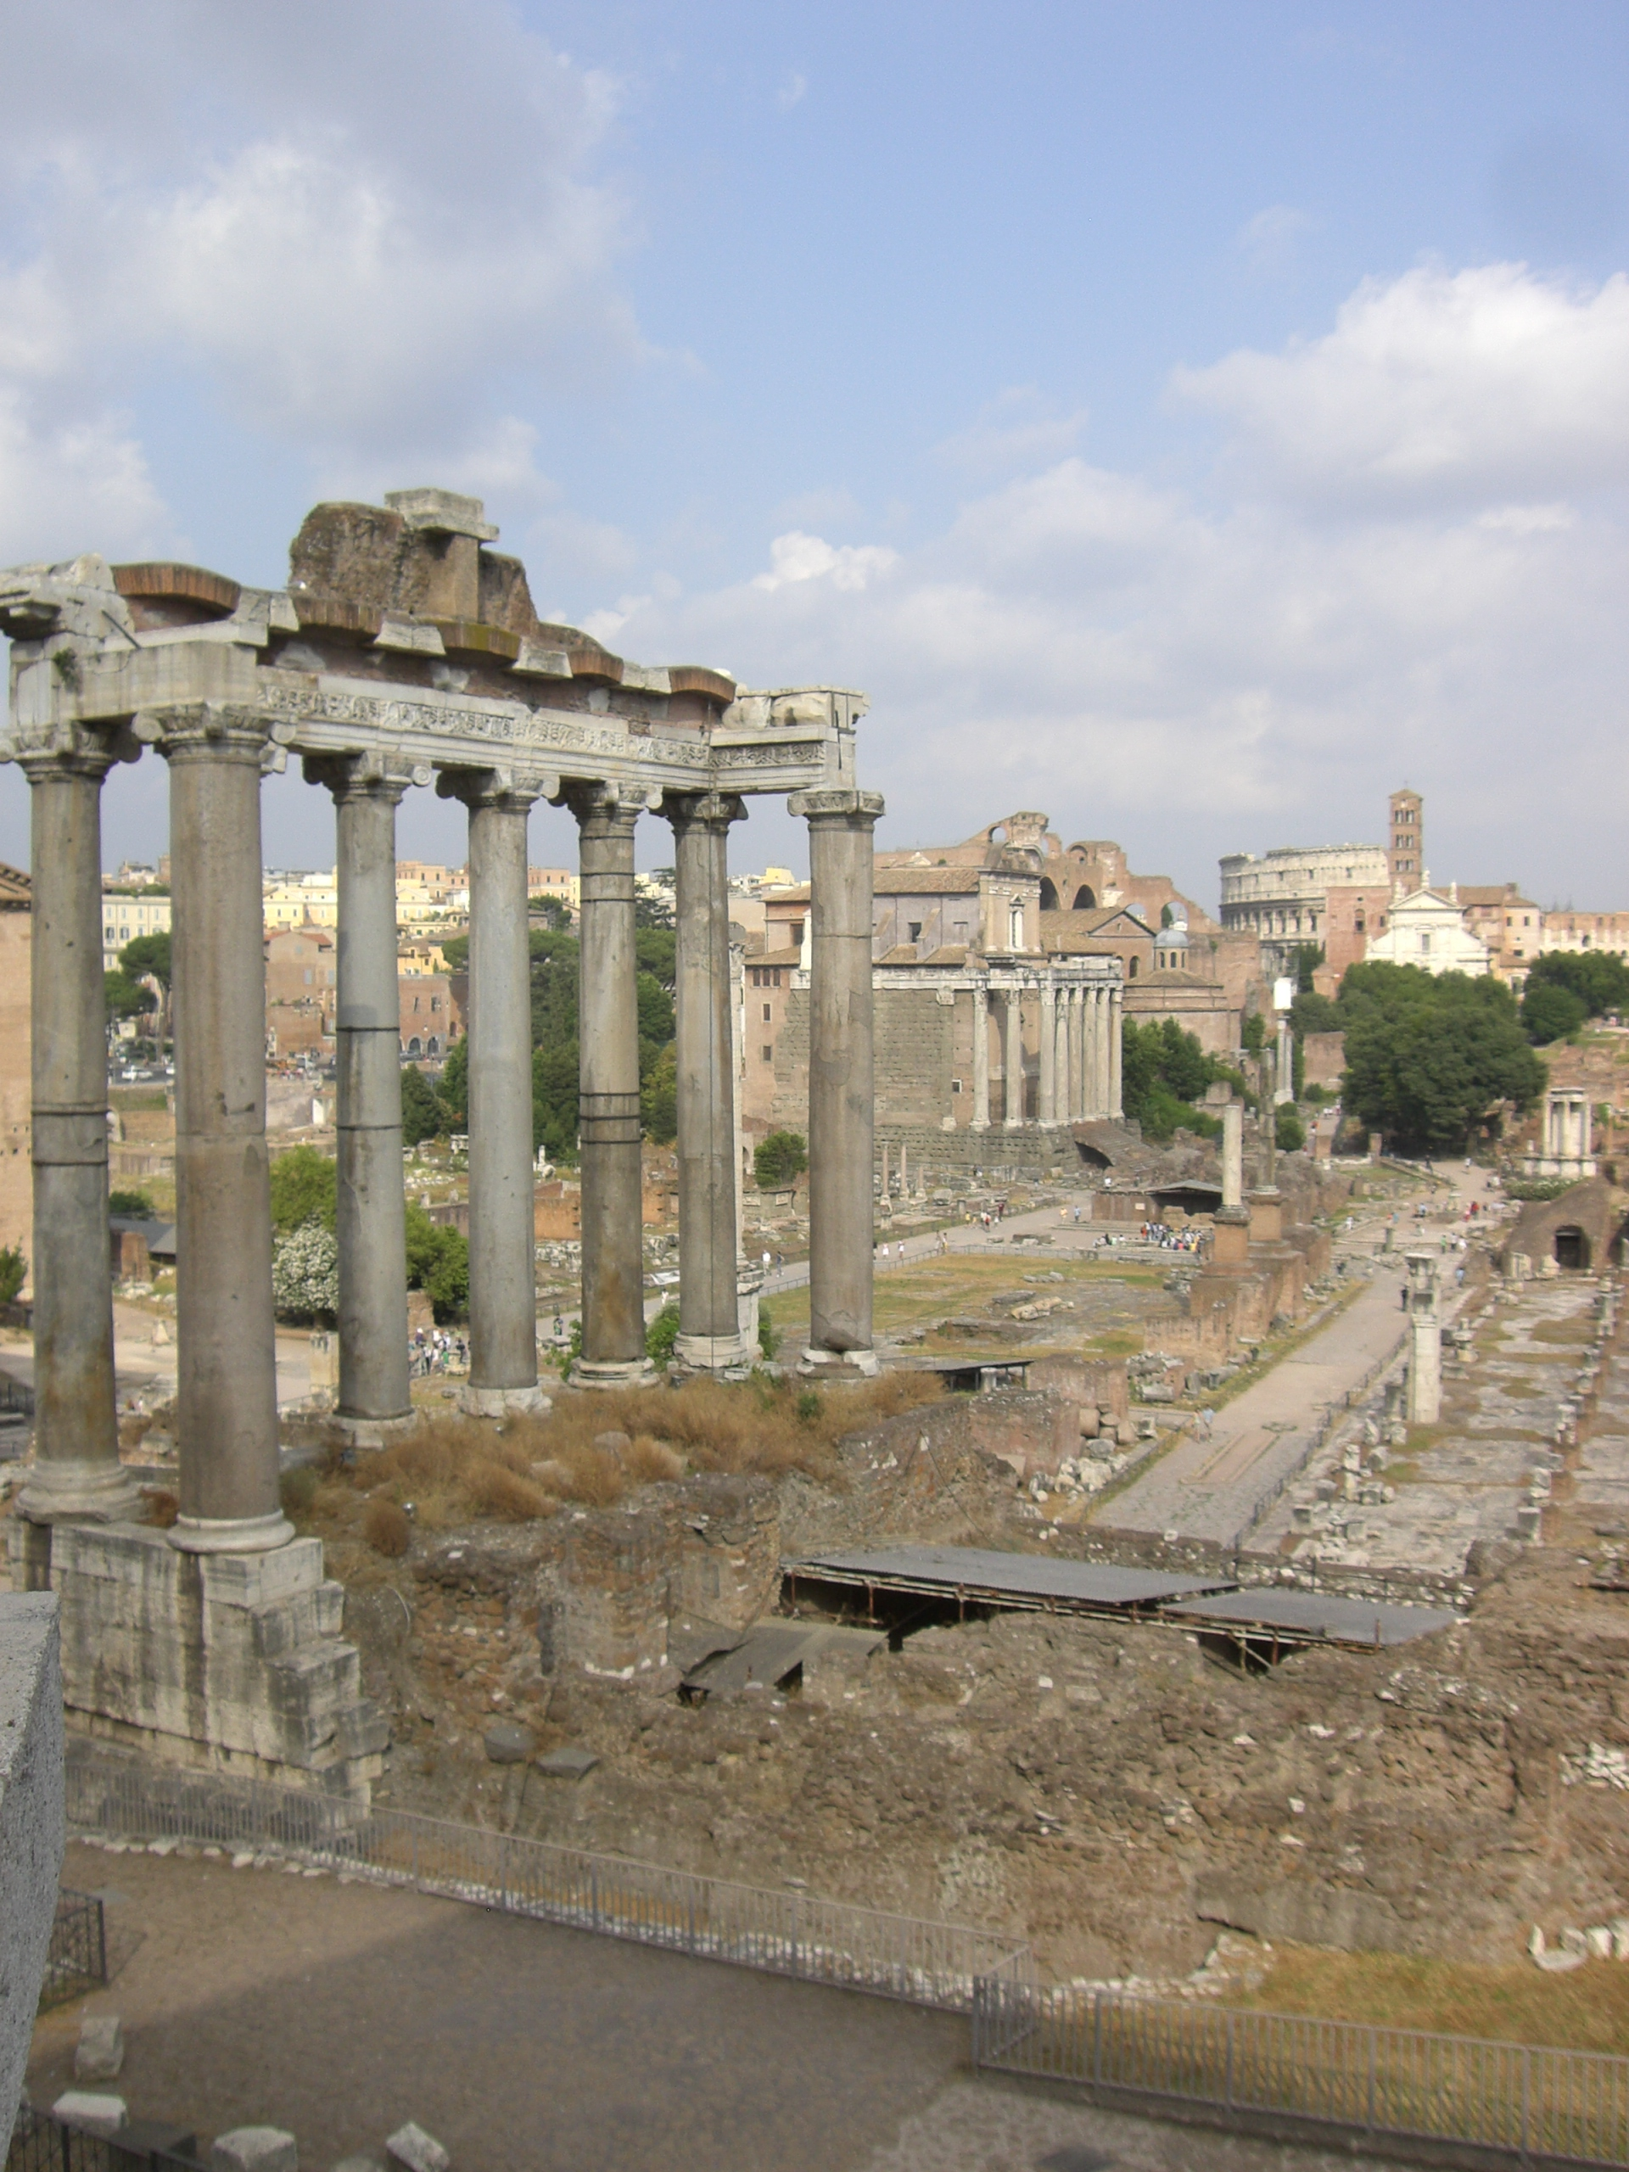
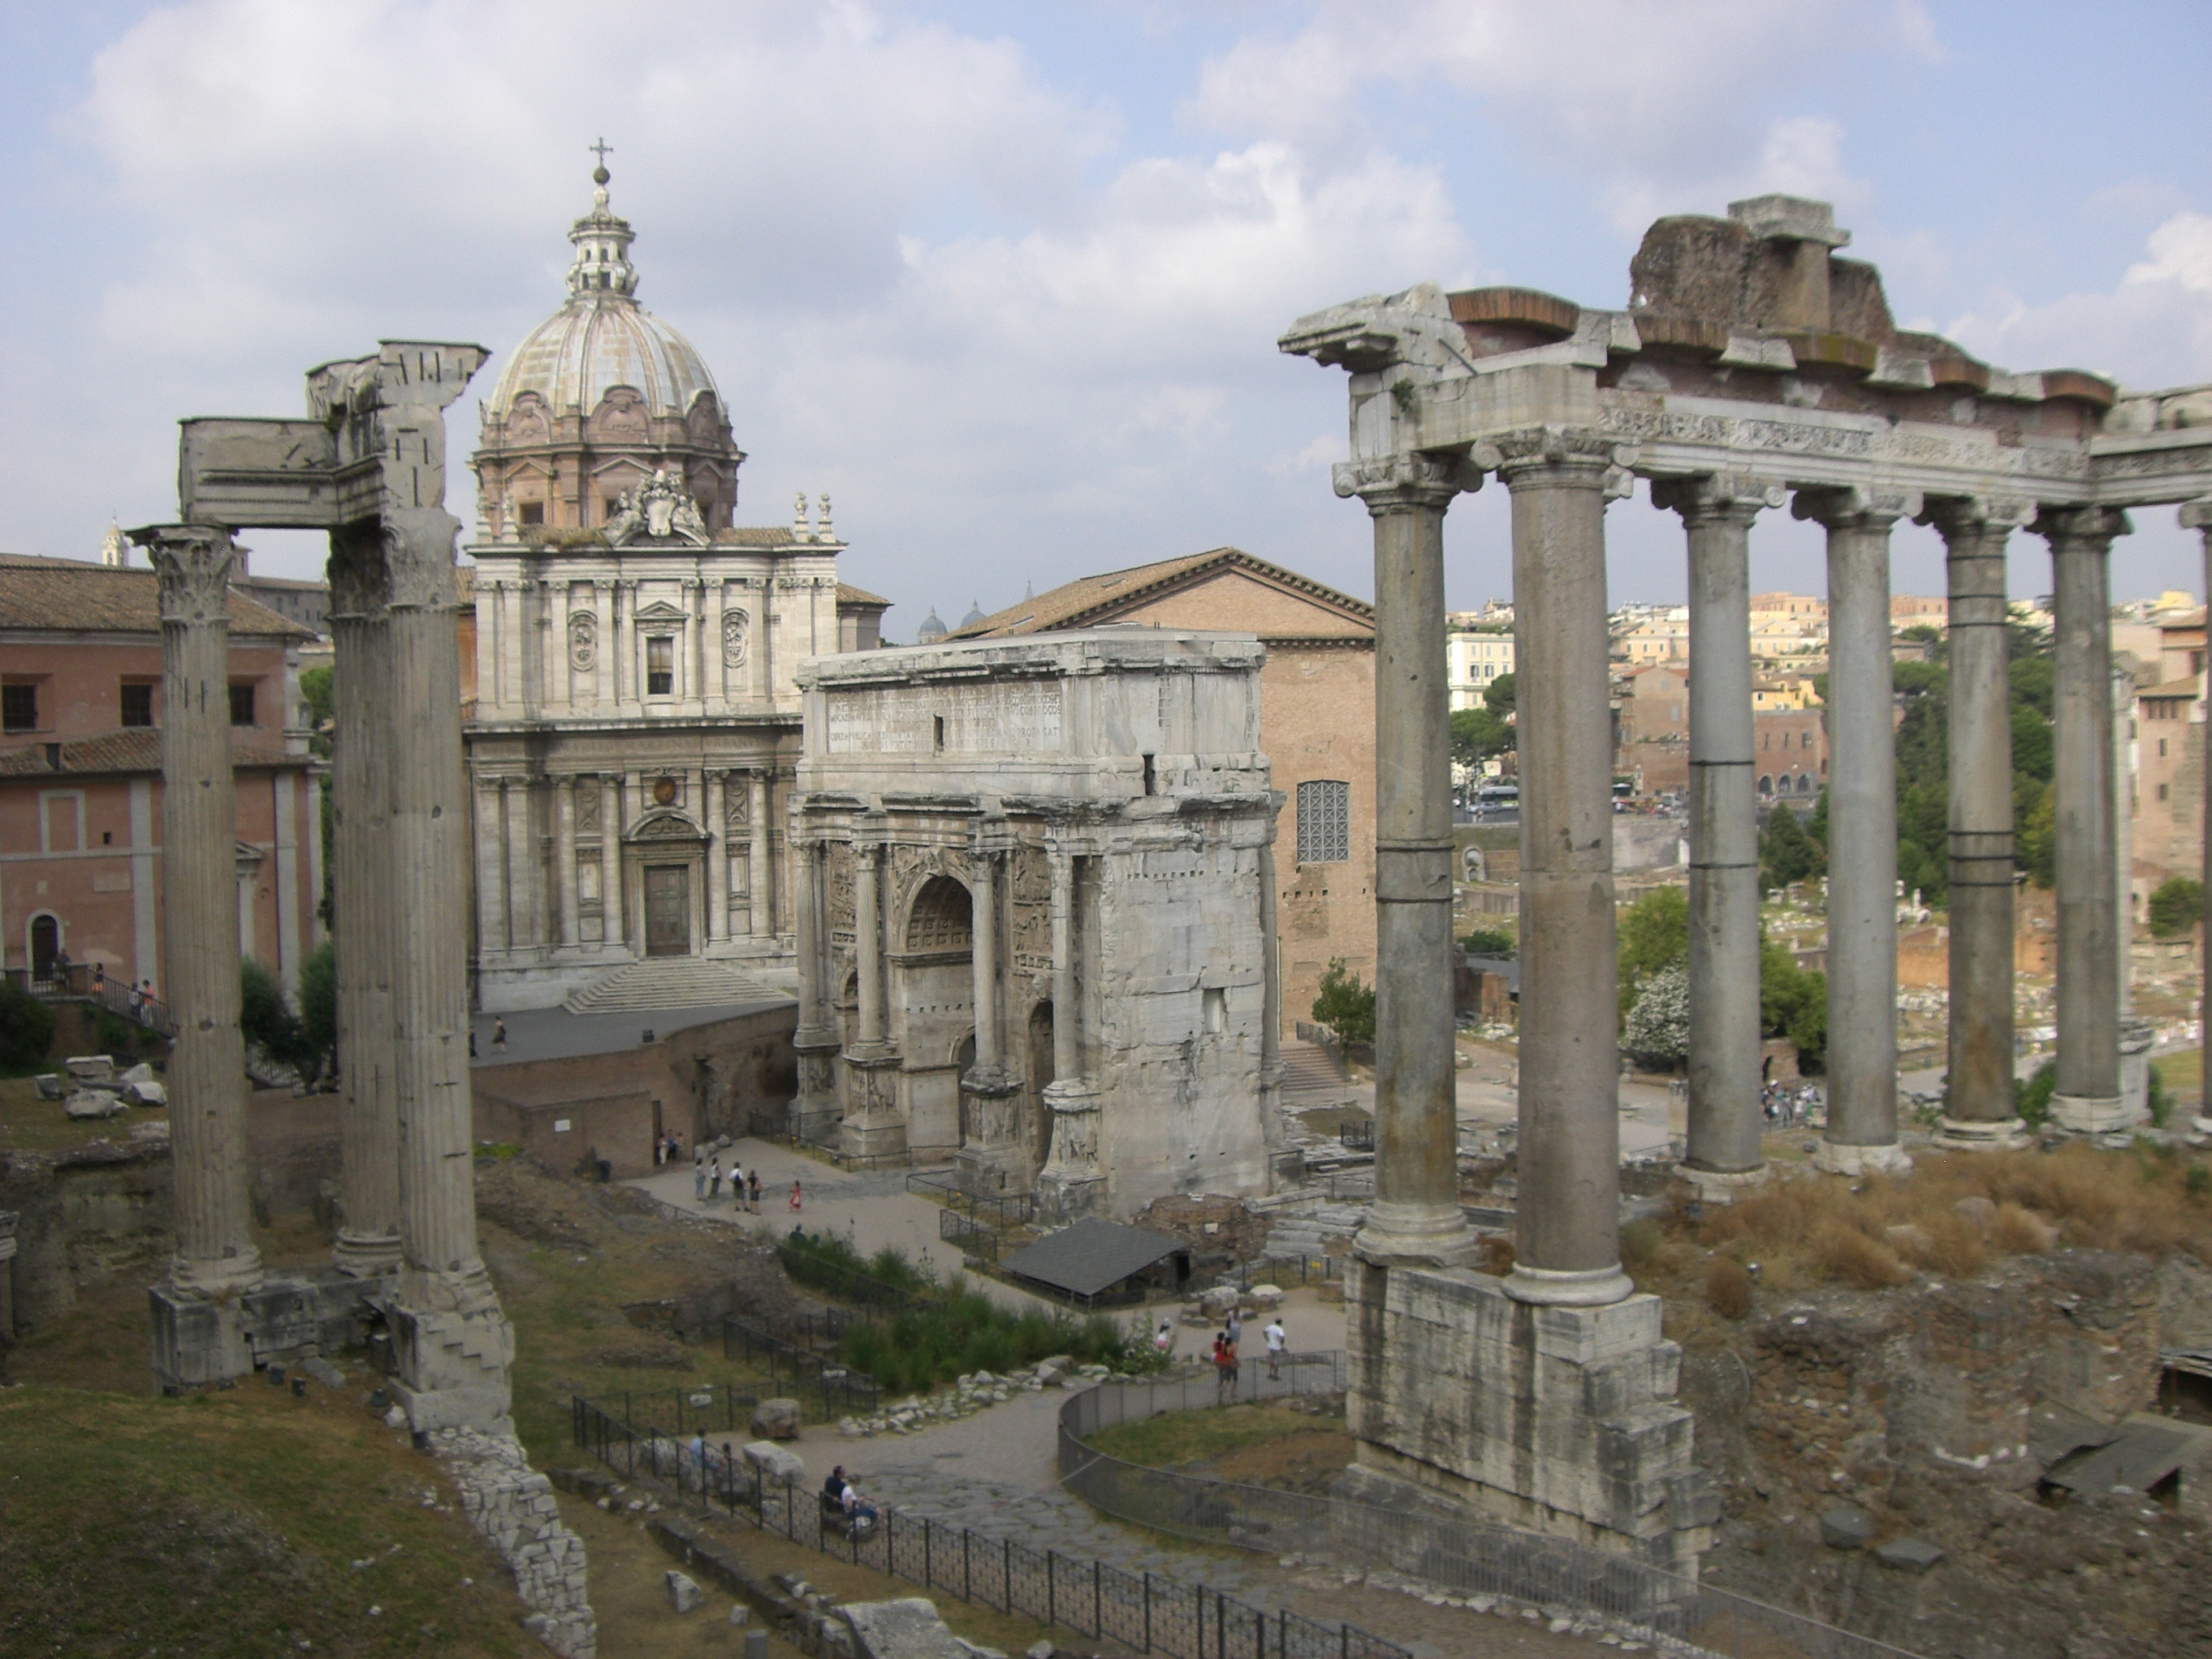
Tour of Ancient Rome
A Tour of Ancient Rome 14

Slide 3
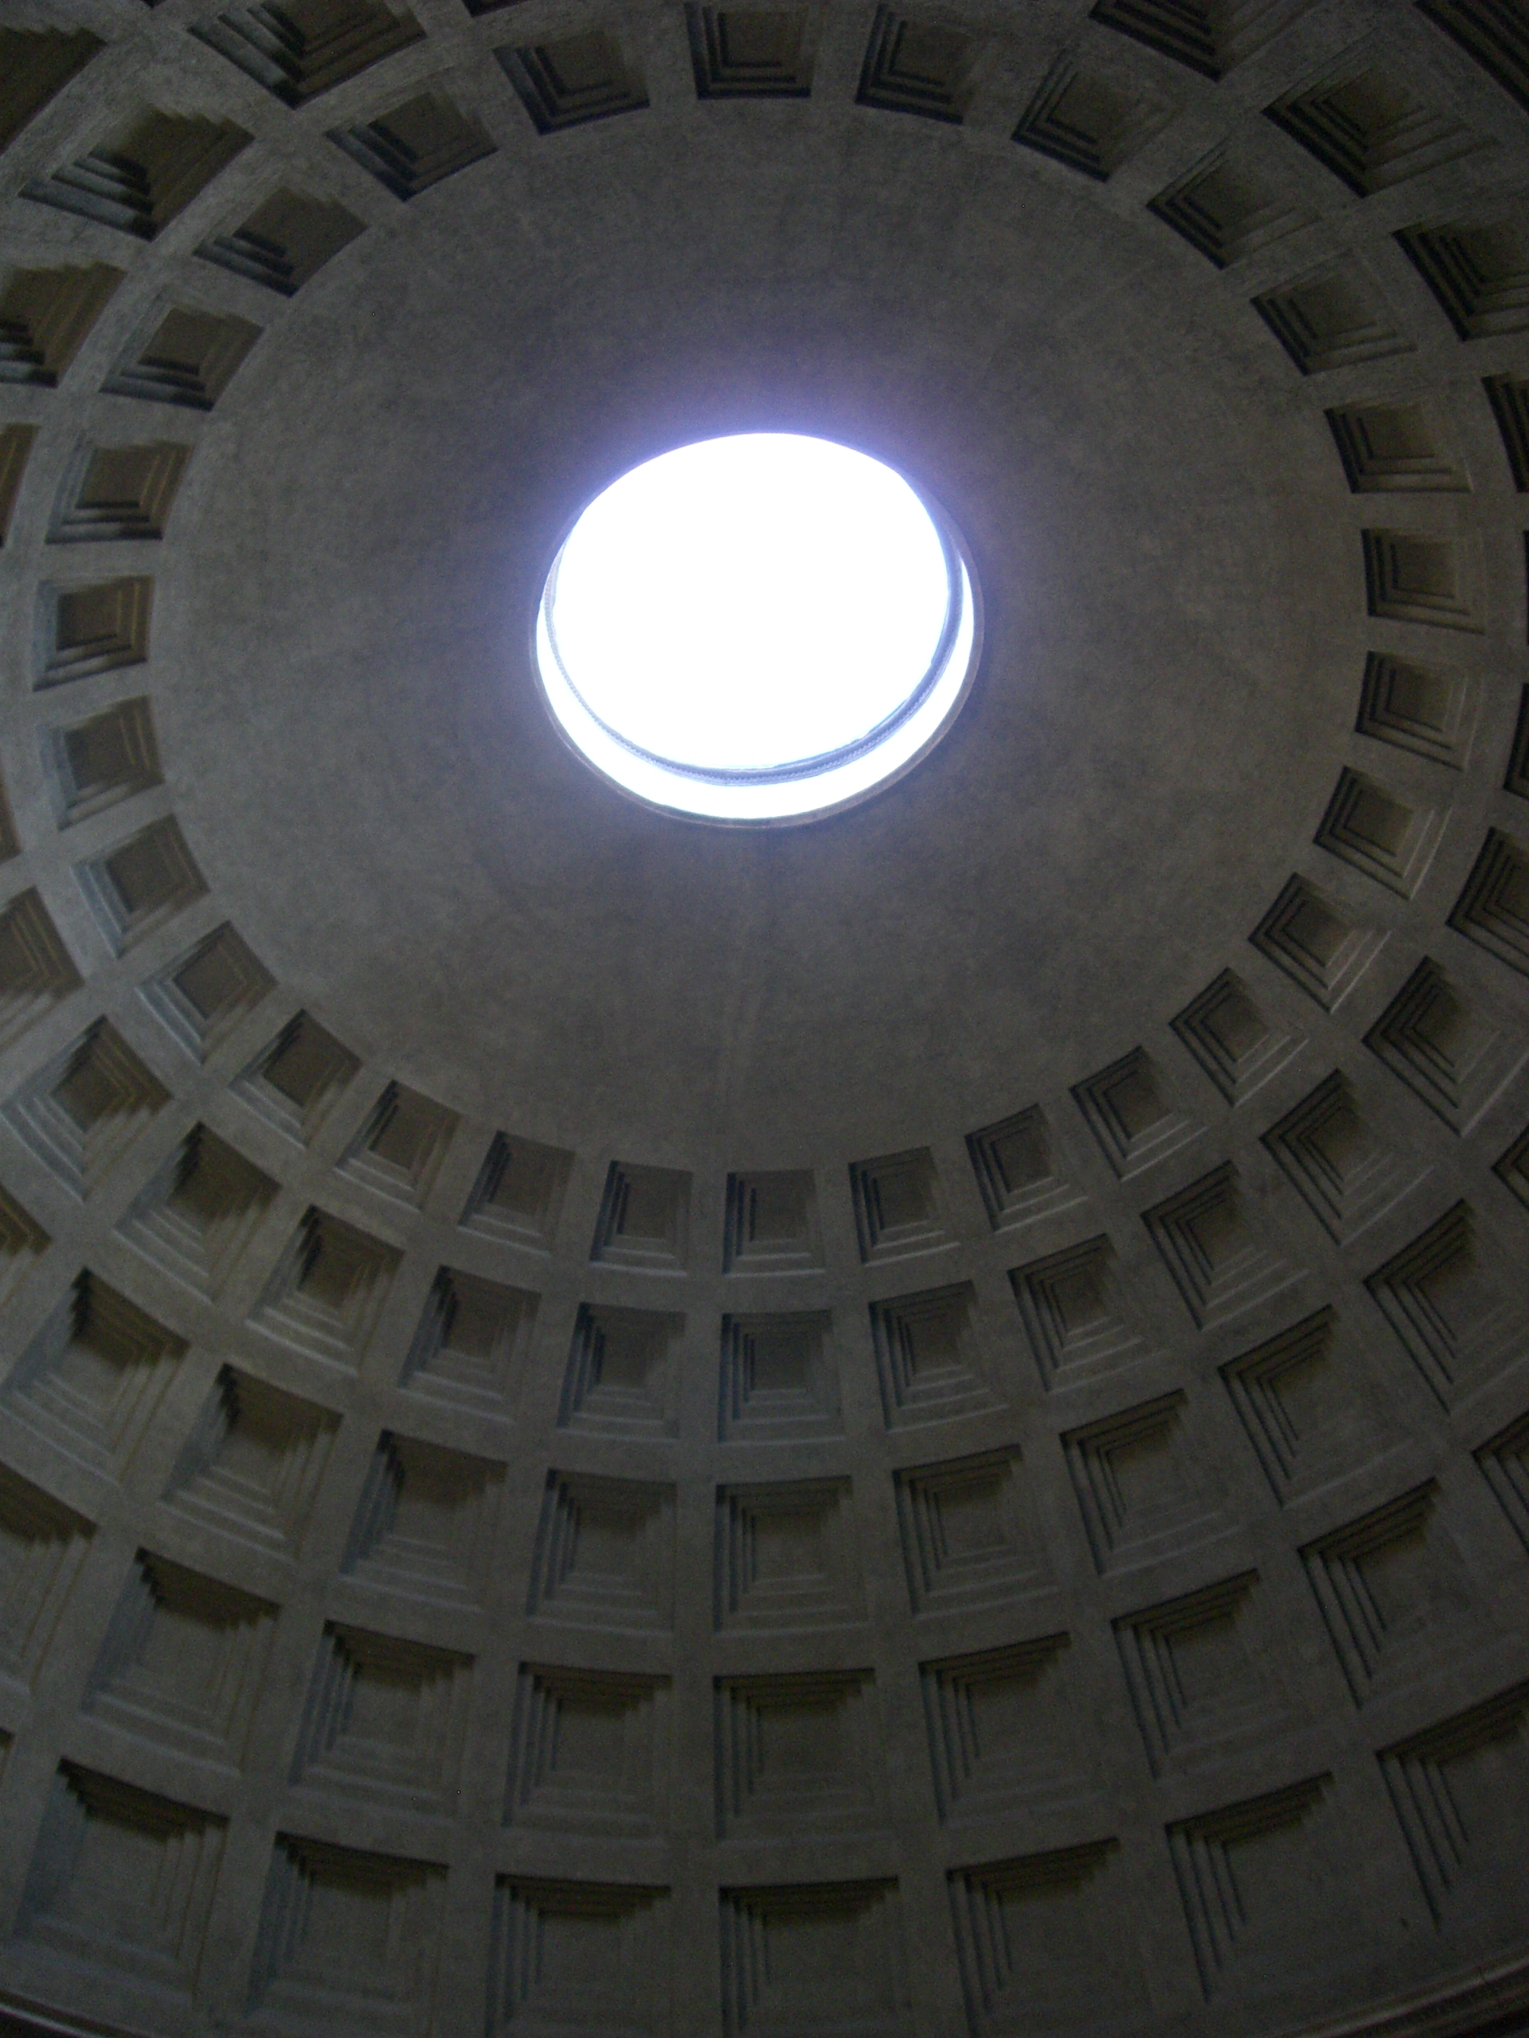
Pantheon

Slide 4
Pantheon
Notes:
Dedicated to all the gods, one of the best preserved Roman temples, considered to be one of the greatest architectural structures from ancient times; originally built in 27 BC by Agrippa during Augustus’ reign, destroyed by a rife in 80 AD finished in 125 AD by emperor Hadrian; the conversion from a temple of polytheism to a Christian Church is the main reason why the structure is still in good condition today. Used as a tomb during the Renaissance – still used for Catholic mass daily. Achieved the dome by using lighter materials as the dome gets higher – heaviest at the bottom and lighter stones on top

Slide 5
Arch
Arch: redistributes the weight of a structure to support construction – Romans were the first to effectively harness the strength of arches – did not invent the concept
Triumphal arches – used to commemorate victorious generals or significant public events such as the founding of new colonies, the construction of a road or bridge, or accession of a new emperor.

Slide 6
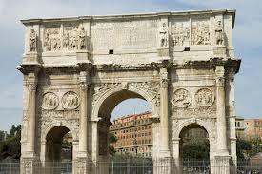
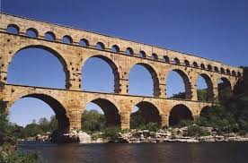
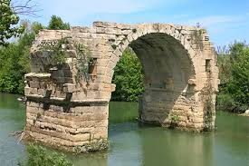
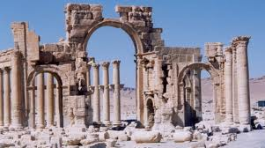

Slide 7
Concrete
Many ancient Roman structures like the Pantheon, the Colosseum, and the Roman Forum are still standing today thanks to the development of Roman cement and concrete.
Their unique recipe used slaked lime and a volcanic ash, which created a sticky paste known as pozzolana, which was very durable when mixed with volcanic rocks to form a concrete.
Roman Architecture 10
Notes:
It even helped concrete set quickly underwater, which helped in the construction of elaborate baths, piers, and harbors.

Slide 8
Roads
Notes:
They were constructed with a combination of dirt, gravel, and bricks made from granite or hardened volcanic lava. These roads were built straight to allow for water drainage. These roads were mostly helpful for military conquests, allowing the legion to travel as far as 25 miles per day.

Slide 9
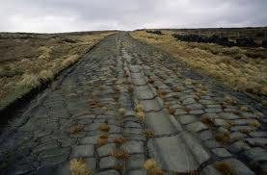
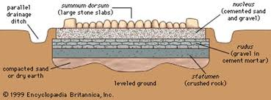

Slide 10
Roman Roads
At its height, the Roman empire encompassed nearly 1.7 million square miles and included most of southern Europe. To ensure effective administration of their territory, the Romans built the most sophisticated system of words the ancient world had ever seen.
Romans built over 50,000 miles of road by 200 AD. 3

Slide 11
Roman baths
Bathing was one of the most common daily activites of Roman culture and was practiced across all social classes.
The Romans borrowed these practices from the Greeks, and carried on this communal activity.
Contained a series of rooms that got progressively hotter
Roman baths: Hypocaust system 4

Slide 12
Roman Baths

Slide 13
Roman Art
Classical styles 8
Sculpture
Painting
Architecture

Slide 14
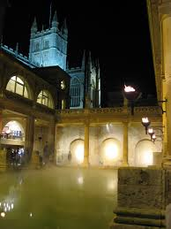
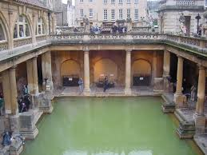
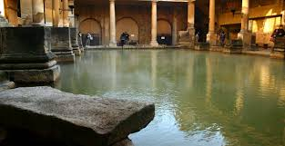

Slide 15
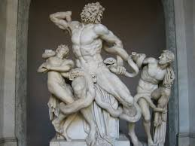
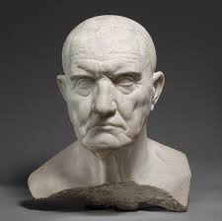
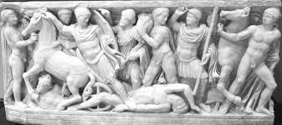

Slide 16
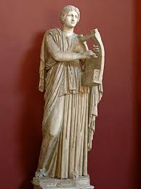
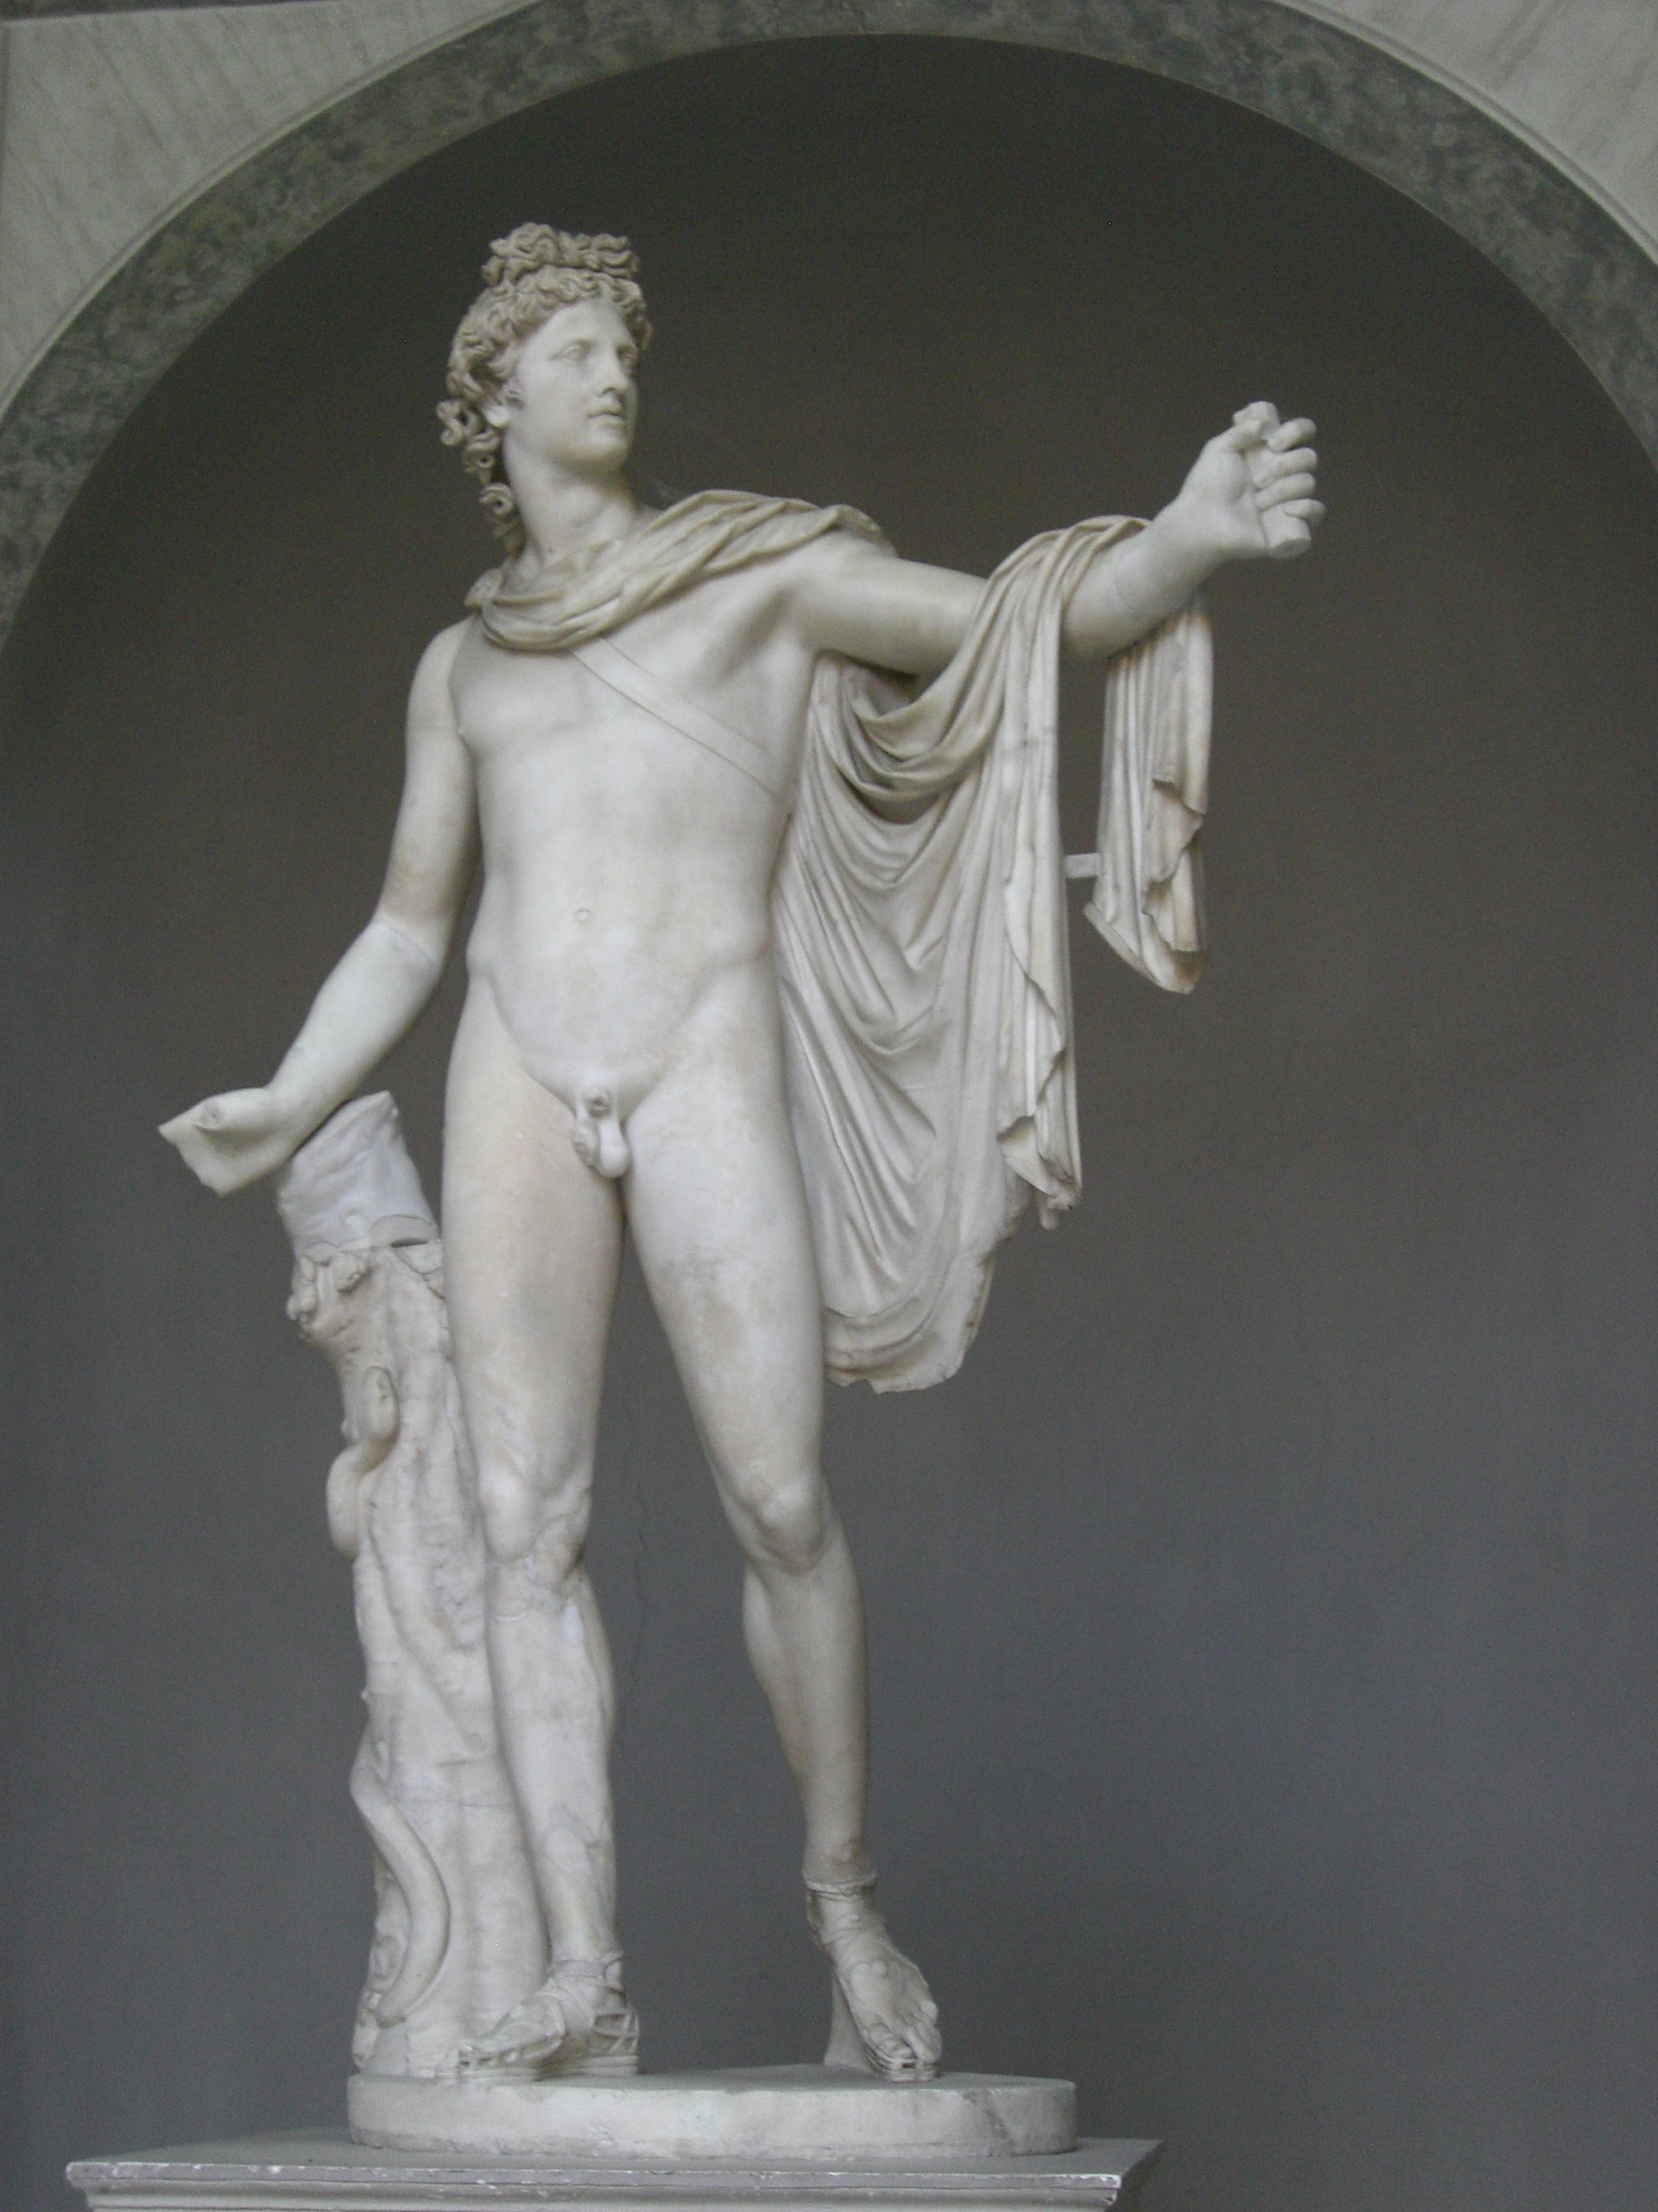
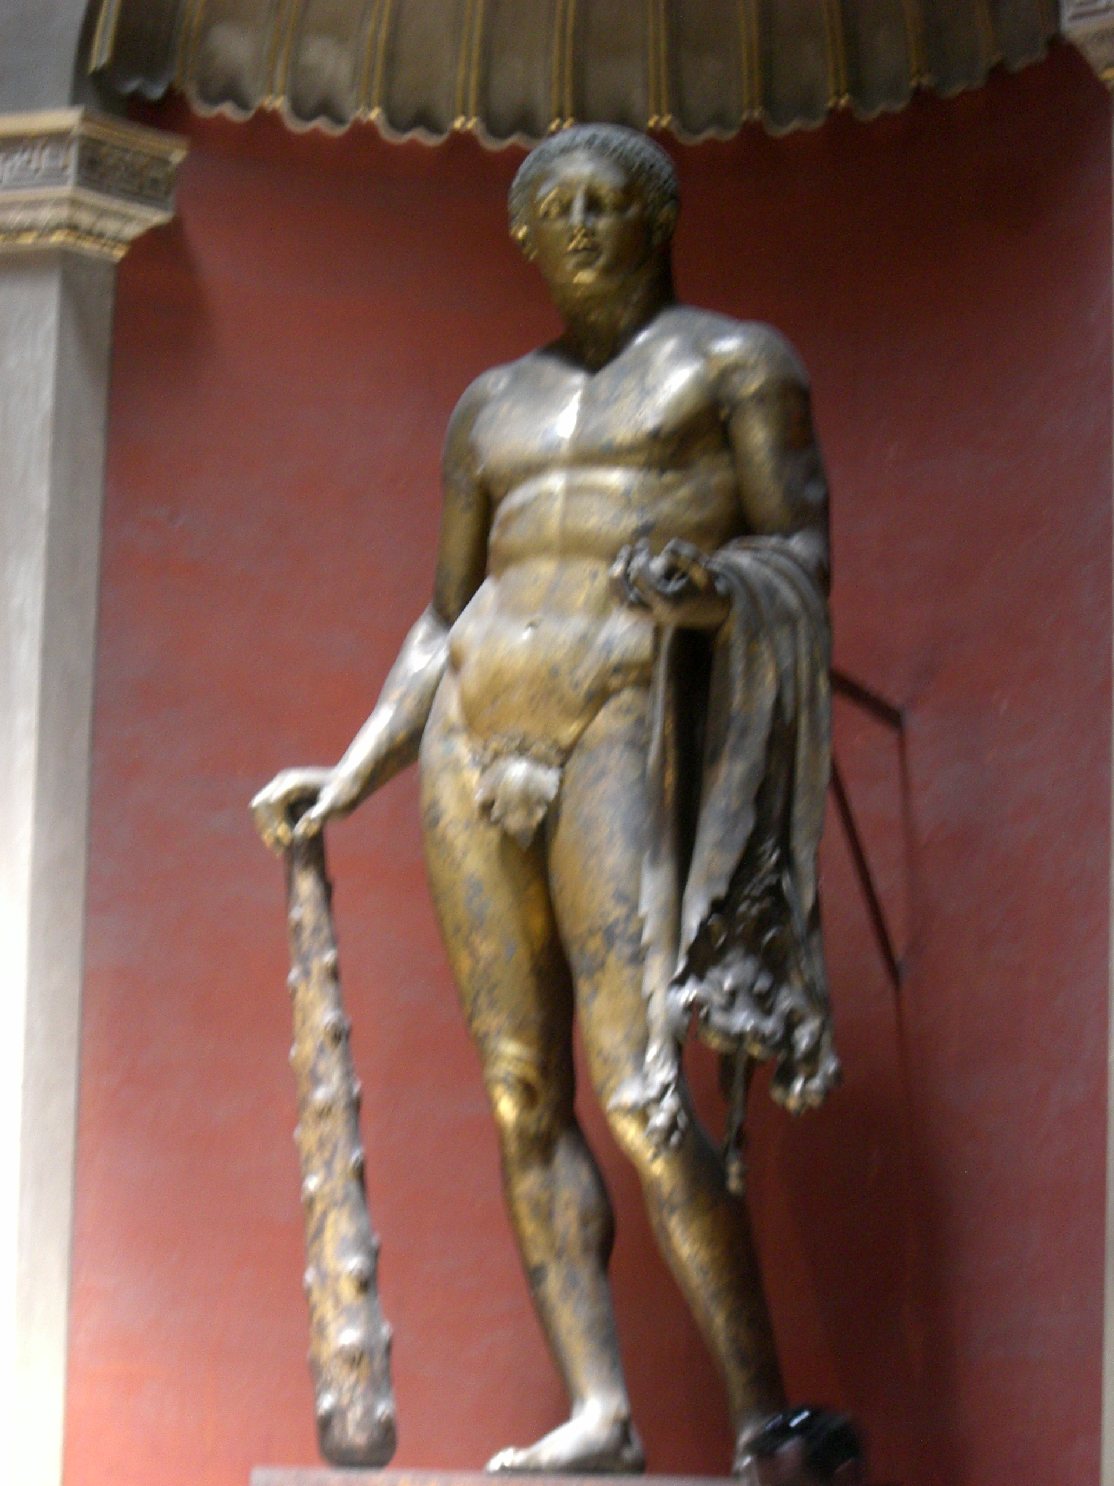
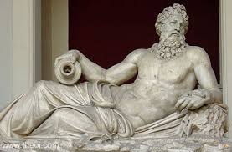

Slide 17
