Slide 1
STANDARD WHI.10a
The student will demonstrate knowledge of civilizations and empires of the Eastern Hemisphere and their interactions through regional trade patterns by
locating major trade routes;
Major trade patterns of the Eastern Hemisphere from 1000 to 1500 A.D. (C.E.)
• Silk roads across Asia to the Mediterranean basin
• Maritime routes across the Indian Ocean
• Trans-Saharan routes across North Africa
• Northern European links with the Black Sea
• Western European sea and river trade
• South China Sea and lands of Southeast Asia
b) identifying technological advances and transfers, networks of economic interdependence, and cultural interactions;
Goods
• Gold from West Africa • Spices from lands around the Indian Ocean
• Textiles from India, China, the Middle East, and later Europe
• Porcelain from China and Persia
Ideas
• Spread of religions across the hemisphere
– Buddhism from China to Korea and Japan
– Hinduism and Buddhism from India to Southeast Asia
– Islam into West Africa, Central and Southeast Asia
• Printing and paper money from China

Slide 2
STANDARD WHI.10d
The student will demonstrate knowledge of civilizations and empires of the Eastern Hemisphere and their interactions through regional trade patterns by
d) describing east African kingdoms of Axum and Zimbabwe and west African civilizations of Ghana, Mali, and Songhai in terms of geography, society, economy, and religion.
Axum
• Location relative to the Ethiopian Highlands and the Nile River
• Christian kingdom
Zimbabwe
• Location relative to the Zambezi and Limpopo rivers and the Indian Ocean coast
• City of “Great Zimbabwe” as capital of a prosperous empire
West African kingdoms
• Location of Ghana, Mali, Songhai empires relative to Niger River and the Sahara
• Importance of gold and salt to trans-Saharan trade
• City of Timbuktu as center of trade and learning
• Role of animism and Islam

Slide 3
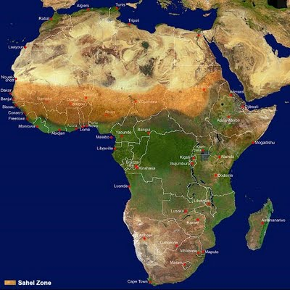
Climate Zones of Africa
Africa is 11,668,545 mi²
The northern region of Africa is
dominated by the Sahara desert
The term Sahara is Arabic for desert and the Sahara desert measures 3.3 million mi²
Below the Sahara is a semi-arid region known as the Sahel, which comes from Arabic for Shore, this is the transitionary area between the Sahara and the Savanna.

Slide 4
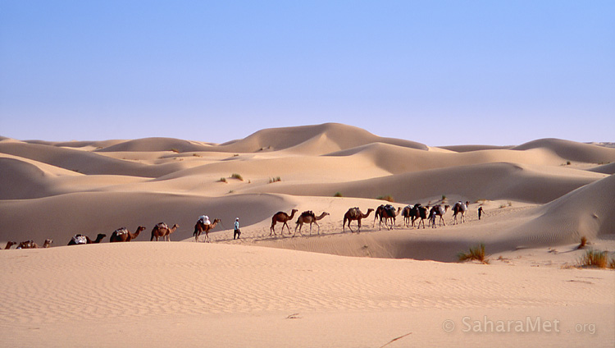
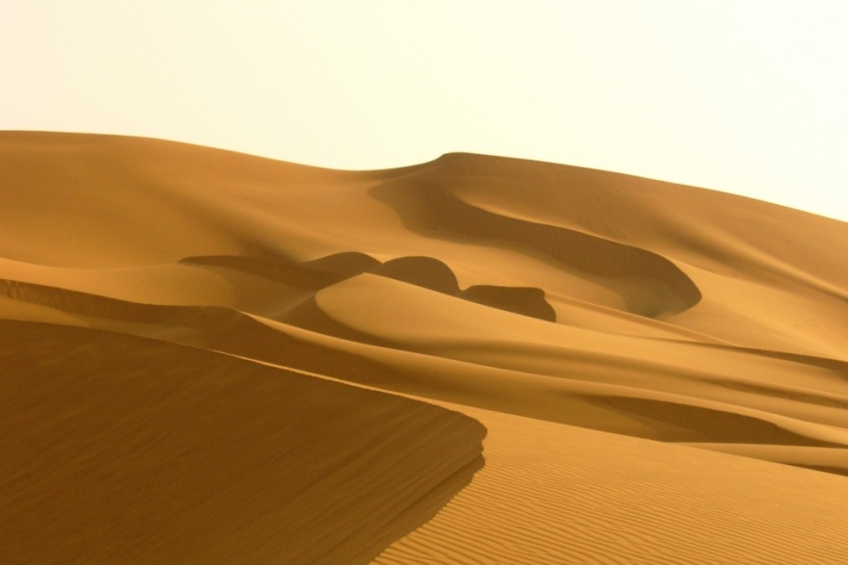
The Sahara
About 25% of the Sahara is dunes

Slide 5
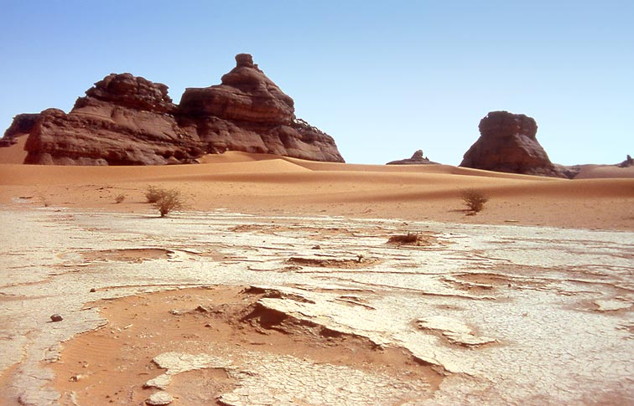
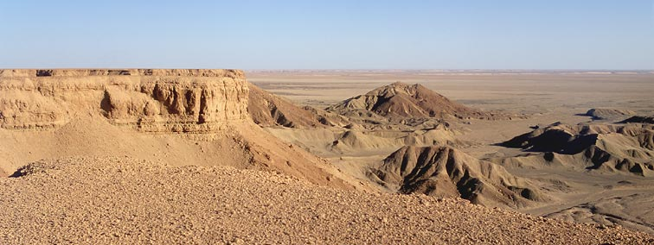
Besides Dunes, large parts of the Sahara are made of rocky plains and rock formations.

Slide 6
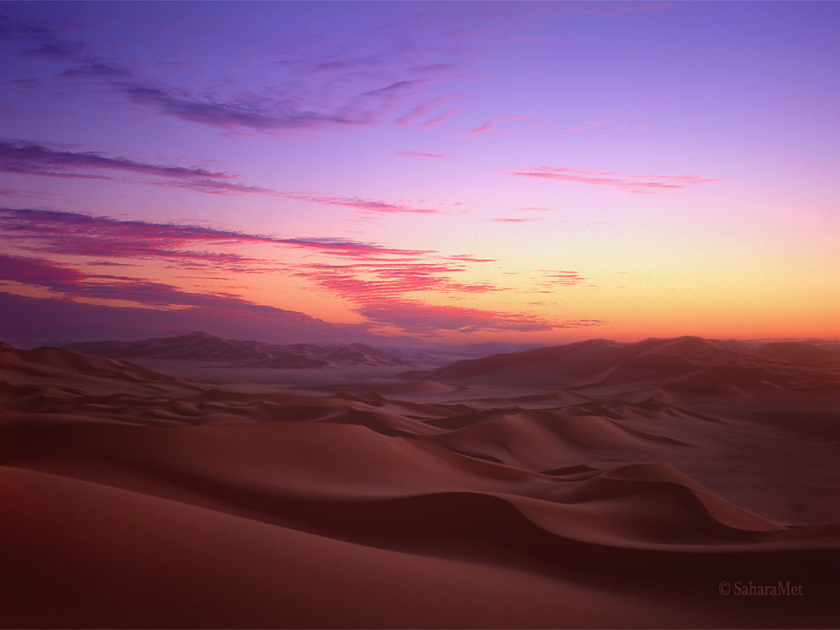

Slide 7
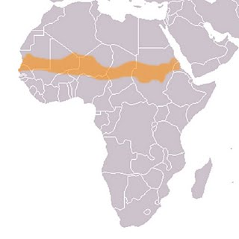
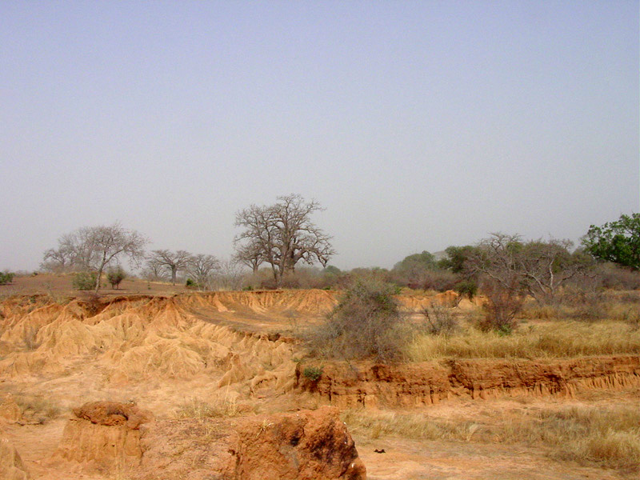
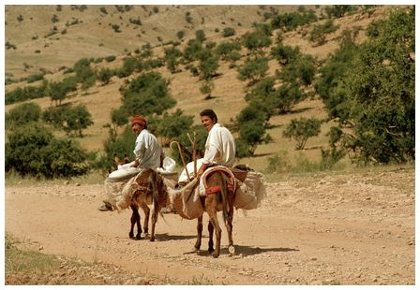
The Sahel: The “Shore” of the Desert

Slide 8
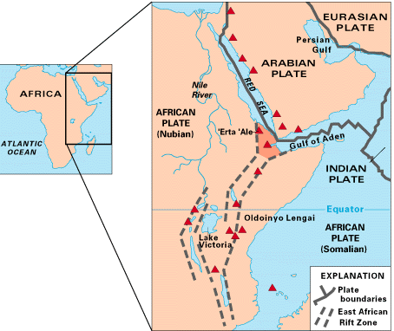
The Great Rift Valley
Found in East Africa, the Great Rift Valley is formed by a divergent tectonic boundary.
There are several
lakes formed by the rift.

Slide 9
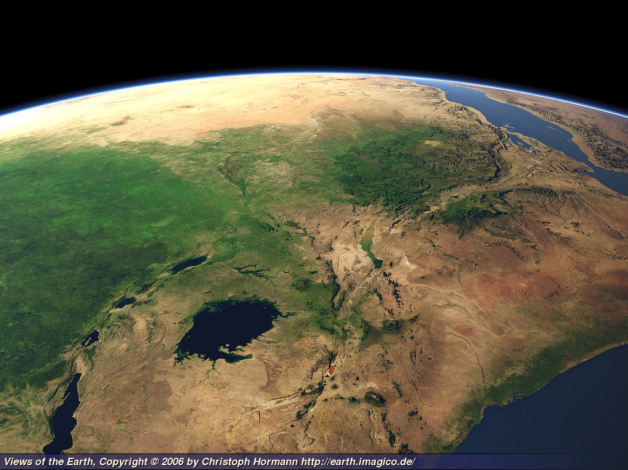

Slide 10
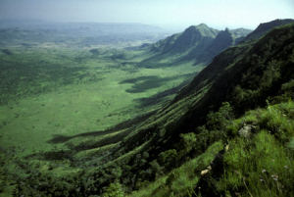
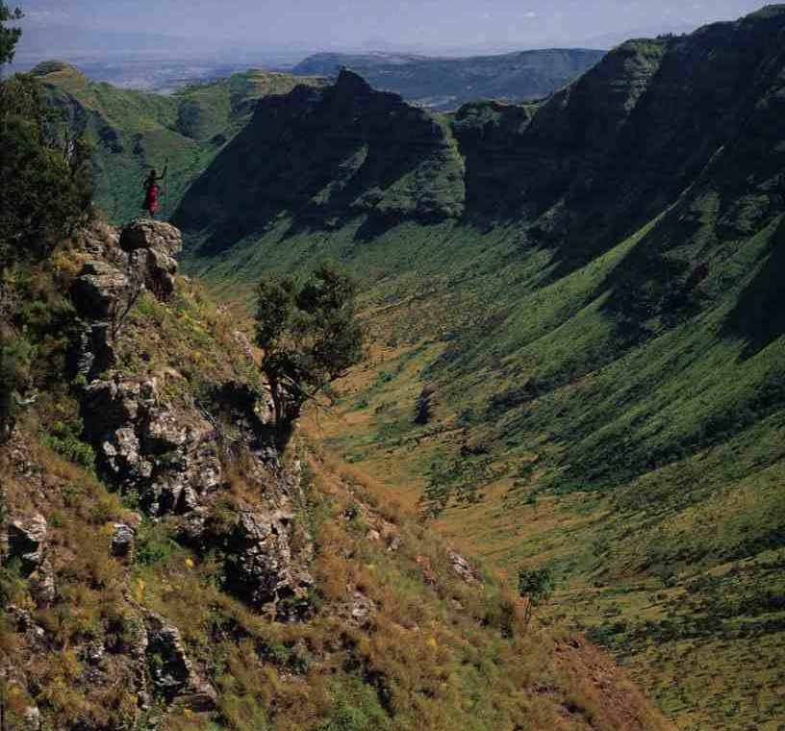

Slide 11
Plateaus and Escarpments
Southern Africa is covered with large plateaus.
Plateaus are high, flat areas.
The areas where these plateaus drop off are known as escarpments.

Slide 12
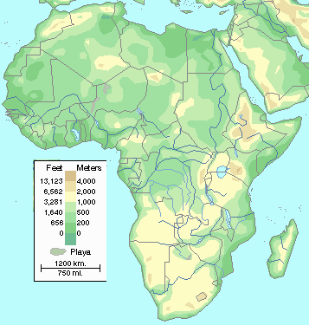
African Plateaus

Slide 13
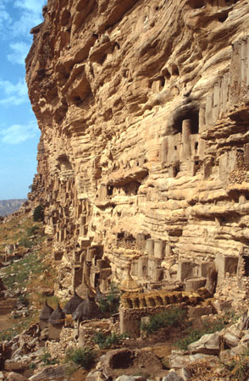

Slide 14
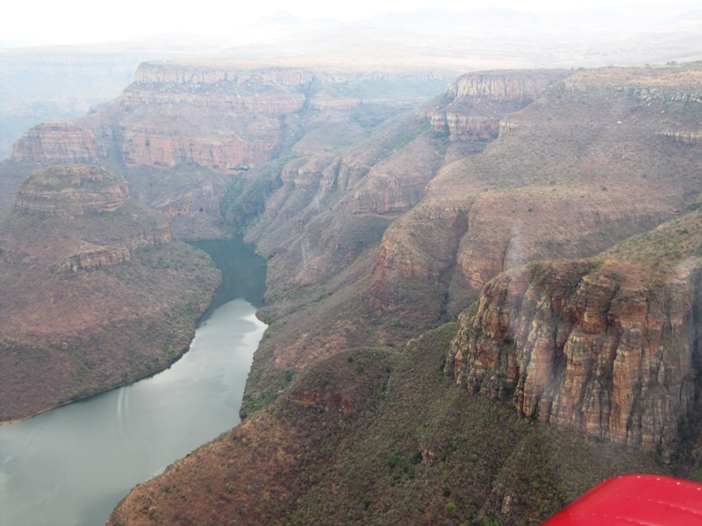

Slide 15
The Climate of Africa
There are four major climate zones in Africa
Desert
Mild Zones
Rain Forest
Savanna

Slide 16
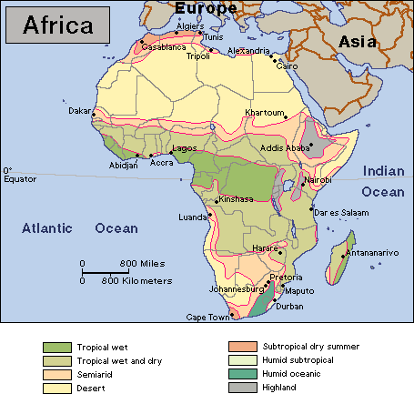
Desert
A desert is any area that receives less
than 10 inches of rain in a year
There are two major deserts in Africa
The Sahara in the North
The Kalahari in the South
The Namib in the SW is another desert

Slide 17
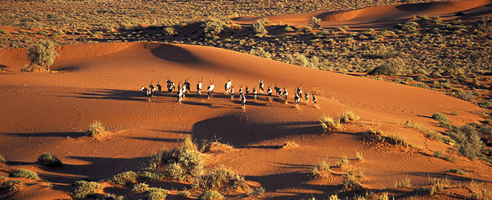
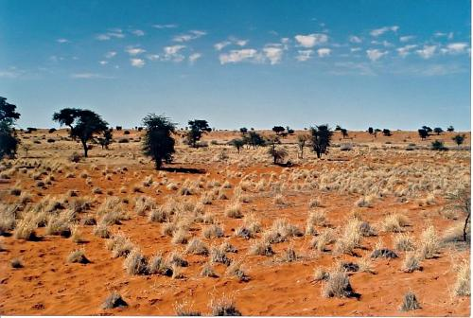
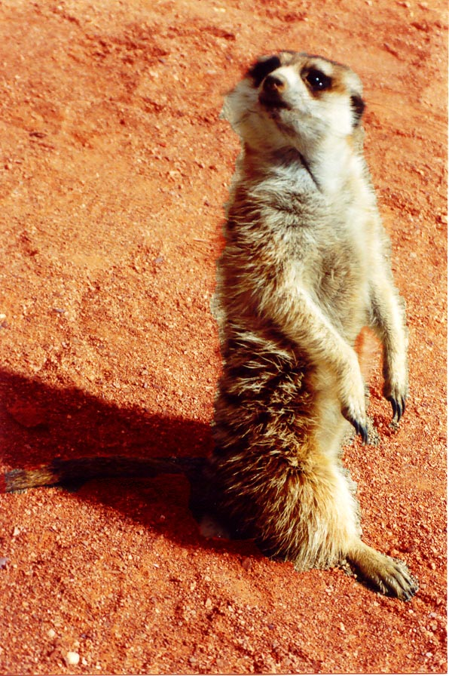
Kalahari

Slide 18
Mild Zones: Found along the Northern Coast and the Southern Tip of Africa
These mild zones are found in the Rain-Shadow /Orographic regions of the Atlas and Drakensberg Mountains.

Slide 19
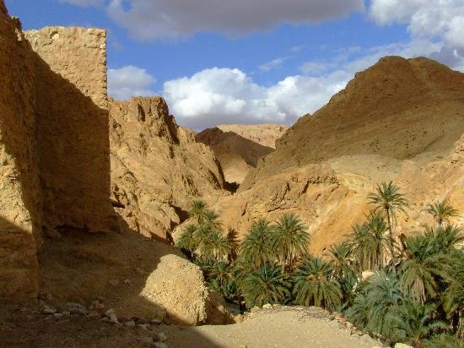
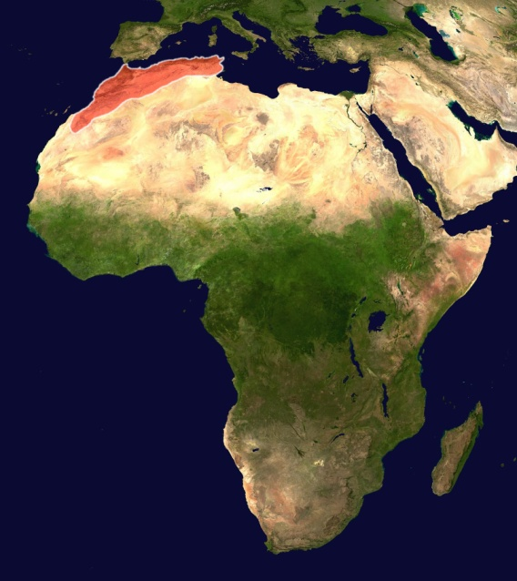
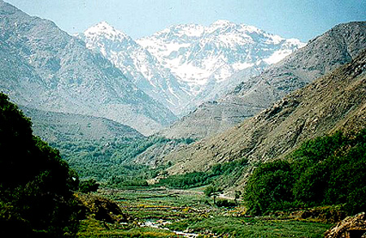
Atlas Mountains

Slide 20
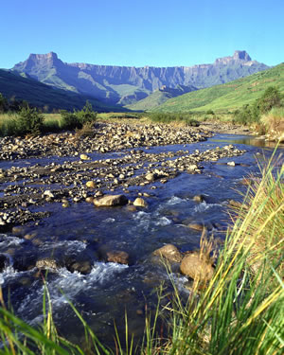
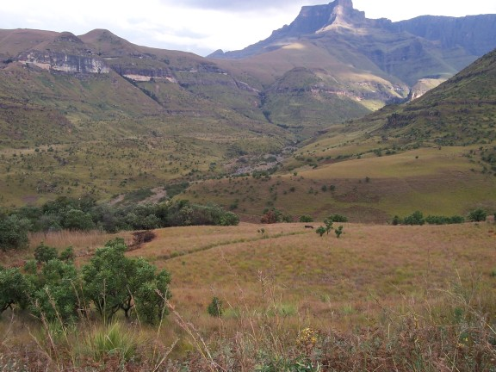
Drakensberg Mountains

Slide 21
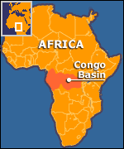
Rain Forest
Central Africa is dominated by the Congo River and the Congo River Basin which forms the Congo Rain Forest.

Slide 22
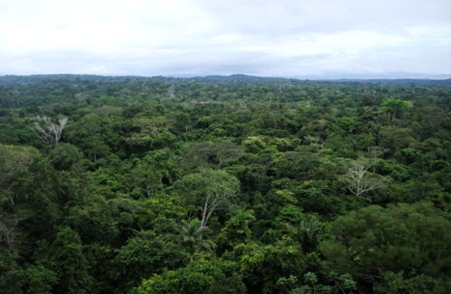
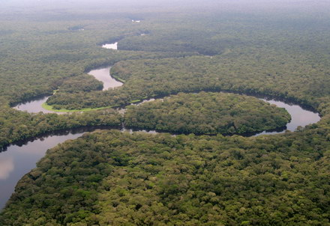

Slide 23
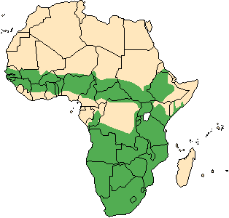
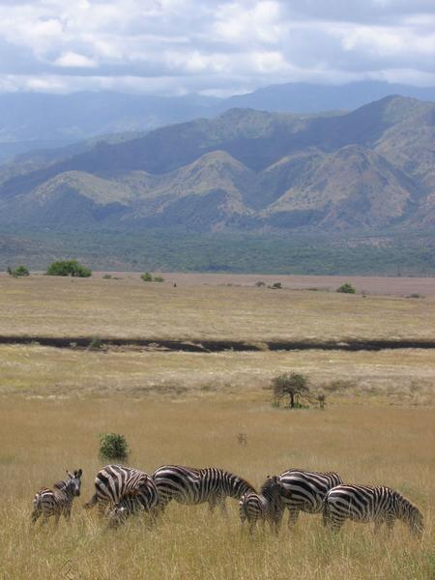
Savanna: A Tropical Grassland

Slide 24
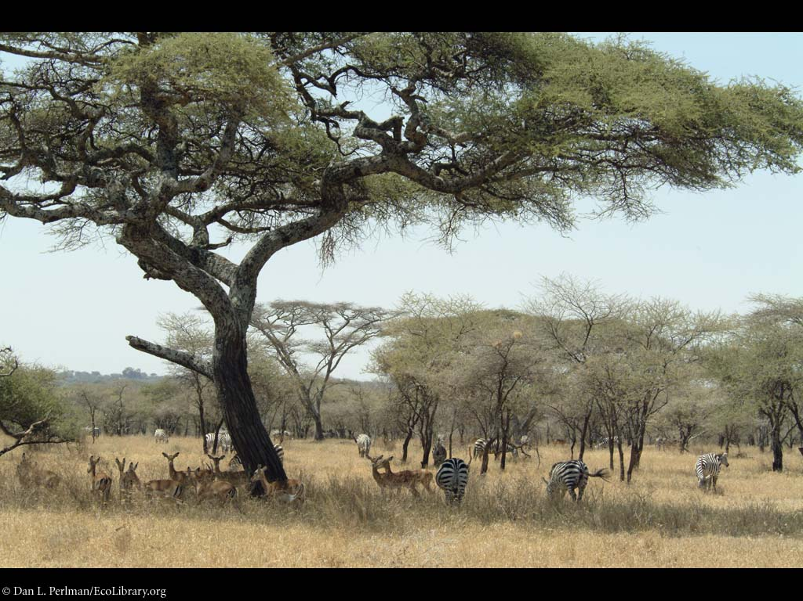

Slide 25
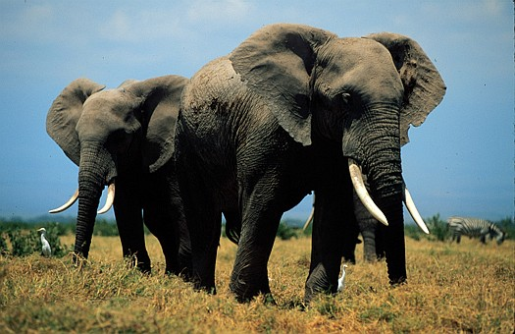
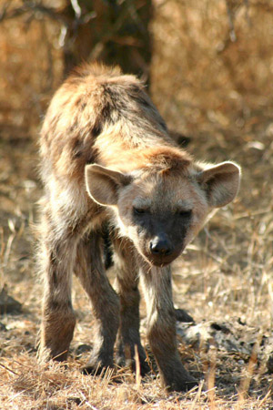
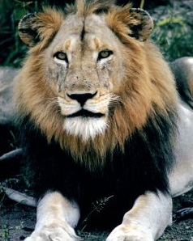

Slide 26
Emerging Civilizations and Religions
The Agricultural revolution in Africa gave rise to the first African civilizations
Kush (AKA Nubia)
Egypt and Nubia had a large trade network by 2000 BCE.
The Egyptians traded ivory, ebony, frankincense, and leopard skins.
Over time, Nubia became independent and became known as the state of Kush.

Slide 27
Kush Empire
In 750 BCE Kush defeated Egypt, but they were then defeated by the Assyrians due to their inferior weapons.
The economy of Kush was based on agriculture and trade.
Their major trading city was Meroë.
This city was along desert trade routes and had great iron resources.
The Kushites learned to smelt iron from their Assyrian conquerors.

Slide 28
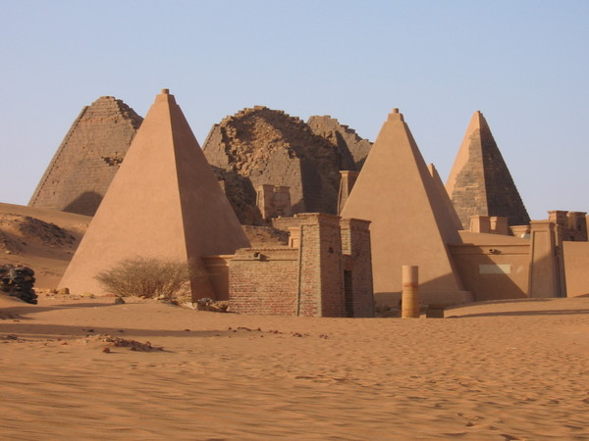

Slide 29
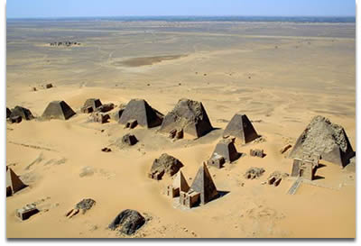
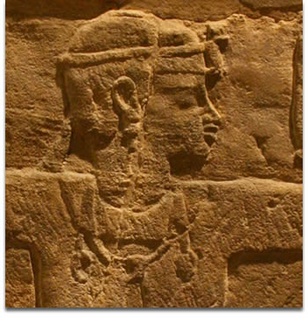

Slide 30
Kushite society continued for several hundred years.
Kush provided iron products, ivory, gold, ebony, and slaves from central and e. Africa to the Roman Empire, Arabia, and India.
In return they received luxury goods from India and Arabia.
Kush was an urban society.
Kush flourished from about 250 BCE to about 150 CE. They fell after the rise of the state of Axum

Slide 31
Axum
Axum was founded by Arabs and combined Arab and African cultures.
Axum was located along the Red Sea on a trade route linking India and the Mediterranean.
They exported ivory, frankincense, myrrh, and slaves and imported textiles, metal goods, wine, and olive oil.

Slide 32
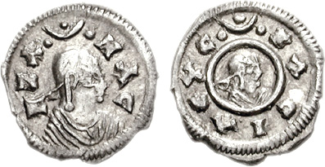
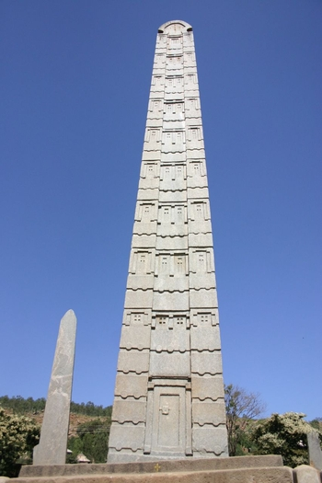
King Ezana
Axum becomes Christian
King Ezana converted to Christianity in 330 AD. A group of shipwrecked men from Syria introduced the religion to Axum.

Slide 33
The Rise of Islam
By 641 Arab forces captured Egypt
By the early 700s Arabs ruled North Africa’s coast west of the Strait of Gibraltar.
Initially Axum and Muslim forces were peaceful, but by the early 15th century Axum became involved in conflict.

Slide 34
Section 2: Kingdoms and States of Africa
Kingdom of Ghana
Emerged c. 500 AD and was located in the upper Niger River Valley, between the Sahara and the tropical rain forests along the West African coast.
The area was agricultural.
The leaders were strong rulers who governed without any laws. They played an active role in running the kingdom and they were very wealthy.

Slide 35
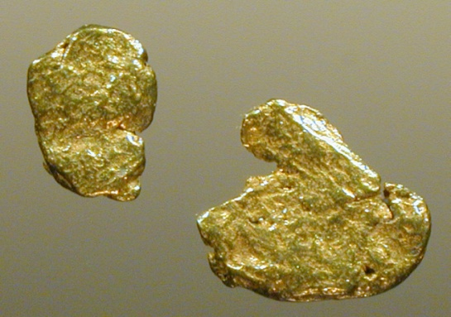
The Land of Gold
The kings of Ghana had well
trained armies and used them as their basis for power.
Ghana also had a great supply of gold. This gold was traded for salt which was used to preserve their food and to also help prevent dehydration in the hot climate.

Slide 36
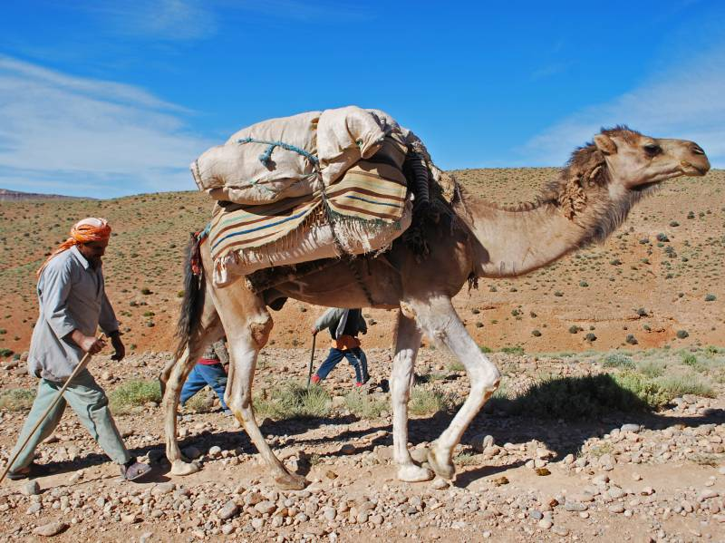
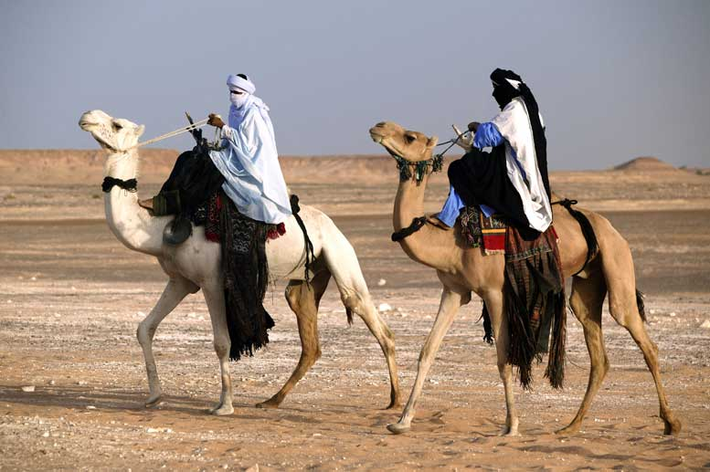
Berbers
Ghana’s trade was carried across the desert by the Berbers who rode their fleets of camels across the desert.
Muslim merchants became the dominant force in Ghana’s trade over time.

Slide 37
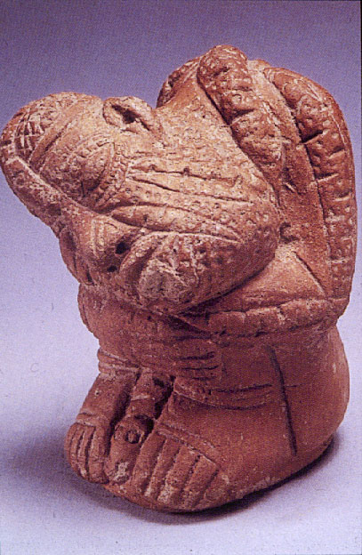
The Kingdom of Mali
Ghana was prosperous for about 700 years until it was weakened by wars and replaced by the state of Mali, established in the mid thirteenth century by Sundiata Keita.

Slide 38
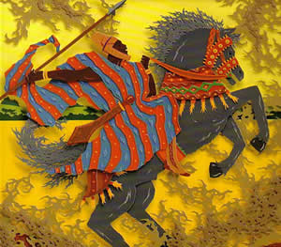
Sundiata Keita
Sundiata Keita is considered to be the founder of his nation. He defeated the forces of Mali in 1240 and established the capital of Timbuktu.
Mali built its power on gold, similar to Ghana, but most of its people worked as farmers.

Slide 39
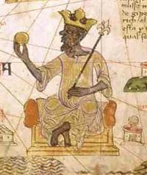
The Reign of Mansa Musa
One of the richest and most powerful kings of Mali, he ruled from 1312 to 1337.
Created a strong central government and divided his kingdom into provinces. Once he felt secure he left to go on Hajj.

Slide 40
Mansa Musa’s Hajj
Mansa Musa’s Hajj was a great undertaking.
He spent large amounts of gold while he made his pilgrimage to Mecca, so much so that he lowered the price of gold by putting so much into circulation.
He was also inspired by his journey to make Timbuktu a center of Islamic learning and culture so he built great mosques and libraries.

Slide 41
Fall of Mali
Mansa Musa was the last of the powerful rulers of Mali.
In 1359 civil war tore Mali apart.
Within a hundred years the new kingdom of Songhai rose to take its place.

Slide 42
The Kingdom of Songhai
Also located along the Niger River valley this area began to expand under a people known as the Songhai.
In 1009 the ruler Kossi converted to Islam and Songhai began to benefit from the Muslim trade routes.
The city of Gao emerged as a major trading center.

Slide 43
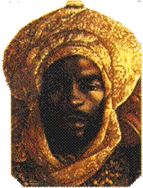
Sunni Ali
The leader Sunni Ali created a new dynasty, the Sunni, in 1464. Under his leadership, Songhai began to expand.
Sunni Ali was a great military leader who both defended and expanded Songhai’s territory.
Conquering the cities of Timbuktu and Djenne, Sunni Ali gave Songhai control of the trading empire and the lucrative gold for salt trade.

Slide 44
Golden Age
The kingdom of Songhai reached its height under the leadership of Muhammad Ture, a powerful military leader and devout Muslim.
He further expanded the territory of Songhai and divided the territory into provinces.
Under Askia Dawud, or Daud who ruled from 1549-1582 Songhai became the largest empire in African history.
Songhai was eventually overthrown by the Sultan of Morocco

Slide 45
Societies in East Africa
Migration of the Bantus
South of Axum there was a mix of people some nomadic hunters and some pastoralists.
In the first millennium BC groups of people who spoke Bantu languages began to migrate from the Niger River valley in West Africa into East Africa.
These people lived on Subsistence farming.
They brought the technology of Iron smelting into East Africa.
They also brought new knowledge in agriculture.

Slide 46
Indian Ocean Trade and Ports
Increasing trade led to the development of port cities along the coast of the Indian Ocean.
These included the trading cities of Mogadishu, Mombasa, and Kilwa.

Slide 47
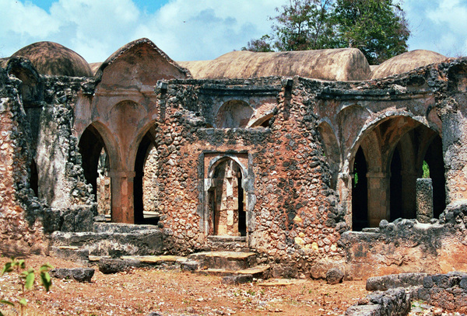
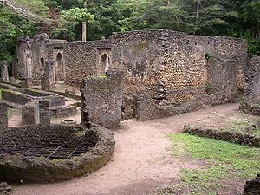
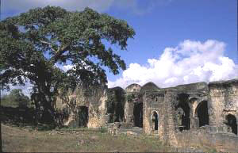
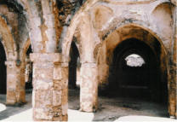
The Great Mosque of Kilwa
Built in the 14th century from coral carved out of nearby cliffs.

Slide 48
Husuni Kubwa Palace

Slide 49
Swahili
In the coastal area of East Africa the blending of influences led to the emergence of a unique culture.
The term Swahili (from sahel, meaning “coast” in Arabic, meaning people of the coast) .
These people spoke a language and developed a society that was a blend of Arab and Bantu language and culture.

Slide 50
Societies in South Africa
States formed more slowly in southern Africa than in the north.
Most of this region was a stateless society, or groups of independent villages organized by clans and led by a local ruler or clan head.

Slide 51
Zimbabwe
In the grassland region of the Zambezi river a mixed economy developed which eventually led to a united people.
From about 1300 to 1400, Zimbabwe was the most powerful state in the region. It had gold trade with the Swahili coast.
The capital of Zimbabwe was Great Zimbabwe and it was located between the Zambezi and Limpopo rivers.

Slide 52
Great Zimbabwe

Slide 53
The Great Enclosure

Slide 54
Section 3
African Society and Culture

Slide 55
Aspects of African Society
African towns and villages evolved over time becoming larger communities that served as centers for trade and government.
Many of these cultures did not have a written language, and so, most of our knowledge of these cultures comes from oral tradition.

Slide 56
King and Subject
In African cultures the kings had a much closer relationship with the people than in Asian and other cultures.
The king still held a high position among the people, but he took a much more personal interest in the affairs of everyday people.

Slide 57
Family and lineage
Family and extended family were very important. These extended families were made up of parents, children, grandparents, and other family members.
These extended families evolved into lineage groups. All the members could claim to be descended from a common ancestor and it gave a sense of identity.

Slide 58
The Role of Women
While women were usually subordinate to men in Africa there were some key differences between the role of women in Africa and elsewhere.
In many African societies lineage was traced through the mother’s side, this is a Matrilineal society rather than a Patrilineal society where lineate is traced through the father.

Slide 59
Community Education and Initiation
Both boys and girls were raised by their mothers until the age of six.
After that boys and girls were educated in the areas in which they would be involved.
Girls learned to be wives and mothers while boys learned how to hunt and farm.
As they matured boys and girls took larger roles in the community.
At puberty many groups held coming of age rituals where there was a physical ordeal of physical sign of the entrance into adulthood.

Slide 60
Slavery
Slavery was practiced in Africa since ancient times.
Berber groups in North Africa frequently raided groups and took people into slavery. These captives were sold along the Mediterranean.
Slaves could be people captured in war, debtors, and some criminals.

Slide 61
Religious Beliefs
Early African beliefs differed from place to place.
One feature that many groups shared was the idea of a single creator god. Sometimes this god worked alone, or there may be lesser gods beneath that god.

Slide 62
Diviners
A way to communicate with the spirits or with the creator god was by using diviners.
Diviners were people who would perform rituals. It was believed they had the power to foretell events and work with supernatural forces.
Ancestors were also seen as an important link with the spiritual world.

Slide 63
Changes
Eventually the animistic beliefs were replaced in many places by Islam.
This process occurred slowly through trade and conquest.
Islam combined with native beliefs to form unique African forms of Islam.

Slide 64
African Culture
Early African culture has a rich artistic tradition.
Artistic expression was frequently used as part of religious practice.
The earliest forms of art were rock paintings.
Later wood carving and clay and metal figures emerged.
Masks and beading are also traditional forms of art.

Slide 65
African Masks

Slide 66
Benin Bronze
In the 13th and 14th century metalworkers at Ife of the Yoruba people produced bronze and iron statues.
In Benin in West Africa there was impressive work in bronze.

Slide 67
Oral Tradition
In the absence of a written language music and storytelling took on a large role in African society.
Storytellers were usually priests or a special class of storytellers known as griots.
These people kept the history of Africa alive.
Unfortunately, because of the lack of a written language many aspects of African history are difficult to reconstruct.

