Slide 1
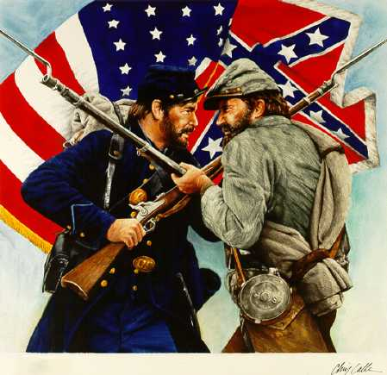
Causes that led to the Civil War (1820-1861)

Slide 2
Build up to the Civil War
Missouri Compromise
The Compromise of 1850
Kansas-Nebraska Act
Fugitive Slave Act
Uncle Tom’s Cabin
Dred Scott v. Sandford

Slide 3
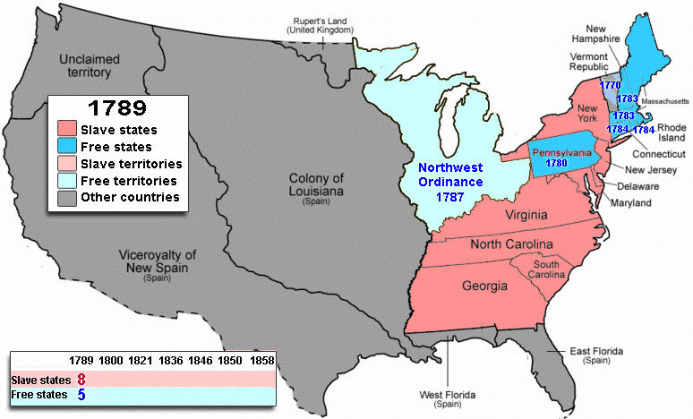
New Territories????

Slide 4
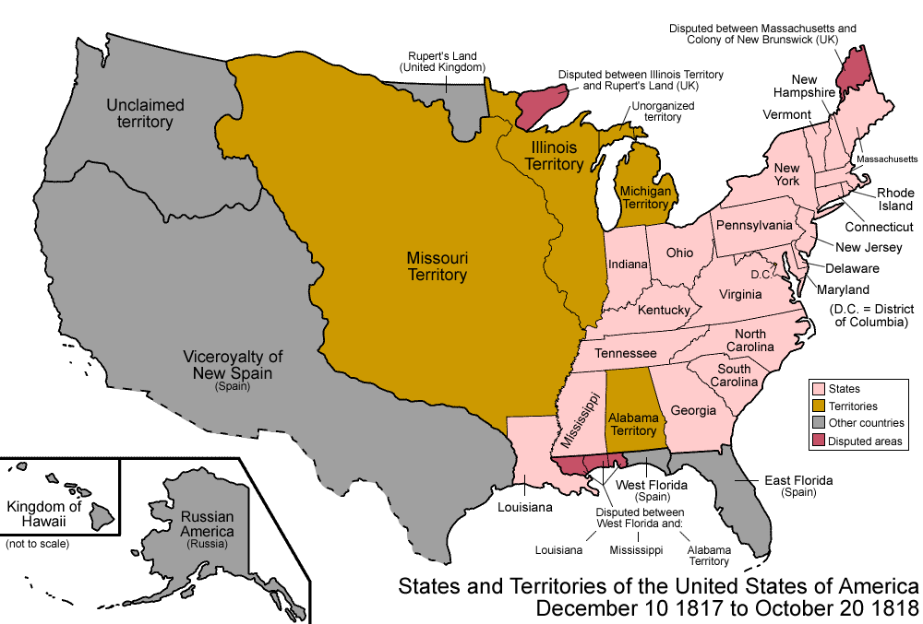

Slide 5
Missouri Compromise(1820)
Proposed by Henry Clay to keep the number of free states and slave states equal.
As a result an imaginary line was drawn across the southern border of Missouri at latitude 36 30 N. and it only applied to the Louisiana Purchase.

Slide 6
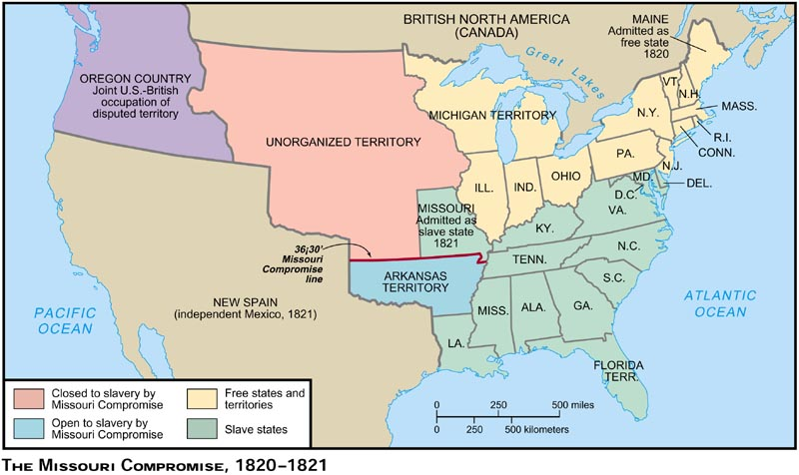

Slide 7
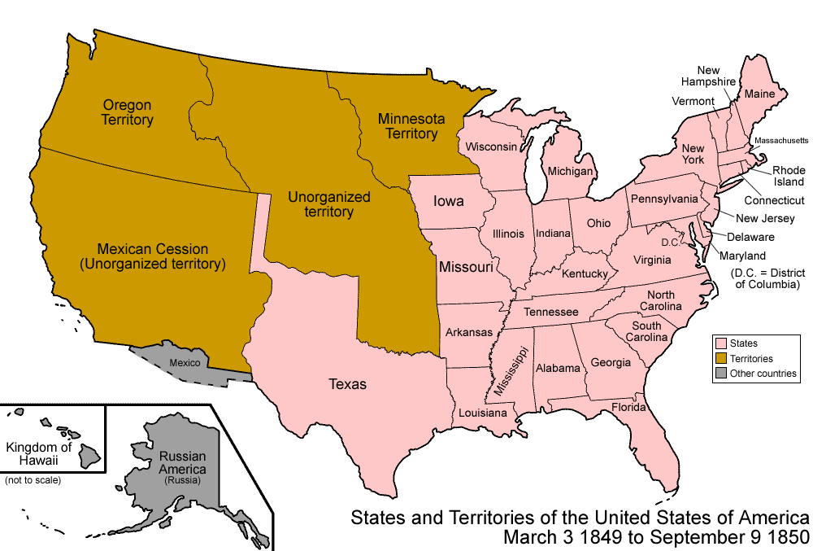
1849 - USA

Slide 8
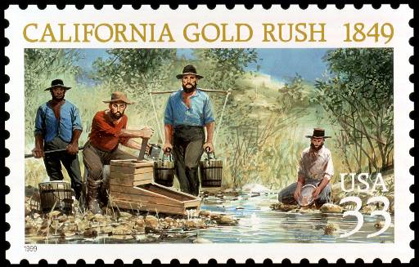
Admission of California as a State
In 1849, the number of free states equaled the number of slave states at 15/15.
Tempers flaired with the admission of California because the balance between free and slave states would be off set.

Slide 9
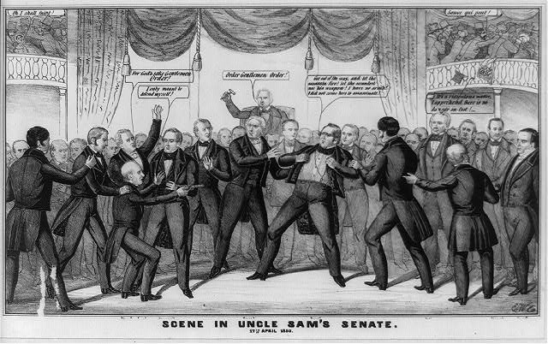
Tempers Flair
California applied for admission to the Union in 1850 to be a free state.
The issue was so heated that Senator Thomas Hart Benton of Missouri had a gun pulled on him by Senator Henry Foote of Mississippi while in the Senate.

Slide 10
Tempers Flair

Slide 11
“Get out of the way, and let the assassin fire! Let the scoundrel use his weapon! I have no arms! I did not come here to assassinate”
- Sen. Hart - Missouri

Slide 12
“I only meant to defend myself!”
Sen. Henry S. Foote
- Mississippi

Slide 13
“For God’s sake gentlemen order!”
V.Pres. - Fillmore

Slide 14
“It’s a ridiculous matter, I apprehend there is no danger on foot!

Slide 15
Does this happen today?
https://www.youtube.com/watch?v=emKIIv2_cNI

Slide 16
Problem in 1850 w/ California?
15 Free States
15 Slave States

Slide 17
Compromise of 1850
Composed of FIVE parts:
Allowed California to enter Union as free state.
Formed territories of New Mexico and Utah and decision of slavery based on popular sovereignty
Ended slave trade in Washington, D.C.
Created a strict slave law – Fugitive Slave Act
Settled a border dispute between Texas and New Mexico

Slide 18
Fugitive Slave Act: an act that outraged
All citizens required to report runaway slaves
Caught helping fugitive slaves would result in a $1000 fine and jail
Judges given rewards for sending runaway slaves back to south
Northerners become a part of the slavery system

Slide 19
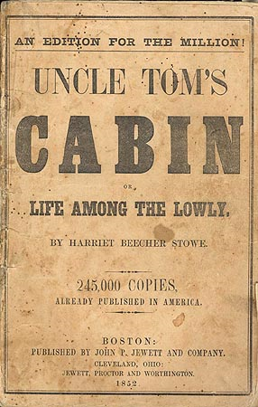
Author: Harriet Beecher Stowe
Antislavery Bestseller
Published in 1852
Showed the evils of slavery and Fugitive Slave Act
Popular in North and hated in the South
Southern complaint: did not give a true picture of slave life
Made more northerners see slavery as immoral

Slide 20
Kansas & Statehood
However, shortly after the Compromise of 1850 proslavery and antislavery forces struggled to for Kansas.

Slide 21
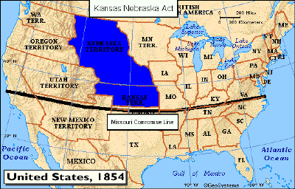

Slide 22
Kansas-Nebraska Act
Proposed by Stephen Douglas.
Established territories of Kansas and Nebraska.
Gave settlers popular sovereignty to decide on slavery issue.

Slide 23
Two Governments in Kansas
Proslavery:
Elections in 1855, established a proslavery legislature.
New laws were passed that made helping slaves escape punishable by death
Antislavery:
Refused to abide by laws of the proslavery government.
Established their own governor and legislature.

Slide 24
Dred Scott
Slave that was from Missouri and had lived in Wisconsin and Illinois. (two free states)
After Scott returned to Missouri his owner died.
Issue led to the Supreme Court case known as Dred Scott v. Sandford.

Slide 25
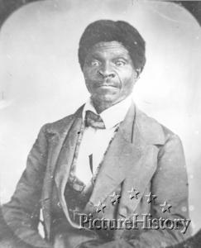

Slide 26
Issues at hand
Scott’s lawyers argued that he had lived in a free territory, so he was a free man.
Did Scott still remain a slave?
What legal rights did Scott possess?

Slide 27
Dred Scott
Court ruled that Scott could not file a lawsuit because he was not a citizen.
Court decision also stated that slaves were considered to be property.
The Supreme Court also ruled that Congress could not outlaw slavery, which made the Missouri Compromise unconstitutional.

